Slide 1
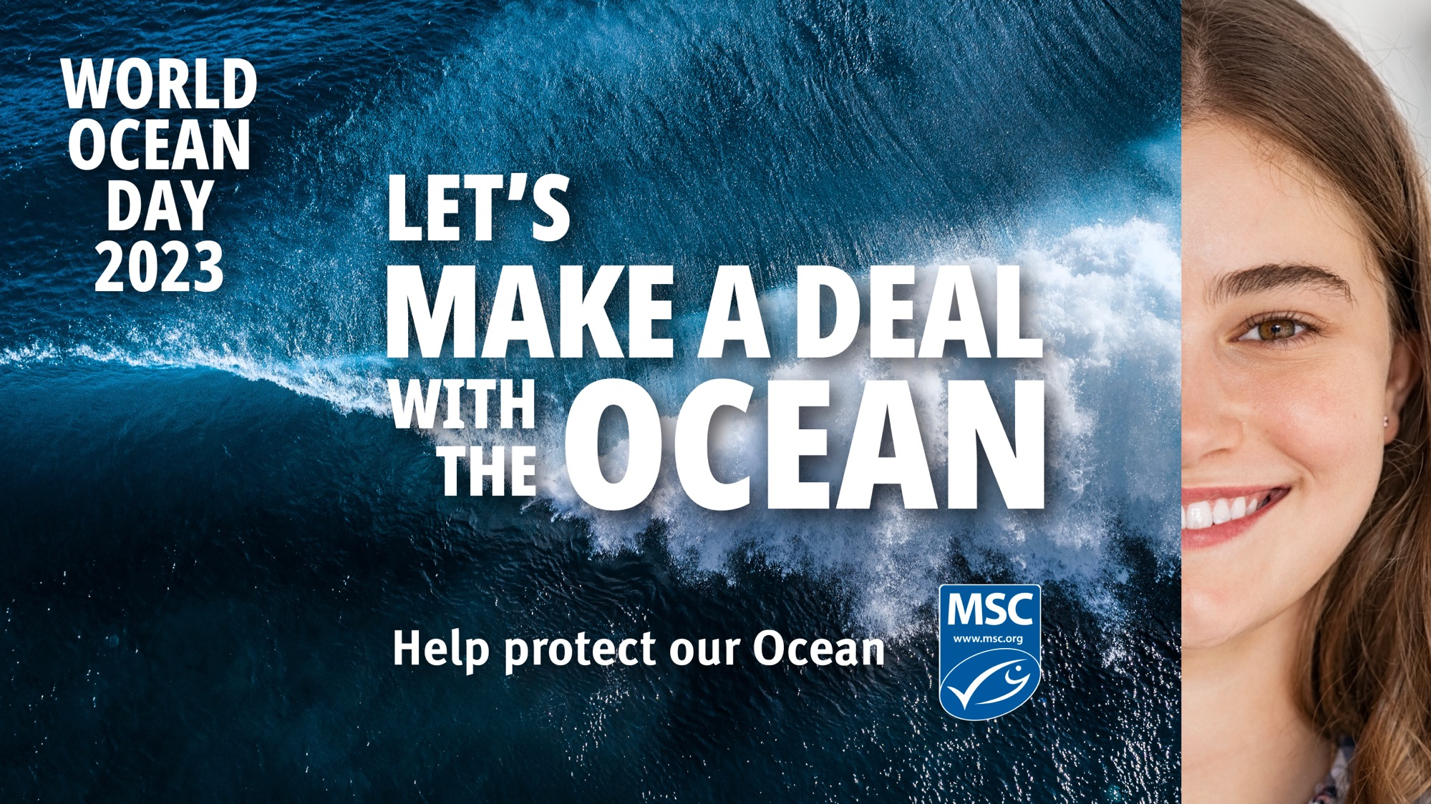

Slide 2
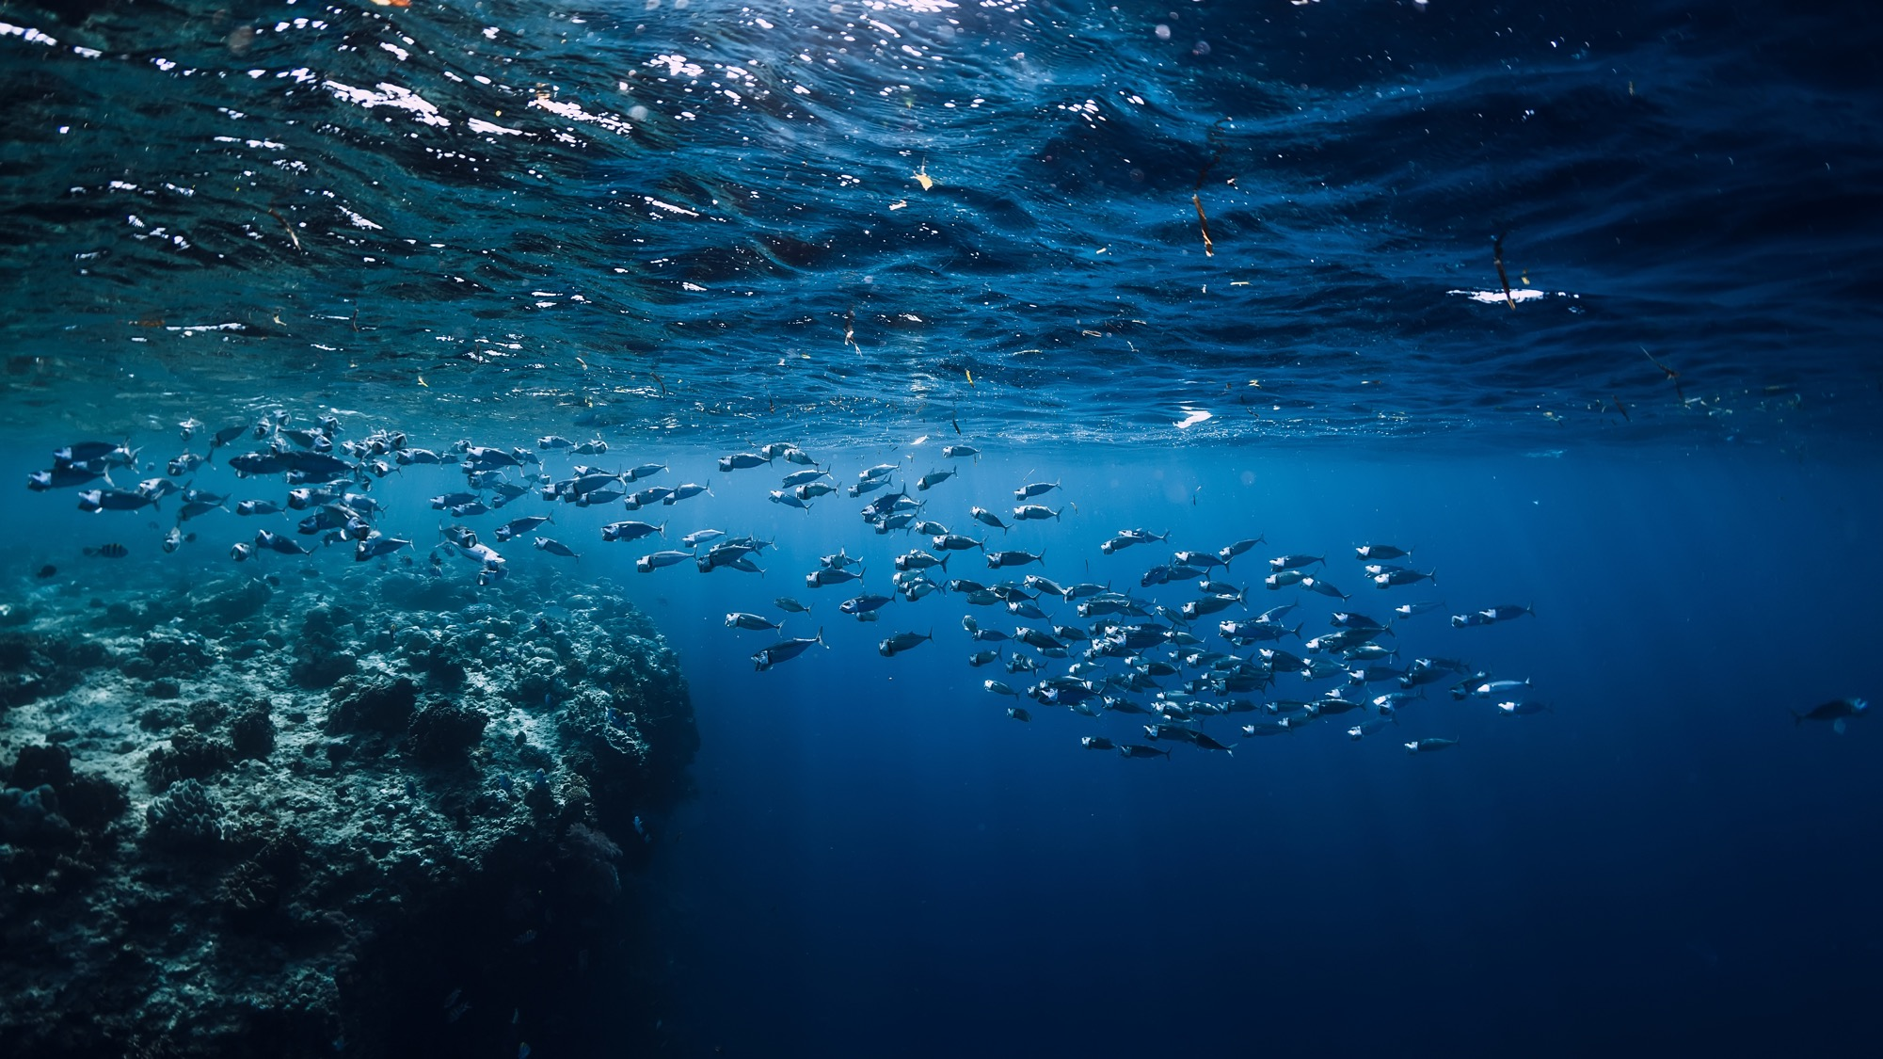
IT ALL STARTS HERE…
Educators’ guide
There are many challenges facing the Ocean. But the momentum to solve them is growing. We all have a part to play in this. Over a third of global fish stocks are exploited at an unsustainable rate. We need to change this. Our individual actions can add up to a bigger change. World Ocean Day is a chance to shine a spotlight on how we can make a deal to protect the ocean.
This presentation is designed to support the World Ocean Day learning activities, suitable for learners aged 9+ across science and social science, with the opportunity to get creative with art or creative writing too.
Use slides 3-4 to start your activity, then choose your sustainability path – social, environmental or economic, and use other slides to support your path.
Finally, learners can think about the actions people can take, and make their deal with the Ocean.

Slide 3

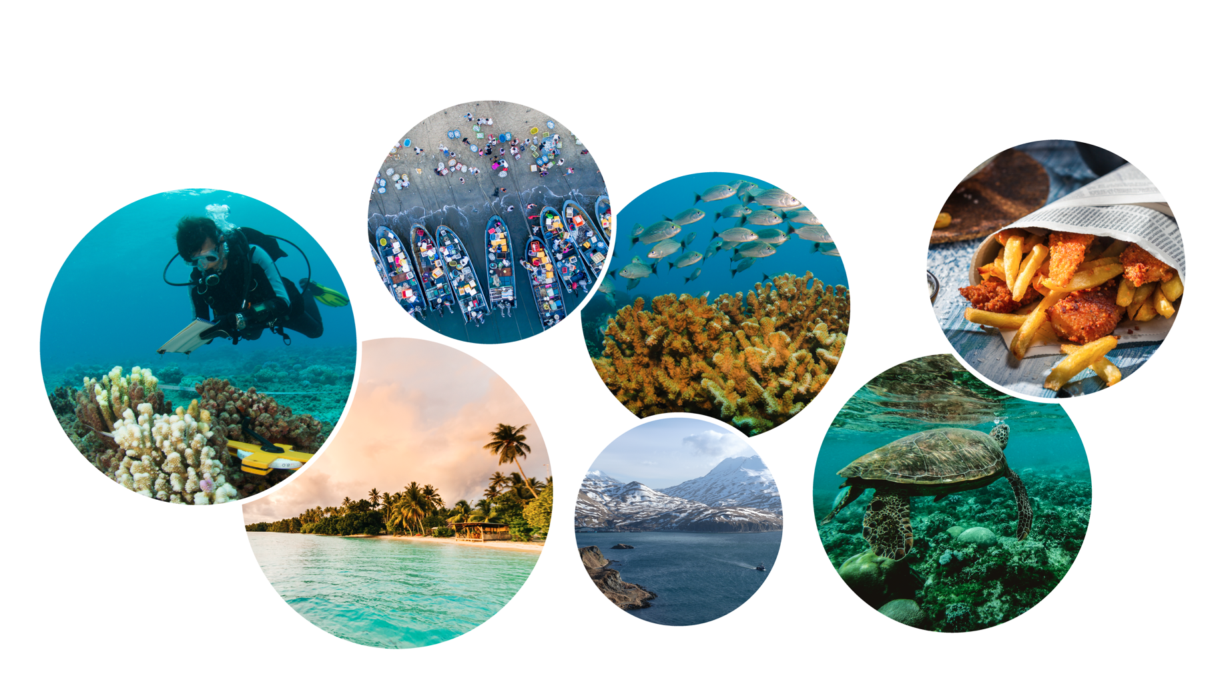
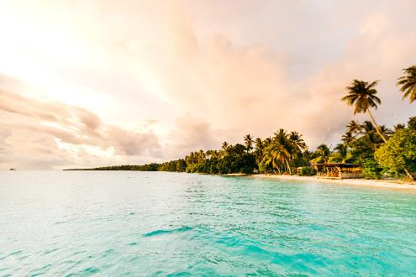
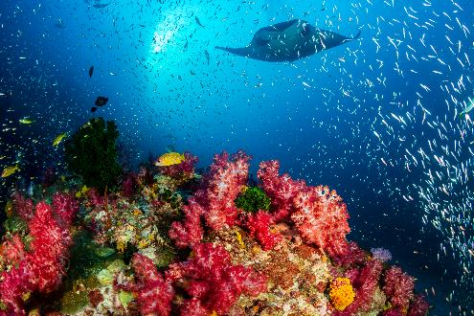
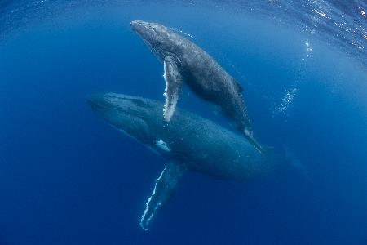
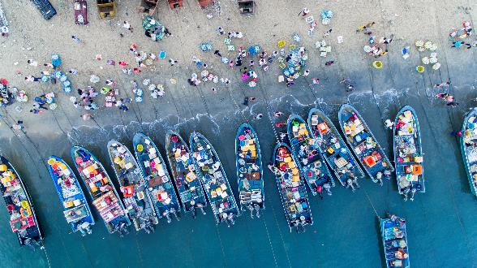
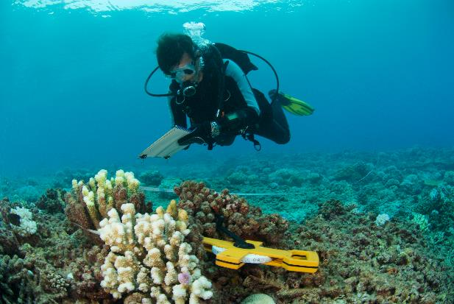
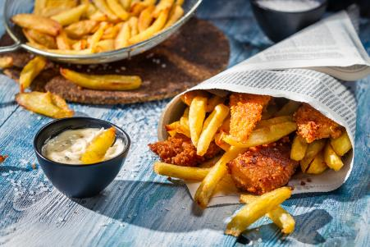
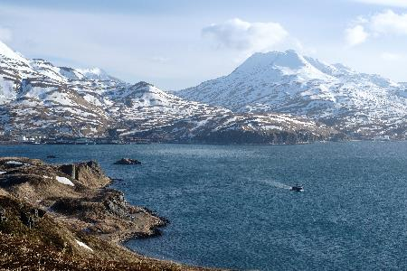
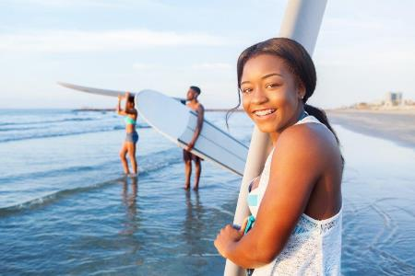
WHY DO WE NEED THE OCEAN?

Slide 4
WHY DO WE NEED THE OCEAN?
Your reasons
Social
Environmental
Economic
e.g. swimming
e.g. ocean plants and animals
e.g. fishing

Slide 5
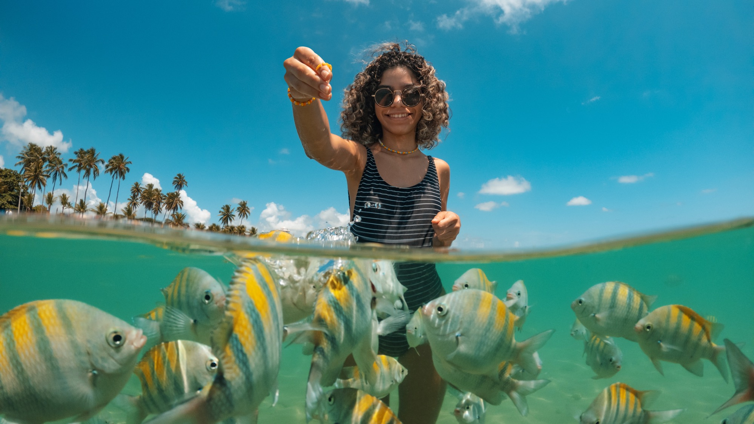
SOCIAL PATH

Slide 6
SUSTAINABILITY
Where do you hear it?
Do you think this word is important?
Do you do anything you feel is ‘sustainable’?
Is ‘sustainable’ just about the environment?
What does this word mean to you?

Slide 7
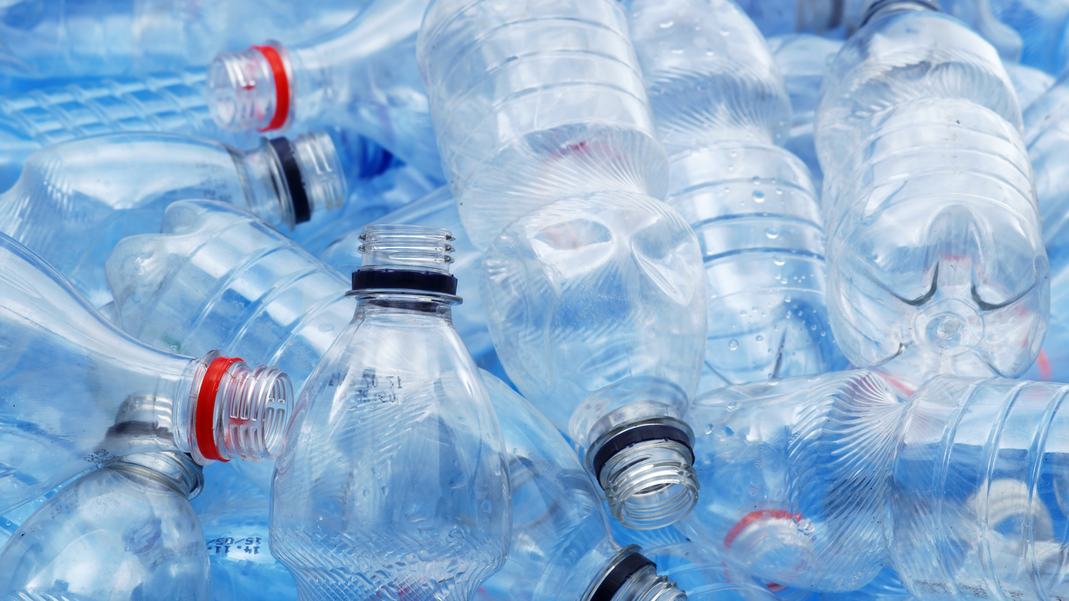
Notes:
Istock image

Slide 8
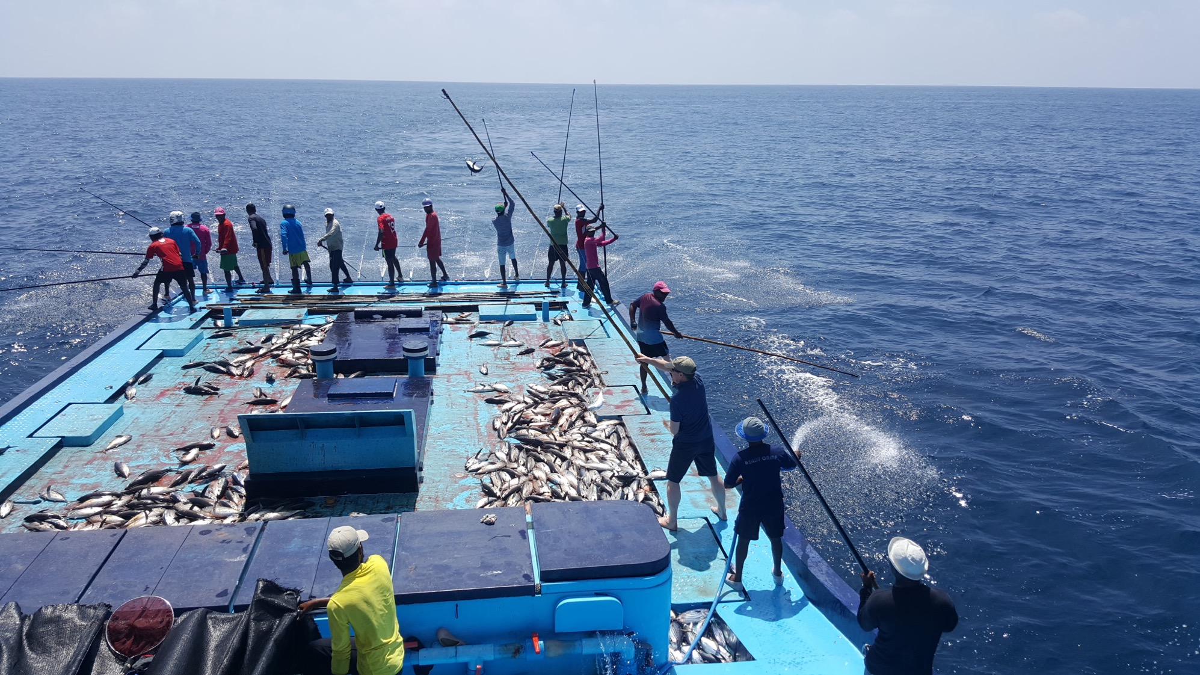
Notes:
Credit: Woolworths SA (from MSC library)

Slide 9
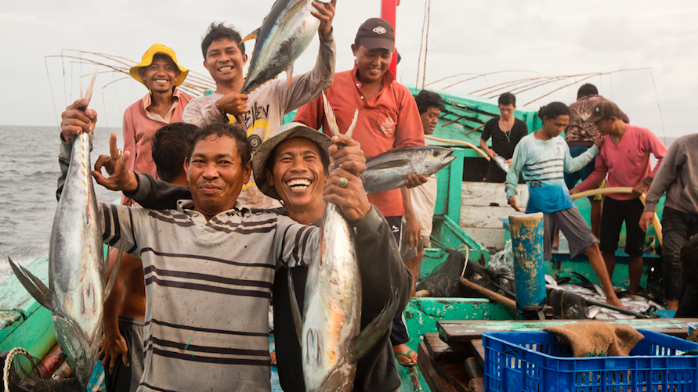

Slide 10
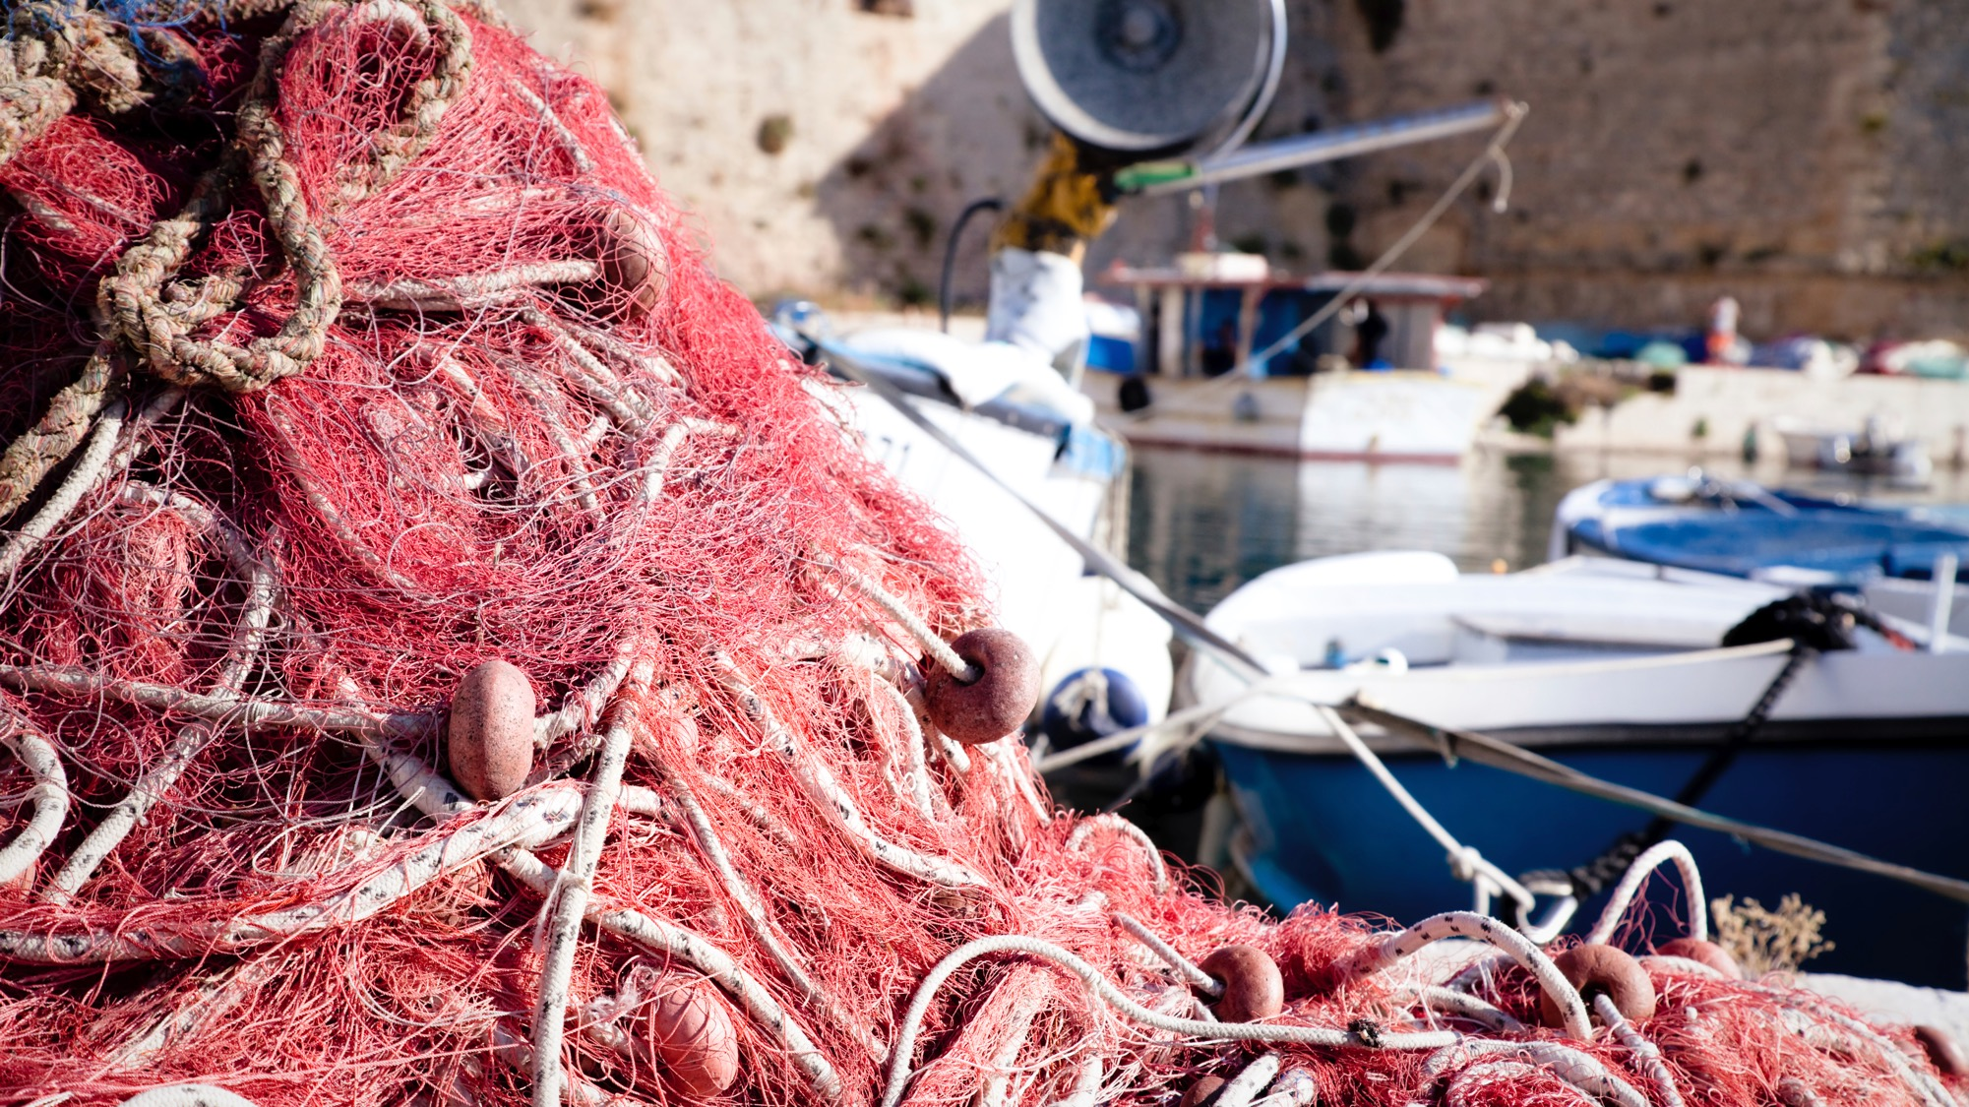
Notes:
istock.com/MatteoBattagliarin

Slide 11
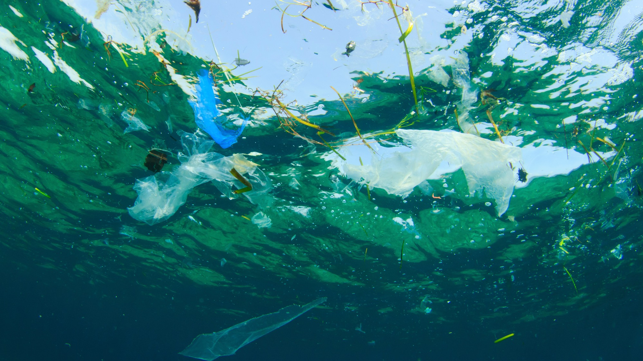

Slide 12
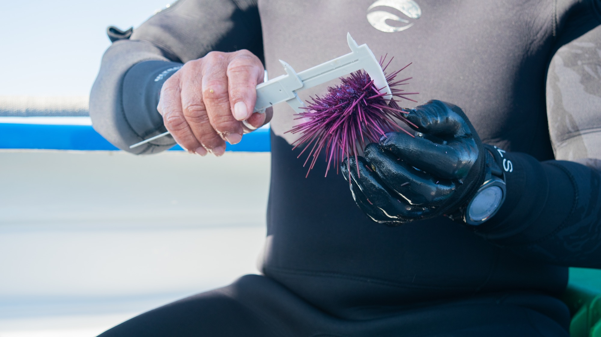

Slide 13
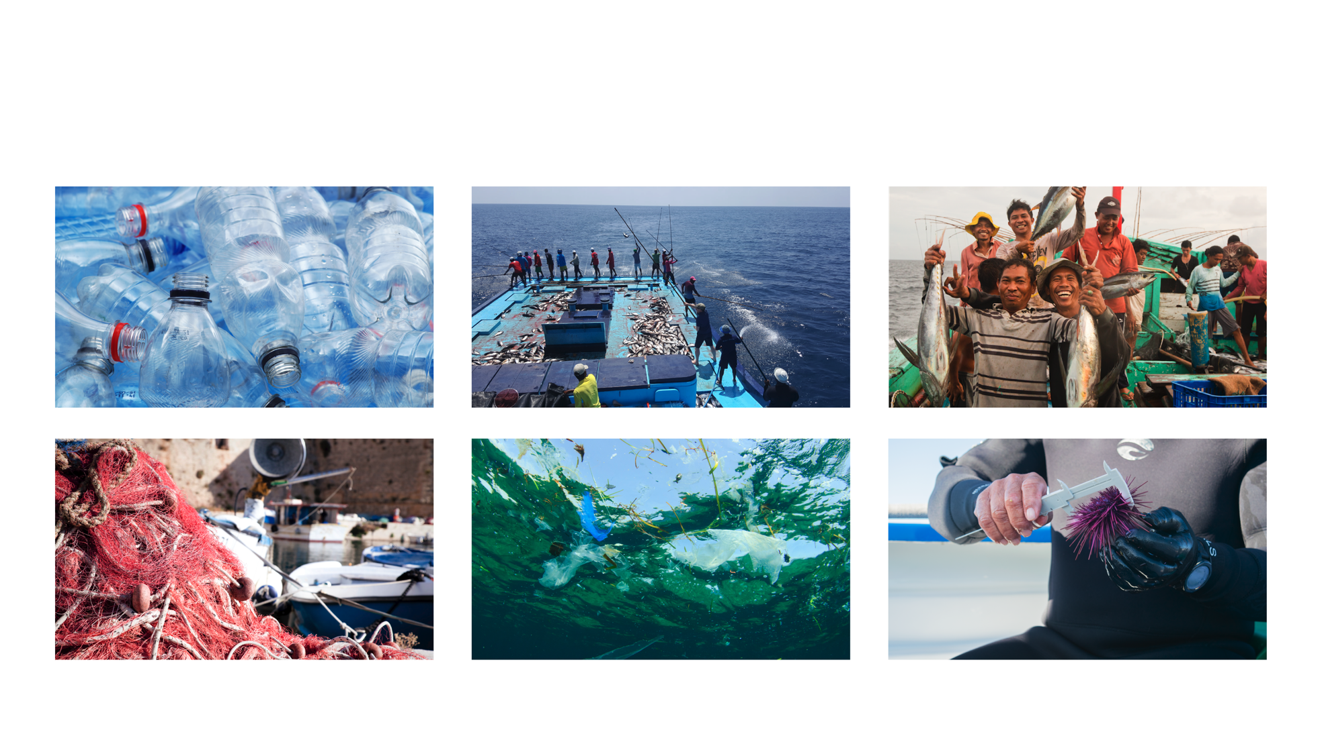

Slide 14
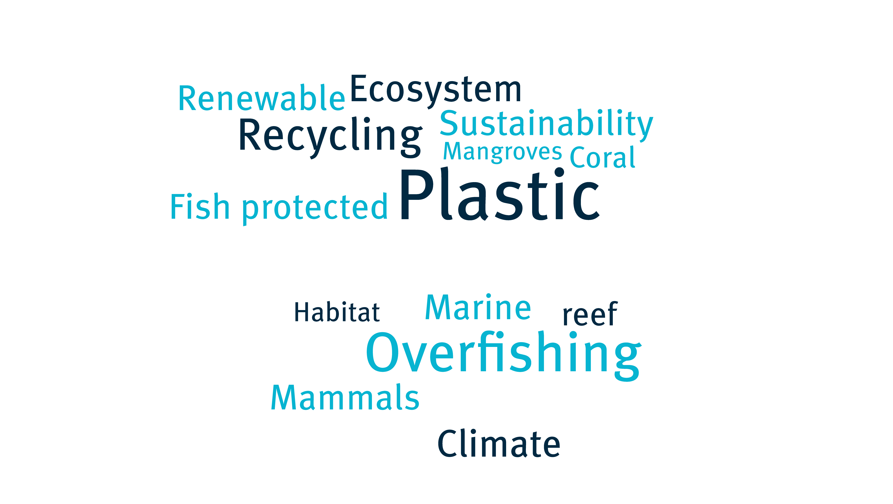
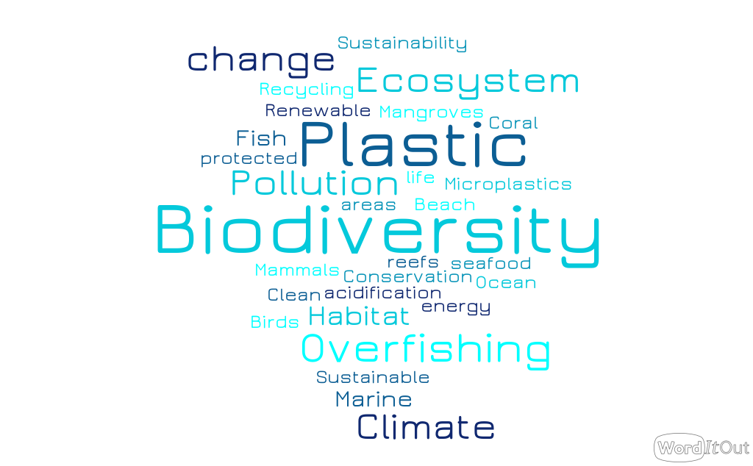

Slide 15
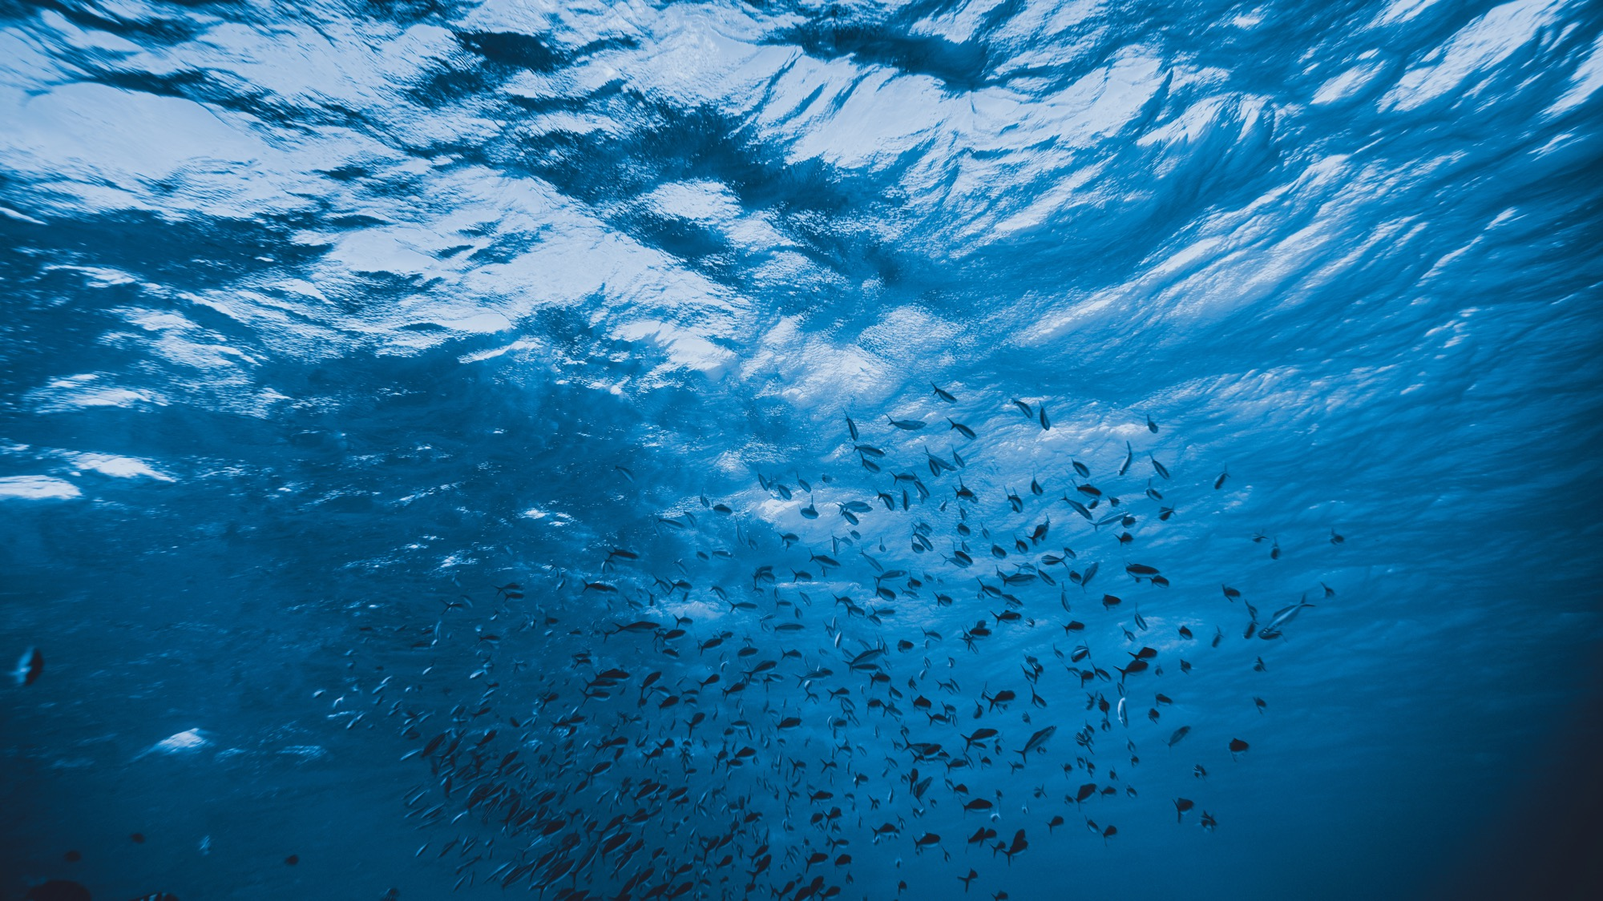
ENVIRONMENTAL PATH

Slide 16
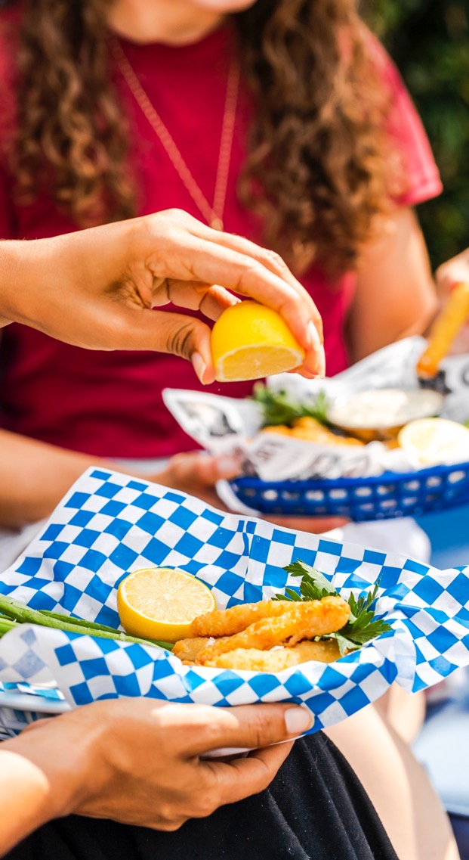
WE ALL NEED TO EAT! BUT WHY?
We all need to eat to live!
All living things – including us! – need energy, and we get it from food.
We use the energy from food to breathe, move and use our bodies. We also store energy in our bodies.
Plants get their energy from the sun.

Slide 17
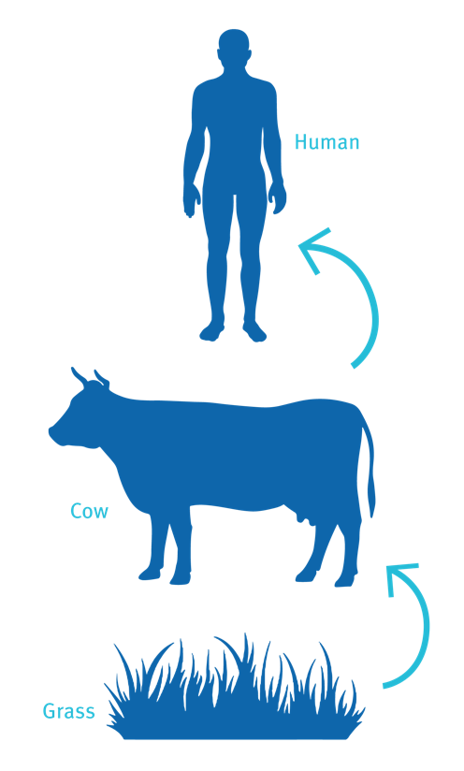
ENERGY TRANSFER
FOOD CHAIN
Some animals eat plants, and others eat other animals. Some eat both!
When an animal eats another animal or a plant, energy is transferred from one organism to another.
If that animal is eaten, energy transfers again. This is called a food chain.
The arrows show the flow of the energy from one animal to another
energy transfer
Grass
Cow
Human
energy transfer

Slide 18
WE CAN LABEL PLANTS AND ANIMALS ACCORDING TO THEIR ROLE IN THE FOOD CHAIN
Plants are producers get their energy from the sun.
Consumers and get their energy from eating plants, other animals, or both.
Can you sort these organisms into producers and consumers?
  Broccoli
  Human
  Plankton
  Seal
  Fish
  Chicken
  Shark
  Seeds
  Shrimp
  Seagrass
  Turtle

Slide 19
CAN YOU MAKE A FOOD CHAIN FEATURING SOME OF THESE PLANTS AND ANIMALS?
  Broccoli
  Human
  Plankton
  Seal
  Fish
  Chicken
  Shark
  Seeds
  Shrimp
  Seagrass
  Turtle
Which organisms are at the top of the food chain?

Slide 20
MORE ABOUT FOOD CHAINS
Primary consumers get their energy from plants.
Secondary consumers get their energy from other animals.
Animals at the top of a food chain are apex predators.
Decomposers get their energy by breaking down other organisms when they die.
  This could be a fungus growing on a tree, or starfish eating a whale at the bottom of the ocean.

Slide 21
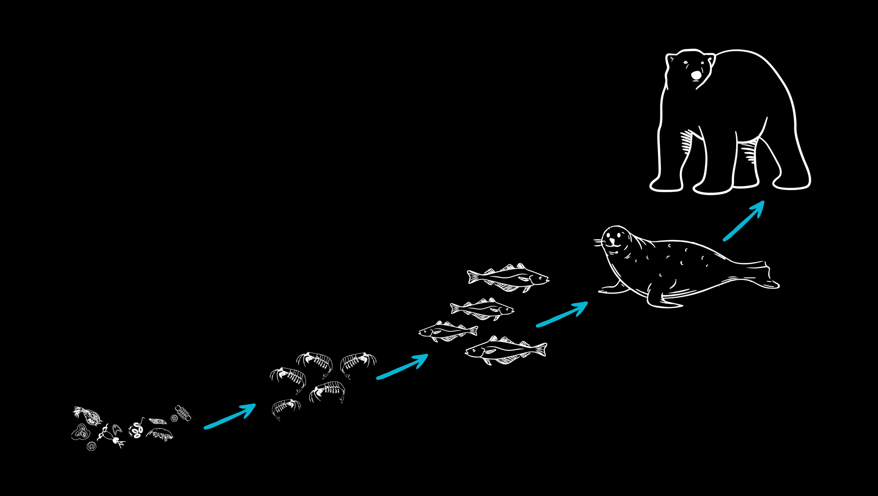
Can you identify a producer, a primary consumer, a secondary consumer and the apex predator in this food chain?
POLAR BEAR
SEAL
phytoplankton
COD
SHRIMP

Slide 22
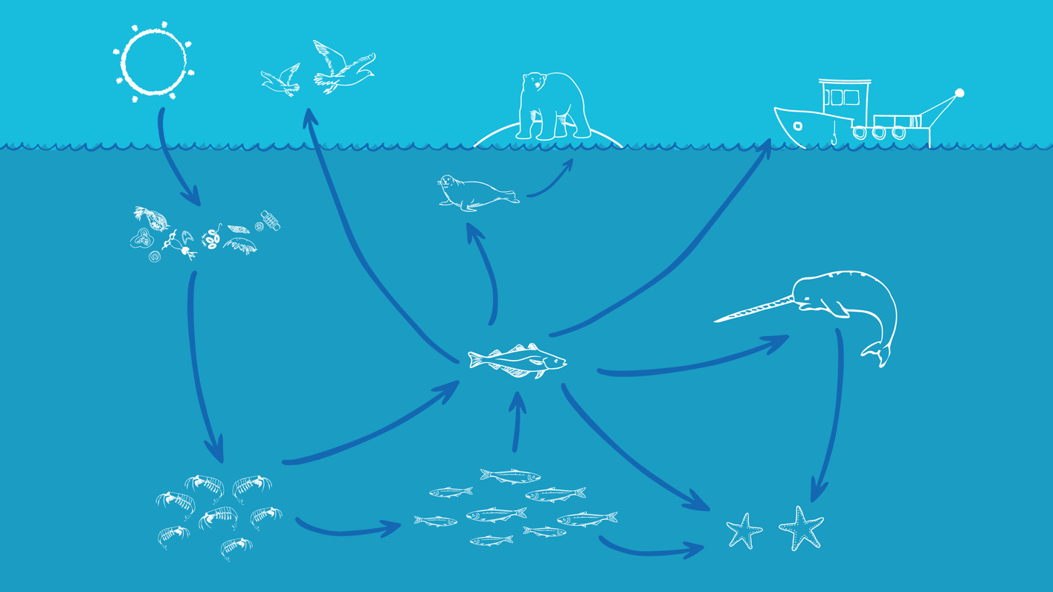
Most animals eat more than one thing! So we often need to make a food web to understand energy transfer better.
HUMANS
POLAR BEAR
SEA BIRDS
SEAL
NARWHAL
phytoplankton
Can you identify the producer, consumers and apex predators in this food web? Which animal is the decomposer?
COD
SHRIMP
STARFISH
HERRING
Notes:
https://marinestewardshipcouncil.sharepoint.com/:i:/s/Communications/EYmxQO6HRiFCtR-nujzOYz4BsoRDN1gxNTNEe3dXT0uEDQ?e=u3LRwW

Slide 23
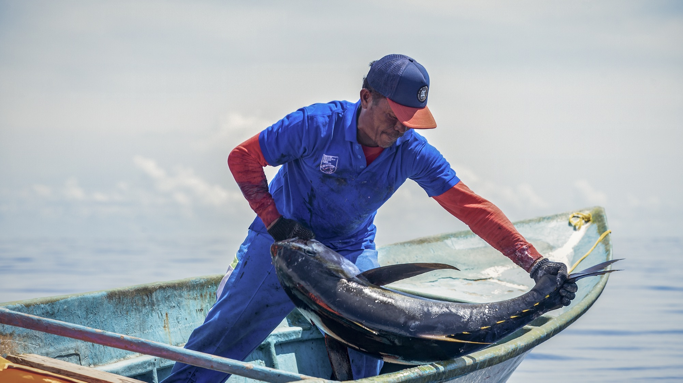
ECONOMIC PATH

Slide 24


Slide 25
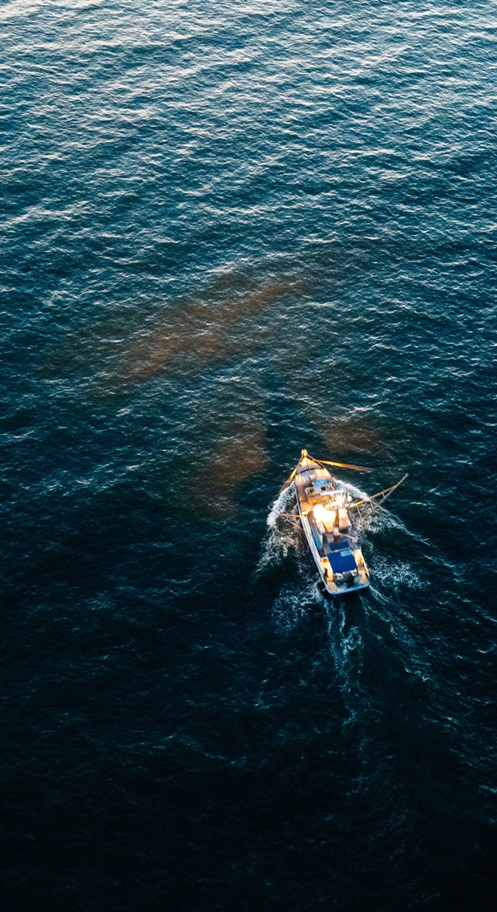
FISHING IS BIG BUSINESS
Many communities around the world depend on the fishing industry for food and income.
For many people fishing is their livelihood.
3.3 billion people get at least 20% of their daily animal protein intake from fish There are 39 million fishers around the world, catching wild fish and seafood from our ocean
Over 50% of the world’s traded seafood comes from low- and middle- income countries
Up to 10% of the global population relies on fisheries for their livelihood. Fisheries are groups of fishers, fishing boats or an area of the ocean where fish are caught to sell
84% of the people who work in the fisheries sector are in Asia, 10% live in Africa (9%) and 4% live in Latin America and the Caribbean.
Notes:
From https://www.msc.org/what-we-are-doing/ oceans-at-risk/the-impact-on-communities
All bullet 4 figures from the UNFAO SOFIA 2022 report

Slide 26
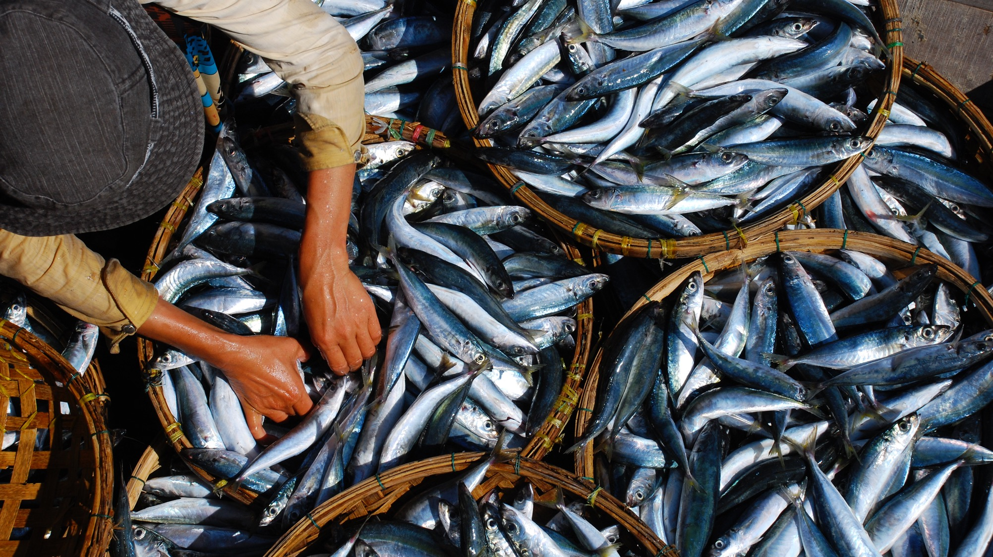
OUR OCEANS ARE UNDER THREAT FROM HUMAN ACTIVITY – and that means the future of our fish and seafood is too.
In the last 50 years, the size of fish populations has gone down by nearly half, across the world.

Slide 27
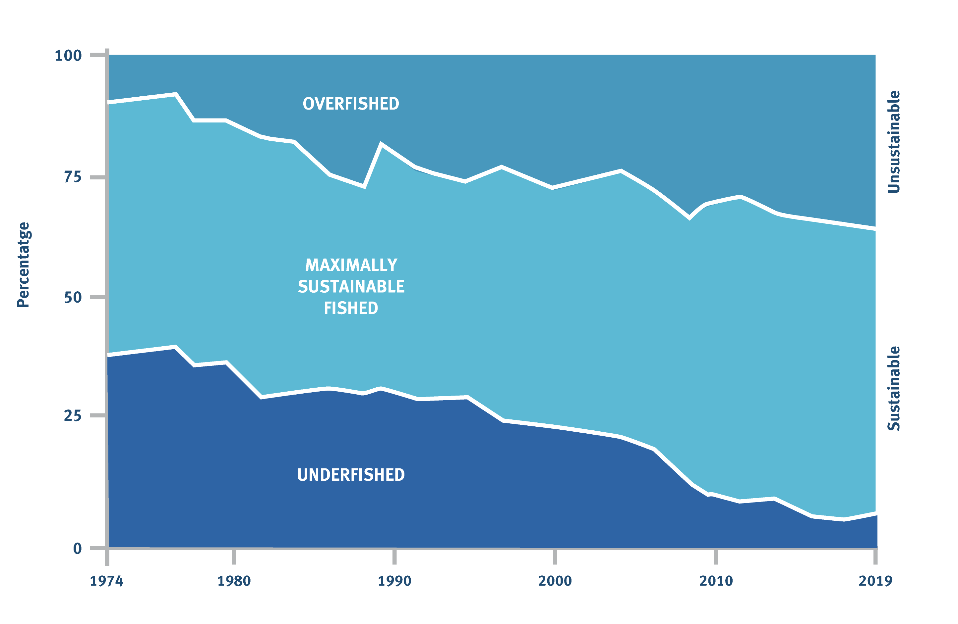
Overfishing is a serious global problem that threatens ocean wildlife, livelihoods and seafood for future generations.
Today, a third of global fish stocks is still overfished, so there’s a risk some species could disappear forever.
MARINE FISHERIES SUSTAINABILITY
© FAO SOFIA 2022

Slide 28
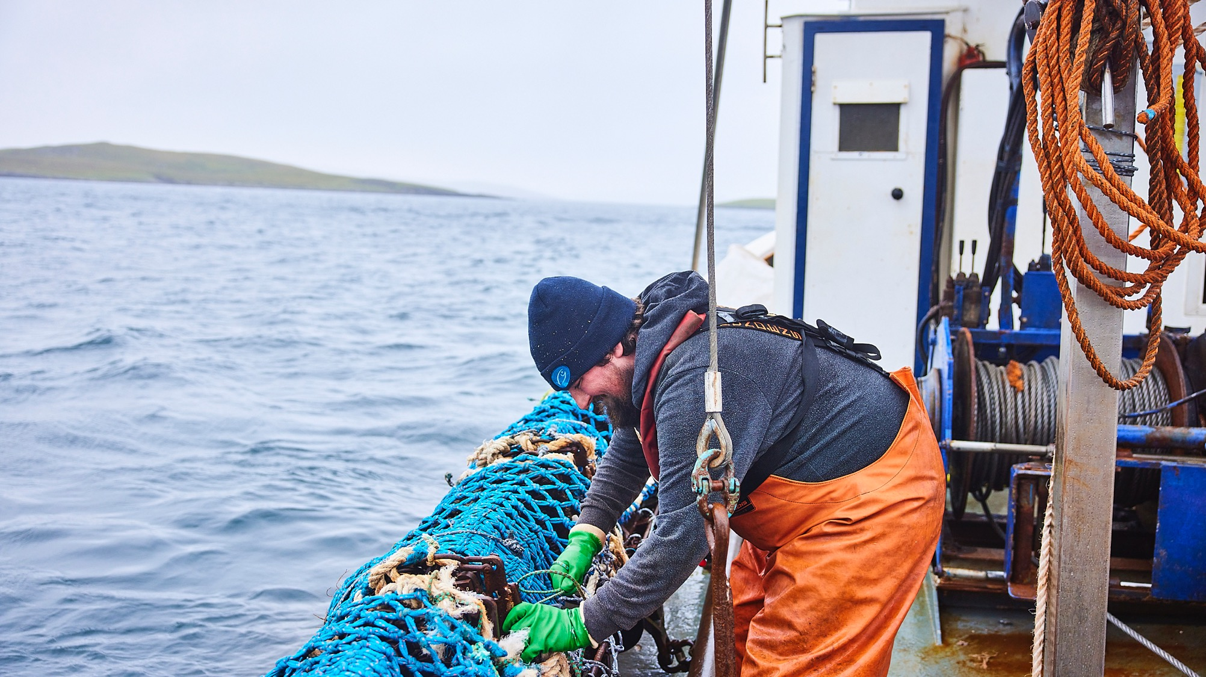
Sustainable fishing means leaving enough fish in the ocean and protecting habitats and threatened species. By safeguarding the oceans, people who depend on fishing can maintain their livelihoods.
Notes:
video: https://www.msc.org/docs/default-source/default-document-library/education-page/4-fishing-sustainably.mp4?sfvrsn=f32fd95d_4

Slide 29
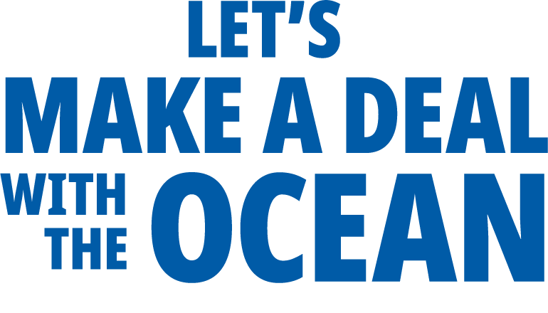

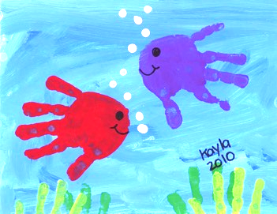
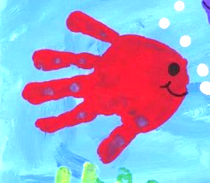
I will use a reusable water bottle
DOWNLOAD HERE
Notes:
https://multimedialibrary.msc.org/?r=17758&k=df3ba79967

Slide 30
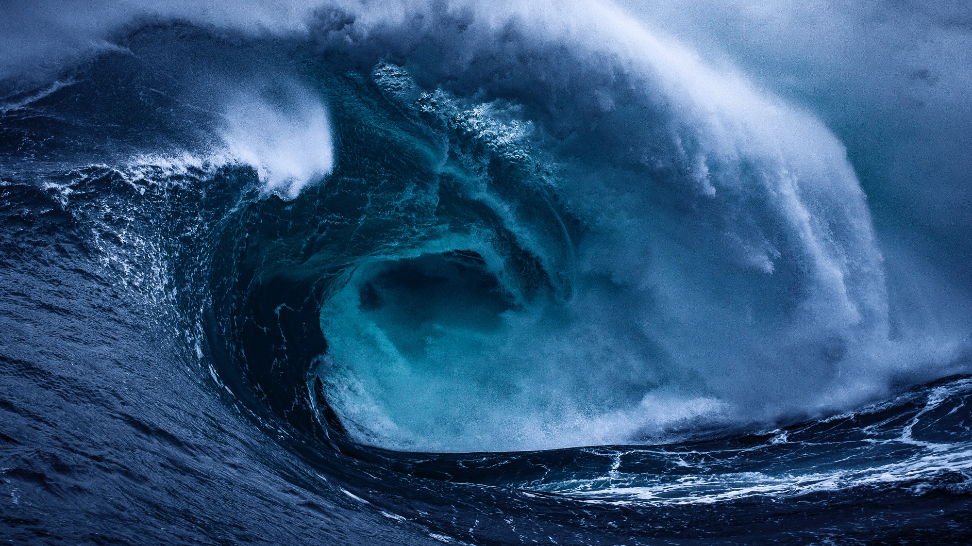

We can all make a deal with the Ocean.
What will yours be?
The Ocean sustains our whole planet
It helps regulate the climate and provides over half of world’s oxygen
It provides food and livelihoods for millions around the world.
It is home to three-quarters of all animal life
It puts healthy and delicious seafood on your plate
What will you do?
Dear ocean,
You are important to me because…
So I promise to …

Slide 31
LET’S MAKE A DEAL WITH THE OCEAN
What can you do?
Discuss with a partner
Make your pledge
Write a letter to the ocean

Slide 32
