Slide 1
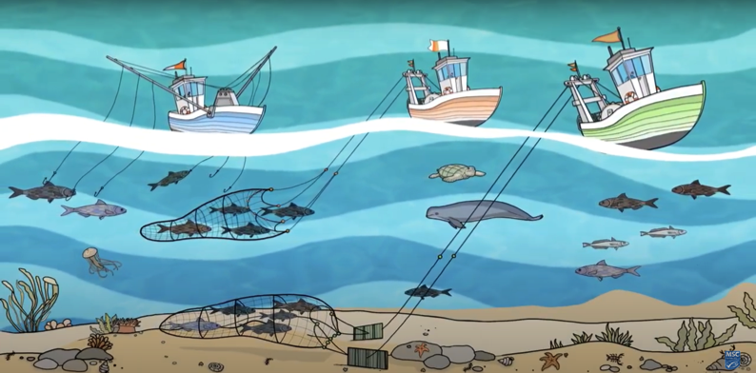
ENVIRONMENTAL IMPACTS OF FISHING (PRINCIPLE 2) Focus Question: How does fishing impact habitat and non target species?
KŌRERORERO / DISCUSSION
Two important ways that fishing can affect the marine environment are:
Habitat damage
Bycatch
HE PĀTAI / CONSIDER THIS
Consider with a partner: (1) Have you ever caught an animal by mistake? (2) Or hurt the home of an animal? (3) What happened and how did you feel?
MĀTAKI TĒNEI / WATCH THIS
Short video [2:11] on marine habitat and species protection (Principle Two)
Notes:
TEACHER NOTES
https://www.youtube.com/watch?v=s1jg8-LZXws

Slide 2
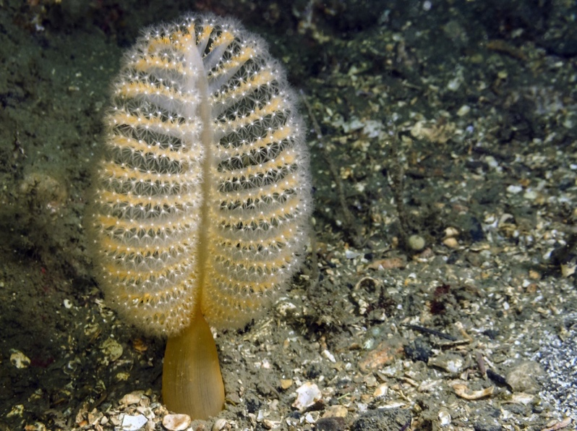
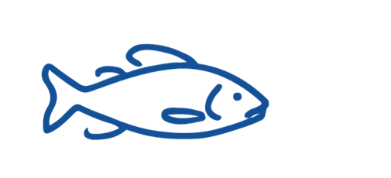
ENVIRONMENTAL IMPACTS OF FISHING (PRINCIPLE 2)
KŌRERORERO / DISCUSSION
(1) Habitat damage happens when fishing gear damages the seafloor
Fishing gear can damage delicate seafloor habitats where there are endangered or slow-growing creatures such as sea pens and sponges grow
Is a sea pen an animal or a plant?
Sea Pen
Notes:
TEACHER NOTES
Sea pens are animals and belong to the phylum cnidaria (known for their stinging cells). Other cnidarians include sea anemone, jelly fish and corals. Sea pens grow up to 45cm tall and are found on sandy seafloors in the ocean at depths of 45 – 225m.
USEFUL RESOURCES / RĀRANGI PUKAPUKA
For more information on sea pens see: https://www.montereybayaquarium.org/animals/animals-a-to-z/sea-pen

Slide 3
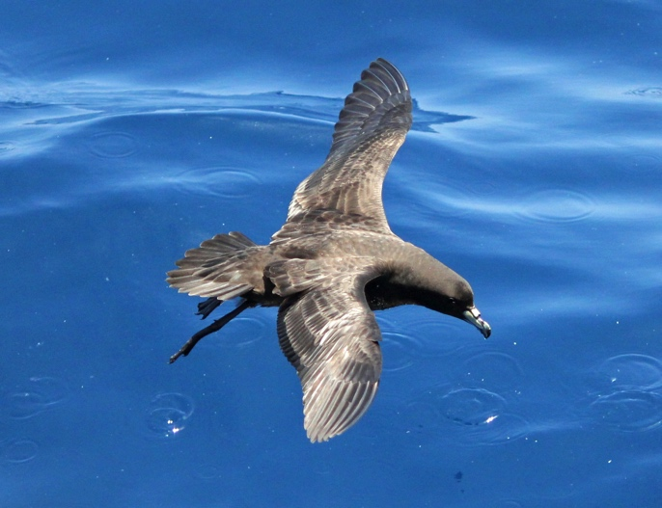
ENVIRONMENTAL IMPACTS OF FISHING (PRINCIPLE 2)
KŌRERORERO / DISCUSSION
(2) Bycatch (or unwanted catch) happens when fish or other marine species are caught by accident while trying to catch another type of fish
Marine life caught as bycatch can include:
Whales and dolphins
Seals and sea lions
Seabirds (like Tāiko, the Black Petrel))
Turtles, sharks and rays
Other (non target) fish and shellfish
Photo: Charlie Westerinen
Tāiko or the Black Petrel
Sometimes caught as ‘bycatch’
by commercial fishers
Notes:
TEACHER NOTES

Slide 4
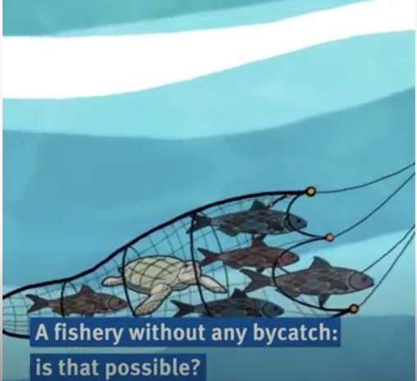
ENVIRONMENTAL IMPACTS OF FISHING (PRINCIPLE 2)
MAHI / ACTIVITY
Complete Activity ‘Bycatch in a Bucket’ OR ‘Bycatch Field Trip’ to experience the dilemma of fishing for a target species with no bycatch
Create your own Bycatch game using Scratch. Check out this one as an example
MĀTAKI TĒNEI / WATCH THIS
Short video [1:00] on What is Bycatch and how it can be managed
Notes:
TEACHER NOTES
Film URL: https://www.youtube.com/watch?v=s1jg8-LZXws
MAHI / ACTIVITY
Activity 4.1 Bycatch in a bucket is a game that can be played indoors and encourages learners to experience how hard it is to catch just the species that you want!
Scratch home page URL: https://scratch.mit.edu
Scratch example game URL: https://scratch.mit.edu/projects/181036139/

