Slide 2
[Version 1.3 – 2024]
Notes:
He tai moana, he tai ika,
He tai timu, he ika nunumi
A sea that is healthy, is a sea that flourishes with life
A sea in decline, becomes void of sea life
Whaktauki or proverb – it outlines a two way context; the need for caring for the ocean or the repercussions of mismanagement of resources

Slide 3
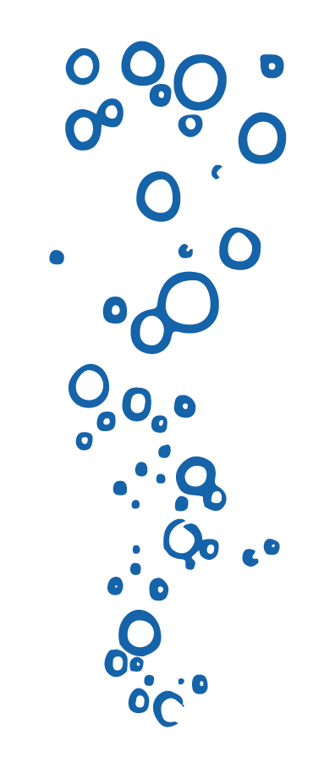
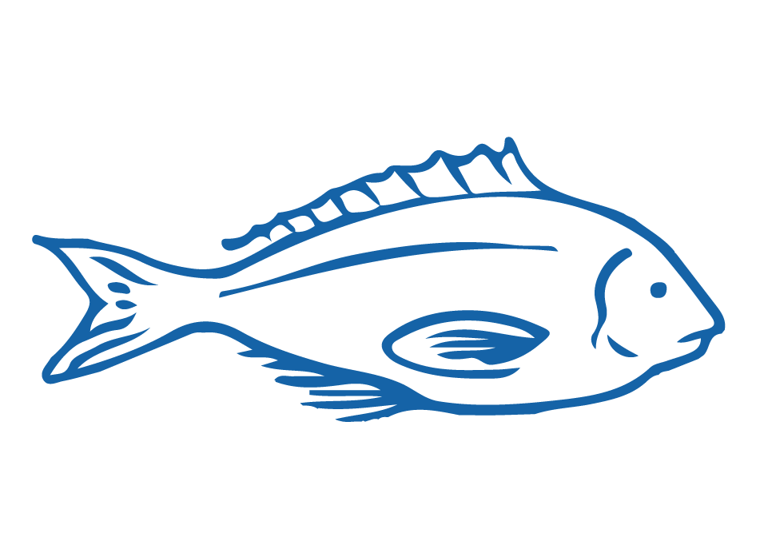
HELPFUL STUFF FOR TEACHERS
Target age range:
10–15 years
Welcome to OUR STORY!
In this topic we explore OVERFISHING & SUSTAINABLE FISHING
Level 3-5 Science, Social Science, Hauora & Pūtaiao
See the Overfishing & Sustainable Fishing Planner for detail on curriculum links, learning outcomes and summary of activities
See also teacher notes below slides
Each subtopic also has a Teacher Outline
Most activities have variations [easy, harder and extending]
Slides with trickier content are labelled expert [top right corner]

Slide 4
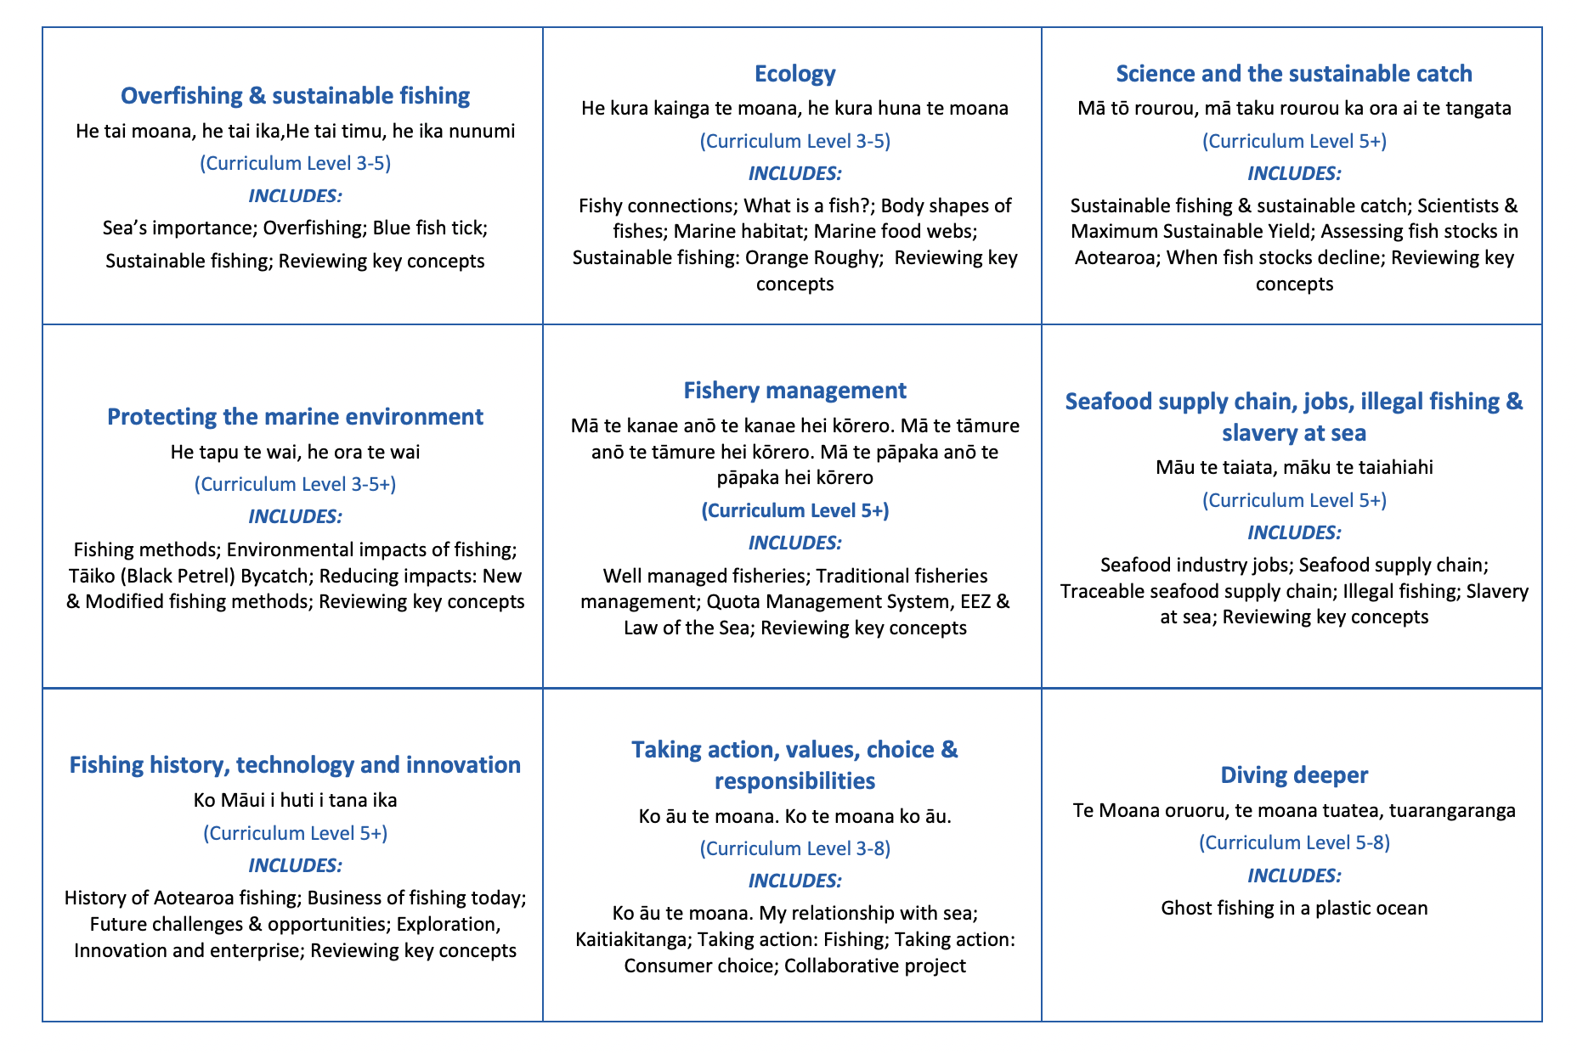
HELPFUL STUFF FOR TEACHERS
Welcome to OUR STORY!
In this topic we explore OVERFISHING & SUSTAINABLE FISHING

Slide 5
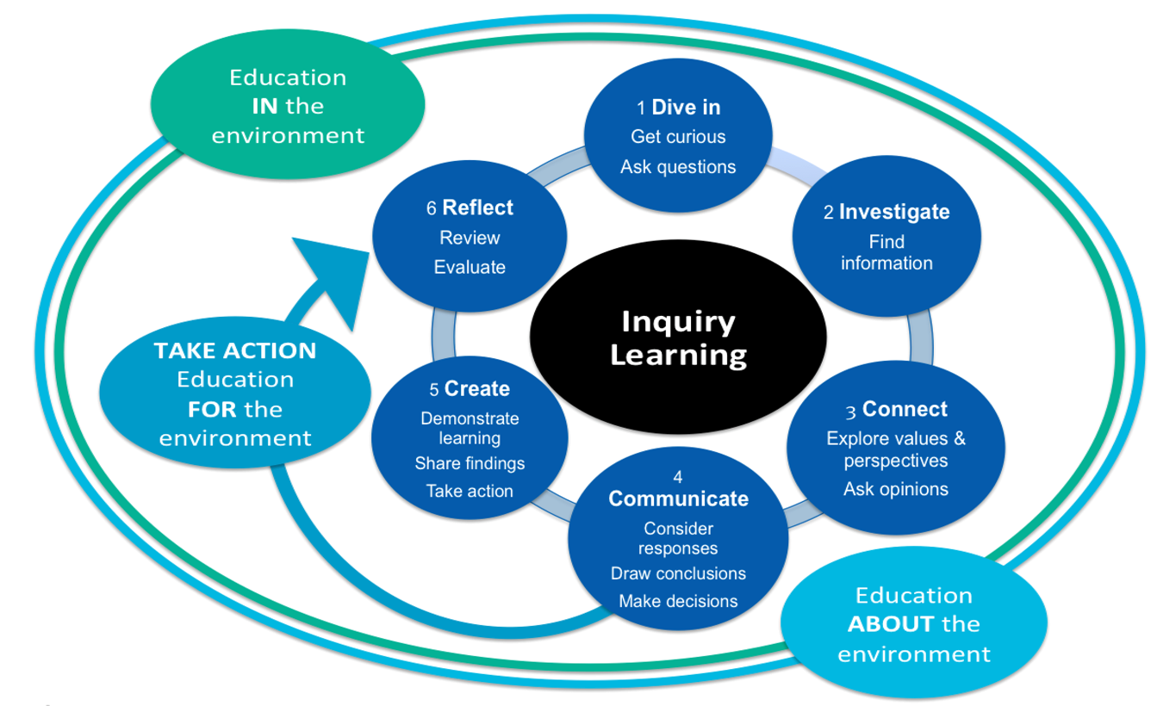
HELPFUL STUFF FOR TEACHERS

Slide 6
IN THIS TOPIC WE LEARN ABOUT…
Importance of sea creatures & the sea
Overfishing & how it impacts people & environments
The Marine Stewardship Council
The Marine Stewardship Council blue fish tick label
Sustainable fishing
New scientific and fisheries related vocabulary

Slide 7
MIHI / INTRODUCTION
Can you imagine a world without fish?
What would that be like?
No more sushi! No more fishing!
No more fish & chips! No more….?
Notes:
TEACHER NOTES
Try to get learners to connect with the personal impact of overfishing and unsustainable practices. What would it be like for ME if there were few or no fish left in the sea!

Slide 8
MIHI / INTRODUCTION
The good news is… some special people are working hard to make sure this doesn’t happen!
We will explore their story:
The story of OVERFISHING,
the MARINE STEWARDSHIP COUNCIL
& SUSTAINABLE FISHING
Let’s take a moment to think why and how …the sea is important!
Notes:
TEACHER NOTES
If you are short on time then you could jump straight to slide 11

Slide 9
IMPORTANCE OF THE SEA TO US Focusing Questions: Why is the sea important for me? How am I connected with the sea?
KŌRERORERO / DISCUSSION
In te ao Māori [the Māori world]:
All things are inter-connected
We are related to the sea through whakapapa [family tree]
People and the sea are children of Papatūānuku [earth mother] and Ranginui [sky father]
“Ko au te moana, te moana ko au” [I am the sea, the sea is me]
Source: Te Ara.govt.nz
HE PĀTAI / CONSIDER THIS
What kai moana [seafood] have you eaten or caught lately?
What beaches have you visited?
Notes:
TEACHER NOTES
USEFUL RESOURCES / RĀRANGI PUKAPUKA
To read more about Tangaroa see: https://teara.govt.nz/en/tangaroa-the-sea/print
Image source: Te Ahukaramū Charles Royal, 'Papatūānuku – the land - Papatūānuku – the
earth mother', Te Ara - the Encyclopedia of New Zealand,
http://www.TeAra.govt.nz/en/whakapapa/11430/papatuanukus-children
(accessed 14 January 2020)

Slide 10
IMPORTANCE OF THE SEA TO US
KŌRERORERO / DISCUSSION
Oceans cover 71% of the earth
Oceans hold 97% of the world’s water
Oceans affect climate & weather
Many of us eat fish and visit the sea
Many tūpuna / ancestors travelled to Aotearoa New Zealand by waka / boat
We are all connected to the sea
MAHI / ACTIVITY
Explore the importance of the sea more deeply using
Ocean Connections Teacher Outline
Notes:
TEACHER NOTES
MAHI / ACTIVITY
Complete the ‘1.2 Ocean Connection’ activities
These include:
Activity 1 – True False card game (15 minutes)
Activity 2 – Online reading, vocab review, Kahoot quiz, review and discuss (25+ minutes)
Activity 3 – Matching games x 2, venn diagram, review and discuss (30+ minutes)
Activity 4 – Group share, create a table, create a graph, review and discuss (40+ minutes)
EXTENSION / HOMEWORK – Create card set or quiz (45+ minutes)
USEFUL RESOURCES / RĀRANGI PUKAPUKA
For more information on oceans importance see:
https://wwf.panda.org/our_work/oceans/open_ocean/ocean_importance/
https://www.mfe.govt.nz/marine/why-our-marine-environment-matters

Slide 11
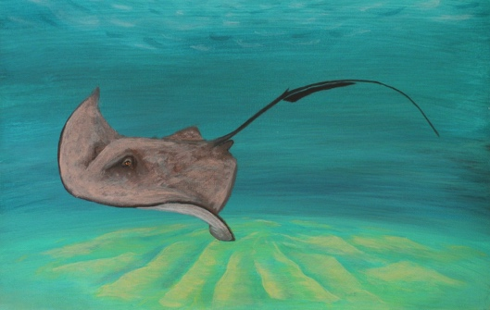
IMPORTANCE OF THE SEA TO US
KŌRERORERO/ DISCUSSION
Many of our tūpuna [ancestors] were fishing folk
The sea and its bounty is a Taonga Tuku iho [a treasure passed down from previous generations]
By being good kaitiaki [guardians or those that look after] the ocean will provide for generations to come
KŌRERO PUKAPUKA / READ
Read the story about Whaitere the stingray who became a kaitiaki
MAHI / ACTIVITY
Play Whaitere Kahoot
Notes:
TEACHER NOTES
USEFUL RESOURCES / RĀRANGI PUKAPUKA
For the Whaitere – Enchanted Stingray story (can be read in Ingarihi or English and Te Reo Māori) see: http://eng.mataurangamaori.tki.org.nz/Support-materials/Te-Reo-Maori/Maori-Myths-Legends-and-Contemporary-Stories/Whaitere-the-enchanted-stingray
For the story of the giant fish caught by Māui (can be read in Ingarihi or English and Te Reo Māori) see: http://eng.mataurangamaori.tki.org.nz/Support-materials/Te-Reo-Maori/Maori-Myths-Legends-and-Contemporary-Stories/Maui-and-the-giant-fish
For the story of the legendary explorer Kupe, who had a famous battle with a giant wheke [octopus], and was also a great fisherman (can be read in Ingarihi or English and Te Reo Māori) see: http://eng.mataurangamaori.tki.org.nz/Support-materials/Te-Reo-Maori/Maori-Myths-Legends-and-Contemporary-Stories/Kupe-and-the-Giant-Wheke
HOW TO PLAY KAHOOT
Connect a device to a projector or screen in front of the classroom.
Navigate to the page called Marine Stewardship Council Kahoot page
https://www.msc.org/en-au/for-teachers/ocean-literacy/new-zealand-education-curriculum/kahoot-quizzes
Select settings
At Kahoot.it, learners enter game-pin and nickname on their own devices (phone, tablet, or computer).
Press “Start now”. The fun begins!
Learners answer questions on their own devices by selecting one of the four answer buttons.
See additional instructions, options, and how to make your own Kahoot at: https://kahoot.com

Slide 12
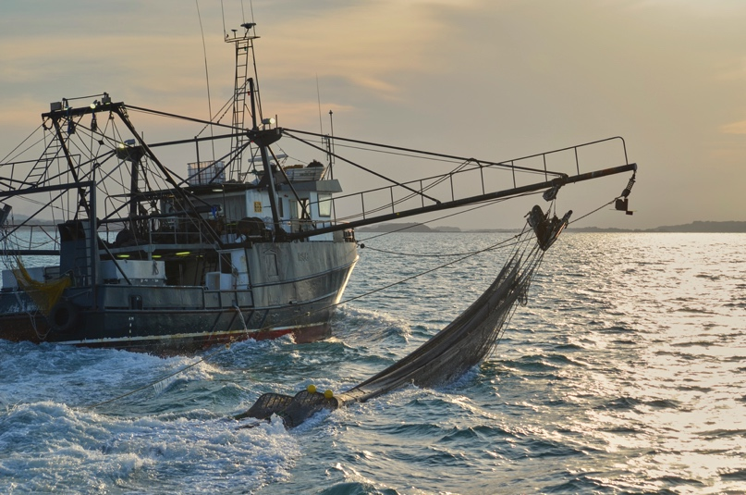
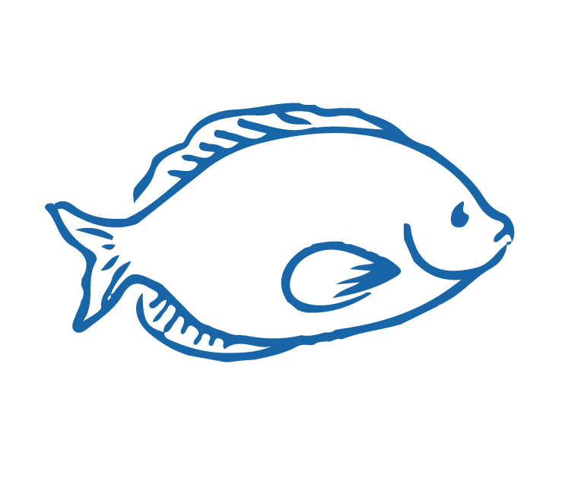
OVERFISHING
Focusing Question: What is overfishing? What impact does overfishing have?
KŌRERORERO/ DISCUSSION
Overfishing is when fish are fished too much so their numbers cannot reproduce to a healthy number so they begin to decline
Overfishing:
Does not leave enough fish in the sea
Can affect whole marine communities
Means catches decline and fishers no longer have their livelihood
Notes:
TEACHER NOTES
Entire marine communities can be affected through food web connections. For example, in Aotearoa New Zealand where snapper are overfished then kina (sea urchin) numbers start to increase and seaweed decreases (eaten by kina)

Slide 13
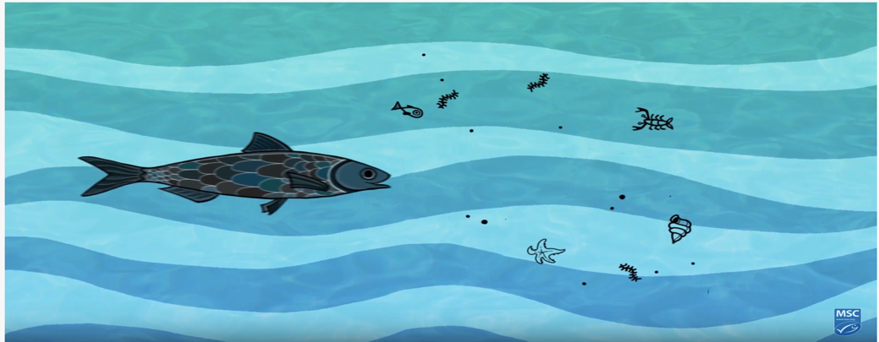
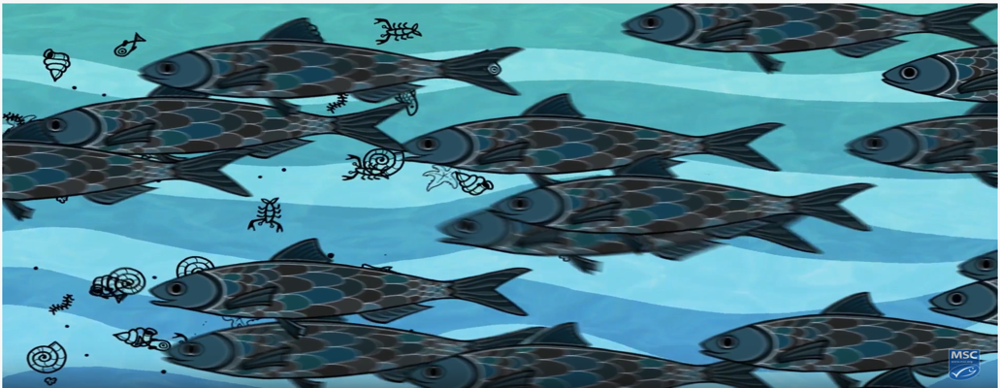
OVERFISHING
KŌRERORERO/ DISCUSSION
When one type of fish is overfished it affects those who fish as well as the whole food web [fish’s community]
HE PĀTAI / CONSIDER THIS
Which picture best shows how the sea might look if overfished?
Why (explain your answer)?
What else can affect health of fish?
Other issues that affect the health of fish and the sea include climate change and pollution
Notes:
TEACHER NOTES
Entire marine communities can be affected through food web connections. For example, in Aotearoa New Zealand where snapper are overfished then kina (sea urchin) numbers start to increase and seaweed decreases (eaten by kina)
MAHI / ACTIVITY
See also Overfishing Activities
Activities include:
Activity 1 (EASY) – images and simple statements to build foundation understanding of overfishing and sustainable fishing (15+ minutes)
Activity 2 (ALL LEVELS) – Prior Knowledge chart (15+ minutes)

Slide 14
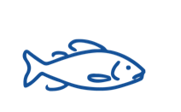
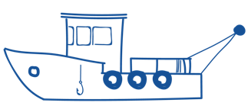
OVERFISHING
HE PĀTAI / CONSIDER THIS
What do you already know about overfishing?
MAHI / ACTIVITY
Complete the Prior Knowledge Chart columns 1 & 2 (see Teacher Outline Overfishing)
OVERFISHING PRIOR KNOWLEDGE CHART
What we know | What we would like to know | What we have learned
Notes:
TEACHER NOTES
A 2015 WWF report suggested that Marine life declined by almost half. This statistic is from WWF who found the size of marine populations had declined by almost half (49%) between 1970 and 2012 [according to WWF’s Living Blue Planet Report 2015].
MAHI / ACTIVITY
See Teacher Outline Overfishing
Warm up activities include:
Activity 1 (EASY) – images and simple statements to build foundation understanding of overfishing and sustainable fishing (15+ minutes)
Activity 2 (ALL LEVELS) – Prior Knowledge chart (15+ minutes)

Slide 15
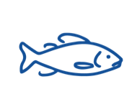
OVERFISHING
MĀTAKI TĒNEI / WATCH THIS
Short film [2:55] Overfishing
HE PĀTAI / CONSIDER THIS
What is overfishing? And what impact does overfishing have on the ocean?
MAHI / ACTIVITY
Add any new knowledge to your ‘Overfishing Prior Knowledge’ chart
Notes:
TEACHER NOTES
Film link is: https://www.youtube.com/watch?v=57QaiexyAFg&t=8s

Slide 16
OVERFISHING
Experts ONLY!
KŌRERORERO/ DISCUSSION
Science Daily says a fishery is: “an organized effort by humans to catch fish or other aquatic species, an activity known as fishing”
Fishery size depends on fish added by:
New (young) fish
Fish migrating in
And fish taken away as:
Fish die
Fish are caught
Fish migrate out of the fishery
So what is a ‘fishery’? Have a go! See if you can write some words or even a sentence that explains what a fishery is!....
Can you think what might affect the size of a fishery [number of fish]?
Notes:
TEACHER NOTES
A second definition is a fishery is… a place where fish or shellfish are caught and a place where fish are reared for commercial purposes
USEFUL RESOURCES / RĀRANGI PUKAPUKA
What is a fishery? – Useful 3 minute video explaining what a fishery is [good for teachers and higher level learners] See: https://www.youtube.com/watch?v=I-DikSs4kRs

Slide 17
OVERFISHING
Experts ONLY!
Overfishing happens when the number of fish being taken out is much greater than the number of fish being added…. Remember..
Fishery size depends on fish added by:
New (young) fish
Fish migrating in
And fish taken away as:
Fish die
Fish are caught
Fish migrate out of the fishery
MAHI / ACTIVITY
Deepen understanding and use online tools like Piktochart or paper and pens to create a diagram showing how overfishing affects the size of a fish population
Notes:
TEACHER NOTES
A second definition is a fishery is… a place where fish or shellfish are caught and a place where fish are reared for commercial purposes
USEFUL RESOURCES / RĀRANGI PUKAPUKA
What is a fishery? – Useful 3 minute video explaining what a fishery is [good for teachers and higher level learners] See: https://www.youtube.com/watch?v=I-DikSs4kRs

Slide 18
THE BLUE FISH TICK LABEL
Focusing Question: Who are the Marine Stewardship Council? What does a blue fish tick label mean?
KŌRERORERO/ DISCUSSION
The Marine Stewardship Council sees if fisheries are sustainable
When a fishery has been found to be sustainable then fish from that fishery can be sold with the Marine Stewardship Council blue fish tick label
There are still many fisheries in the world that do not have the blue fish tick label
MĀTAKI TĒNEI /
WATCH THIS
Short video (0:48) on the Blue Fish Tick Label
Notes:
TEACHER NOTES
Film clip can be found at: https://www.youtube.com/watch?v=Kac1cqkjX1U

Slide 19
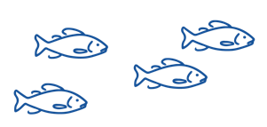
THE BLUE FISH TICK LABEL
KŌRERORERO/ DISCUSSION
The Marine Stewardship Council is an international non-profit organisation
The Marine Stewardship Council’s vision is of oceans teeming with life, and seafood supplies that are safeguarded for future generations!
MĀTAKI TĒNEI / WATCH THIS
Watch the short (1.30) film about sustainable fishing and the Marine Stewardship Council
KŌRERO PUKAPUKA / READ
Read Ocean’s at Risk Worksheet Complete the Kahoot quiz
Notes:
TEACHER NOTES
The short film can be found at https://www.youtube.com/watch?v=3rVeSBdpO6Q
KŌRERO PUKAPUKA / READ
See Ocean’s at Risk Factsheet (10-15 minutes)
Quick reading fact sheet with suggested reading and extension activity as well as literacy based questions.
Kahoot game includes questions on information contained in the fact sheet (10-15 minutes)
HOW TO PLAY KAHOOT
Connect a device to a projector or screen in front of the classroom.
Navigate to the game called Marine Stewardship Council Kahoot
https://www.msc.org/en-au/for-teachers/ocean-literacy/new-zealand-education-curriculum/kahoot-quizzes
Select settings
At Kahoot.it, learners enter game-pin and nickname on their own devices (phone, tablet, or computer).
Press “Start now”. The fun begins!
Learners answer questions on their own devices by selecting one of the four answer buttons.
See additional instructions, options, and how to make your own Kahoot at: https://kahoot.com

Slide 20
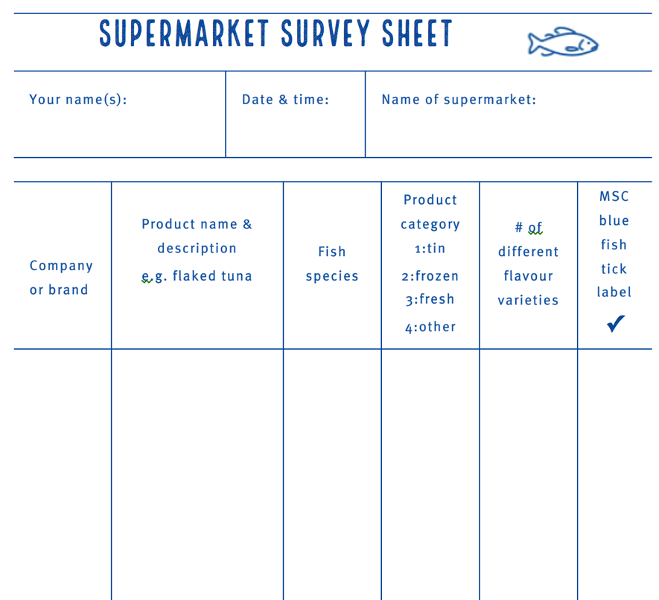
BLUE FISH TICK LABEL
MAHI / ACTIVITY
A supermarket field trip!
Visit a local supermarket and hunt for fish products that do and don’t show the Marine Stewardship Council blue label
Complete the Supermarket survey sheet
Bring your answers to share, compare and graph with the class
Just in case… this is what the Marine Stewardship Council Blue Label looks like!
Notes:
TEACHER NOTES
Estimated time to complete:
Field work: Supermarket survey: 30 – 60 minutes [depending on writing speed!]
In class: Share results, create class result table and graph: 30 – 60 minutes

Slide 21
SUSTAINABLE FISHING
Focusing Question: What is sustainable fishing?
KŌRERORERO/ DISCUSSION
The Marine Stewardship Council is on a mission to end overfishing!
Marine Stewardship Council check that fishing is ‘sustainable’ which means:
Leaving enough fish in the ocean
Looking after places where fish live [habitats]
Ensuring people who fish can keep fishing
The Marine Stewardship Council put a blue fish tick label on all sustainable fish … so we know the fish we eat comes from a ‘sustainable’ fishery
Notes:
TEACHER NOTES

Slide 22
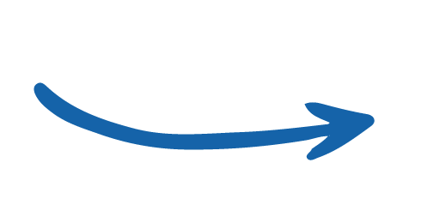
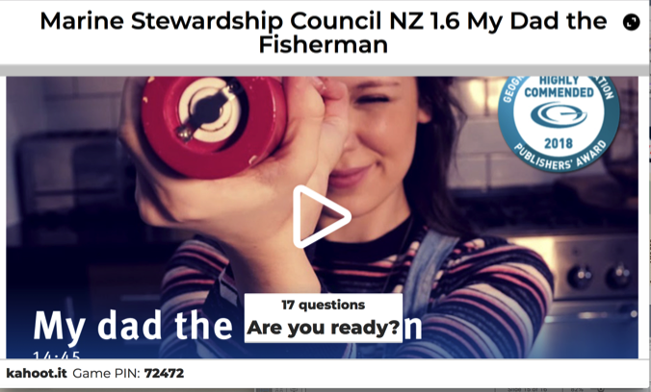
SUSTAINABLE FISHING
MĀTAKI TĒNEI / WATCH THIS
Short award winning film (14.46) called My Dad the Fisherman
MAHI / ACTIVITY
Complete the quiz on Kahoot!
To learn more about sustainable fishing: Play the Go Fish Game
Notes:
TEACHER NOTES
My dad the fisherman can be found at:
https://www.youtube.com/watch?v=OIsA8xQ7WbQ
HOMEWORK IDEAS
The ‘My Dad the Fisherman’ video clip includes most of the concepts that are key to understanding the idea of sustainable fishing.
To reinforce learning or as a good homework activity - re-watch the video ‘My Dad the Fisherman’ and play the Kahoot.
HOW TO PLAY KAHOOT
Connect a device to a projector or screen in front of the classroom.
Navigate to the game called Marine Stewardship Council Kahoot page
https://www.msc.org/en-au/for-teachers/ocean-literacy/new-zealand-education-curriculum/kahoot-quizzes
Select settings
At Kahoot.it, learners enter game-pin and nickname on their own devices (phone, tablet, or computer).
Press “Start now”. The fun begins!
Learners answer questions on their own devices by selecting one of the four answer buttons.
See additional instructions, options, and how to make your own Kahoot at: https://kahoot.com

Slide 23
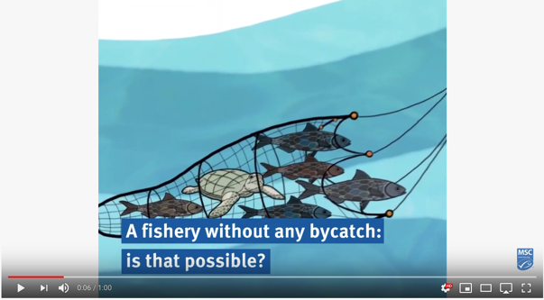
SUSTAINABLE FISHING
Aside from taking too many fish, unsustainable fishing can include:
Bycatch – lots of other sea creatures are caught, not just the target fish
Shark finning – removal of shark fins
Ghost fishing – nets thrown away or lost at sea keep entangling and catching creatures
Seafloor damage - of special habitats or places on the sea floor
TAKE ACTION!
What could you do to help with
Bycatch
Shark conservation
Ghost fishing
Seafloor protection
MĀTAKI TĒNEI / WATCH THIS
Bycatch & how it can be managed [1:00]
MAHI / ACTIVITY
Reinforce learning using Unsustainable fishing cards & activities
Notes:
TEACHER NOTES
One minute video on bycatch can be downloaded from: https://www.youtube.com/watch?v=_3od7CqoQfs
MAHI / ACTIVITY
See Teacher Outline (1.4) Unsustainable fishing practices
EASY – Matching card activities – three different sets (20+ minutes)
HARD – Matching card activities (10+ minutes)
EXTENSION – Research and create a poster activity
USEFUL RESOURCES / RĀRANGI PUKAPUKA
Shark finning
MSC on shark finning: https://www.msc.org/standards-and-certification/developing-our-standards/ending-shark-finning
WWF on sharks: https://www.worldwildlife.org/species/shark
Smithsonian: https://ocean.si.edu/ocean-life/sharks-rays/shark-finning-sharks-turned-prey
Shark Stewards: https://sharkstewards.org
Some good news about shark fin demand in Hong Kong: https://sharks.panda.org/news-blogs-updates/press-releases/hong-kong-shark-fin-imports-down-50
Watch the short film called “Shark fin Crisis” by Shark Alliance: https://vimeo.com/16811009
MSC on shark finning: https://www.msc.org/standards-and-certification/developing-our-standards/ending-shark-finning
Some great ideas on how to support conservation of great white sharks in Aotearoa NZ: https://whitesharkconservationtrust.org.nz/how-you-can-help/
Another practical NZ project for shark conservation: http://www.sustainableoceansociety.co.nz/projects/shark-conservation
See next slide notes for more resources

Slide 24
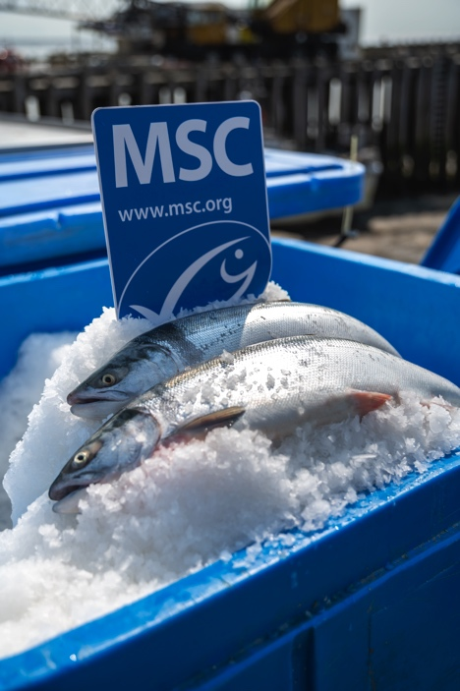
SUSTAINABLE FISHING
TAKE ACTION!
Check out our Taking Action topic to see how to take action on these issues! ….In the meantime … one easy action to buy fish products displaying the Marine Stewardship Council Blue Fish Tick label!
Marine Stewardship Council will only give the blue fish tick to sustainable fisheries that:
Have low BYCATCH
Do not undertake SHARK FINNING
Avoid GHOST FISHING and are finding new ways to help fisheries avoid losing gear
Do not badly DAMAGE HABITATS and the sea floor
Notes:
TEACHER NOTES
USEFUL RESOURCES / RĀRANGI PUKAPUKA
Ghost nets and ghost fishing
MSC on lost gear and ghost fishing: https://www.msc.org/standards-and-certification/developing-our-standards/preventing-lost-gear-and-ghost-fishing
WWF on ghost nets: https://www.worldwildlife.org/stories/our-oceans-are-haunted-by-ghost-nets-why-that-s-scary-and-what-we-can-do--23
Endangered ecosystems and habitats
MSC on ecosystems and habitats: https://www.msc.org/standards-and-certification/developing-our-standards/minimising-fishing-impacts-on-ecosystems-and-habitats
Bycatch
MSC on bycatch of endangered, threatened species: https://www.msc.org/standards-and-certification/developing-our-standards/protecting-endangered-species
WWF on Bycatch: https://www.worldwildlife.org/threats/bycatch
Smithsonian: https://ocean.si.edu/conservation/fishing/bycatch-cost-catching-what-you-dont-want
Cool Bycatch case study
Stats NZ Tatauranga Aotearoa. 2019. Bycatch of protected species: Hector’s and Māui dolphins. (includes a cool interactive tool)
https://www.stats.govt.nz/indicators/bycatch-of-protected-species-hectors-and-maui-dolphins

Slide 25
SUSTAINABLE FISHING
KŌRERORERO/ DISCUSSION
Over hundreds of years Māori developed Tikanga [ways of doing things] to help look after the sea and avoid overfishing
In Aotearoa New Zealand commercial fisheries are managed under a system called the Quota Management System (QMS)
In Topic 5 we look at the QMS and our approach to sustainable fisheries in Aoteaora New Zealand
HE PĀTAI / CONSIDER THIS
How do you look after the sea and creatures that live there?
What ‘tikanga’ do you know that helps look after fisheries?
What do you already know about how we prevent overfishing here in Aotearoa?
Notes:
TEACHER NOTES
Example of tikanga:
For example: not gutting or disposing of fish near the sea [can deplete fish as predators like sharks are attracted]

Slide 26
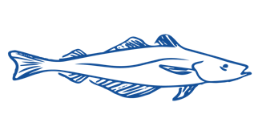
SUSTAINABLE FISHING
To receive the Marine Stewardship Council blue fish tick label, fisheries must be:
1. Sustainable fish stocks - Fishing must be at a level that it can carry on indefinitely and the fish population will stay healthy
3. Effective fisheries management - The fishery must be well managed and able to adapt to changing environmental conditions
2. Minimising environmental impact – Fishing must be done carefully so that other species and habitats are looked after
Notes:
TEACHER NOTES
These three principles are explored in much more detail in topics 3, 4 and 5
USEFUL RESOURCES / RĀRANGI PUKAPUKA
For more information see the MSC Fisheries Standard at https://www.msc.org/standards-and-certification/fisheries-standard
For more detail see also the 10 minute film called ‘Sustainable Seas: what is the MSC Fisheries Standard and how does it ensure healthy oceans’ at: https://www.youtube.com/watch?v=bw5tsy05uM8

Slide 27
SUSTAINABLE FISHING
Experts ONLY!
Consider under which principle the following would be assessed: bycatch, effect on seafloor, overfished fisheries; inability of a fish population to replenish, poor fisheries management
HE PĀTAI / CONSIDER THIS
What do you think the MSC would consider under each principle?
KŌRERORERO / DISCUSSION
Discuss your ideas in pairs. Be prepared to share answers
Check your answers against A guide to the MSC Fisheries Standard
Notes:
TEACHER NOTES
These three principles are explored in much more detail in topics 3, 4 and 5
USEFUL RESOURCES / RĀRANGI PUKAPUKA
For information see the MSC Fisheries Standard at https://www.msc.org/standards-and-certification/fisheries-standard
For more detail see also the 10 minute film called ‘Sustainable Seas: what is the MSC Fisheries Standard and how does it ensure healthy oceans’ at: https://www.youtube.com/watch?v=bw5tsy05uM8

Slide 28
REVIEWING KEY CONCEPTS
Focusing Question: What have we learnt?
MĀTAKI TĒNEI / WATCH THIS
Re-watch the short award winning film (14.46) called My Dad the Fisherman
MAHI / ACTIVITY
Write down as many words and phrases to do with the term “sustainable oceans”
Match terms to definitions (see Key term worksheet) Create an infographic for one term
Notes:
TEACHER NOTES
My dad the fisherman can be found at:
https://www.youtube.com/watch?v=OIsA8xQ7WbQ

Slide 29
REVIEWING KEY CONCEPTS
MAHI / ACTIVITY
Complete the following:
Kahoot: Overfishing & Sustainable Fishing Topic Kahoot!
Animation: Use Powtoon to make an animation telling the story of sustainable fishing - include terms from the Key term worksheet
Notes:
TEACHER NOTES
The summary can be found at: https://dad-fishes-for-the-future.msc.org/?_ga=2.178911460.1759312358.1578727525-1836922175.1578727525#start-dOPb2kpn4D
HOMEWORK IDEAS
Any of the Kahoot, Worksheet or crossword could be good homework activities.
HOW TO PLAY KAHOOT
See other teacher notes for instructions
URL for this game is:https://create.kahoot.it/share/review-quiz-overfishing-sustainable-fishing-topic-marine-stewardship-council-nz/563e8ed3-6f56-494c-803f-b3bf840cec95
SUSTAINABLE OCEAN KEY TERM WORKSHEET
The sustainable ocean key term worksheet can be found at: https://www.msc.org/docs/default-source/default-document-library/education-page/msc-lesson-plan-using-the-oceans-resources-responsibly.pdf?sfvrsn=5c15a87a_14
ANIMATION USING POWTOON
Use Powtoon to enable learners to create their own animation that tells the story of sustainable fishing. Include the key terms from the worksheet to make sure that all the key information is included.

Slide 30
He tai moana, he tai ika,
He tai timu, he ika nunumi
A sea that is healthy, is a sea that flourishes with life
A sea in decline, becomes void of sea life
Whaktauki or proverb – it outlines a two way context; the need for caring for the ocean or the repercussions of mismanagement of resources

