Slide 1
[Version 1.3 – 2024]

Slide 3
HELPFUL STUFF FOR TEACHERS
Target age range:
10–15 years
Welcome to OUR STORY!
This topic is about taking action, choice, values and responsibility … aka ocean citizenship!
Focus: Taking action, values, choice, responsibilities
Curriculum Level: Level 3 - 5+
Curriculum: Geography; Science; Social Science; Tikanga-ā-iwi; Pūtaiao; Hauora
Key competencies: Thinking; Managing self; Relating to others; Participating & contributing
Planning: See also the Ocean Citizenship Planner and teacher notes below slides
Extending learning: See topic outlines and slides labelled expert [top right corner]

Slide 4
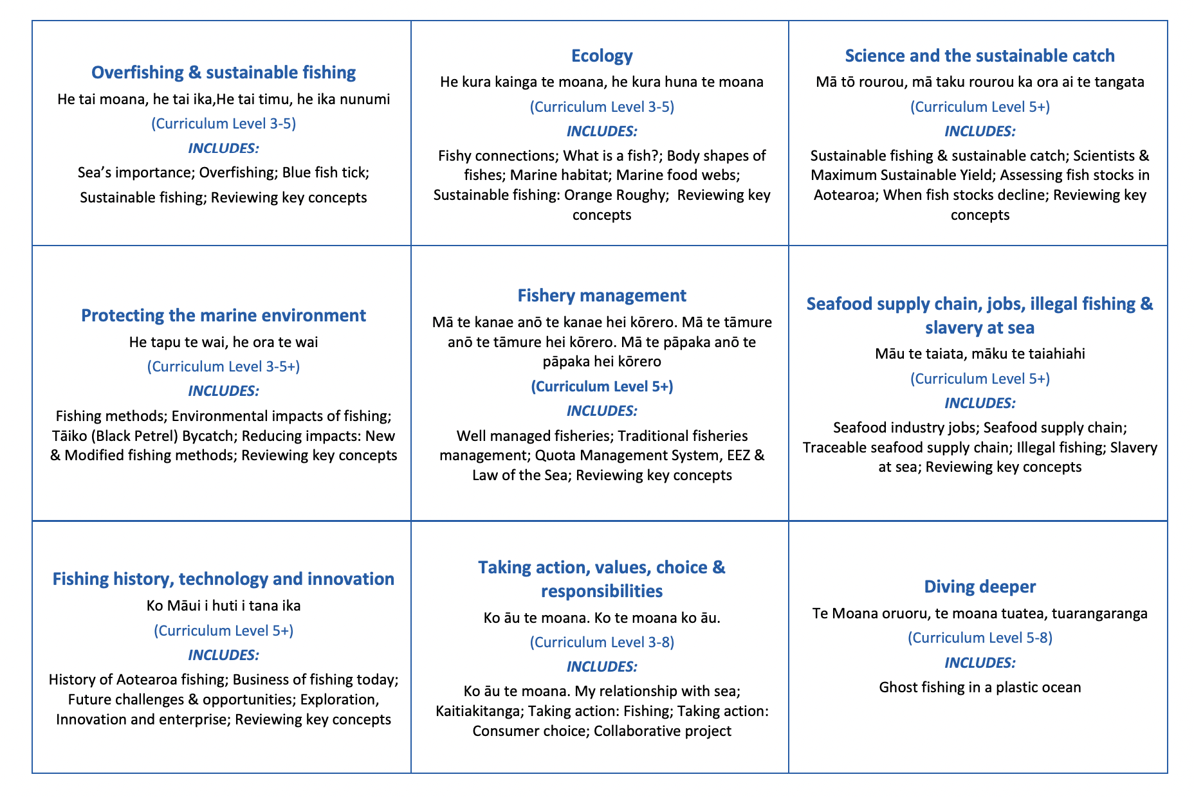
HELPFUL STUFF FOR TEACHERS
Welcome to OUR STORY!
This topic is about taking action, choice, values and responsibility … aka ocean citizenship!
Notes:
TEACHER NOTES

Slide 5
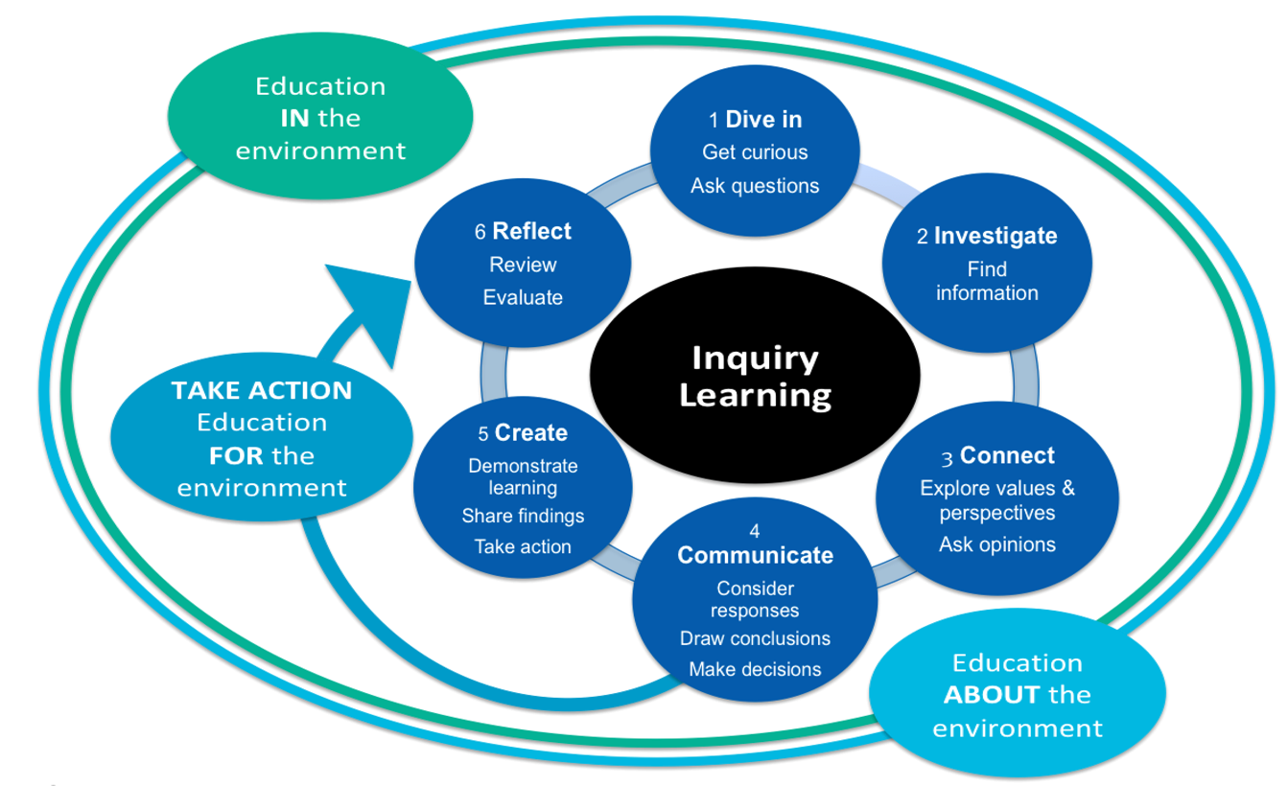
HELPFUL STUFF FOR TEACHERS
Notes:
TEACHER NOTES

Slide 6
IN THIS TOPIC WE WILL LEARN ABOUT…
Develop a sense of connectedness and tūrangawaewae with the sea and coast
Understand that different people value and use the sea and coast differently
Explore different viewpoints people have about the sea and use of ocean resources
Understand the reciprocal nature of kaitiakitanga
Investigate personal actions that we can take that make a difference to the health of the ocean and sustainability kai moana [seafood] resources
Identify an issue to do with sustainability of kai moana resources & the sea & collaboratively work to plan &carry out an action to help address the issue
Use specialised words and terms in relation to ocean sustainability
Notes:
TEACHER NOTES

Slide 7
MIHI / INTRODUCTION
Can you imagine a world without fish?
What would that be like?
No more sushi! No more fishing!
No more fish & chips! No more….?
Notes:
TEACHER NOTES
Try to get learners to connect with the personal impact of overfishing and unsustainable practices. What would it be like for ME if there were few or no fish left in the sea!

Slide 8
MIHI / INTRODUCTION
The good news is… some special people are working hard to make sure this doesn’t happen!
In this topic look more closely at our relationship with the ocean and how we can ensure our ocean and kai moana are managed sustainably
Let’s take a moment to think about our connection
with the sea?
Notes:
TEACHER NOTES

Slide 9
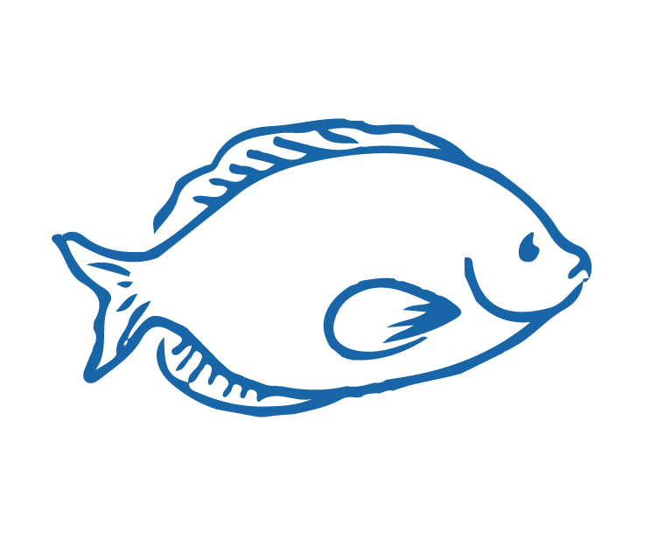
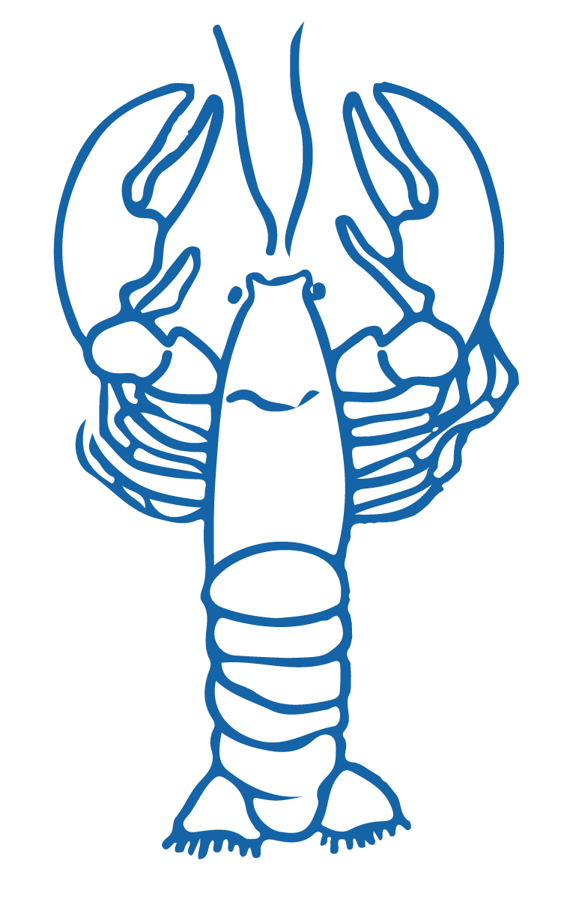
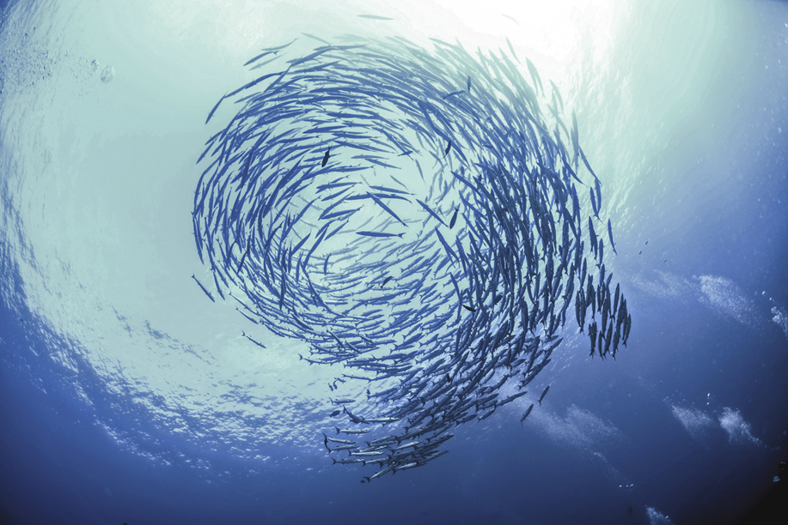
KO ĀU TE MOANA, KO MOANA TE ĀU Focus Question: How do I feel connected to the sea? How do different people value the sea? What different viewpoints do people hold about the sea? What is my viewpoint?
KŌRERORERO / DISCUSSION
In te ao Māori [the Māori world]:
- All things are inter-connected
- We are related to the sea through whakapapa [family tree]
HE PĀTAI / CONSIDER THIS
What kai moana [seafood] have you eaten or caught lately?
What beaches have you visited & why?
Notes:
TEACHER NOTES
USEFUL RESOURCES / RĀRANGI PUKAPUKA
To read more about Tangaroa see: https://teara.govt.nz/en/tangaroa-the-sea/print

Slide 10
KO ĀU TE MOANA, KO MOANA TE ĀU
KŌRERORERO / DISCUSSION
In te ao Māori [the Māori world]:
We are related to the sea through whakapapa [family tree]
People and the sea are children of Papatūānuku [earth mother] and Ranginui [sky father]
“Ko au te moana, te moana ko au” [I am the sea, the sea is me]
Source: Te Ara.govt.nz
Notes:
TEACHER NOTES
USEFUL RESOURCES / RĀRANGI PUKAPUKA
To read more about Tangaroa see: https://teara.govt.nz/en/tangaroa-the-sea/print
Image source: Te Ahukaramū Charles Royal, 'Papatūānuku – the land - Papatūānuku – the earth mother', Te Ara - the Encyclopedia of New Zealand,
http://www.TeAra.govt.nz/en/whakapapa/11430/papatuanukus-children
(accessed 14 January 2020)

Slide 11
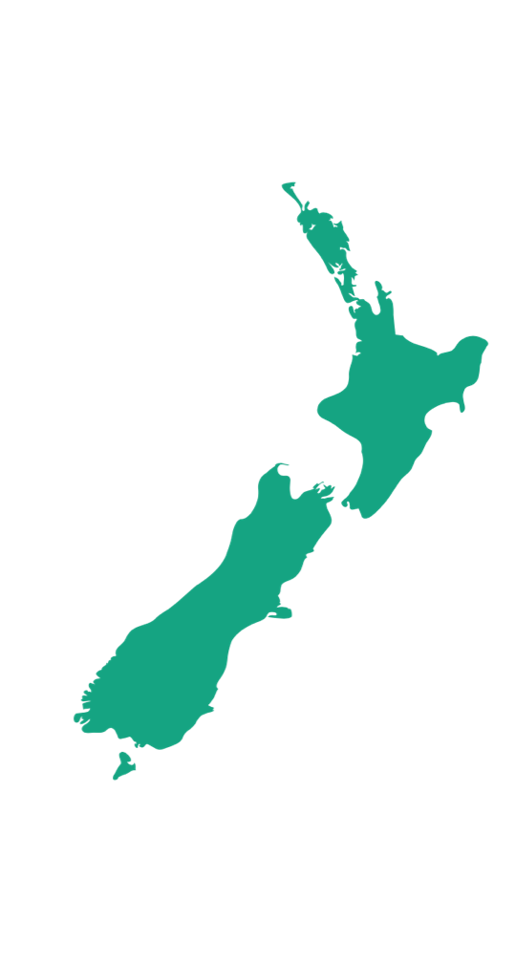
KO ĀU TE MOANA, KO MOANA TE ĀU Focus Question: What is my relationship with the sea?
KŌRERORERO/ DISCUSSION
In Aotearoa New Zealand we have a unique and strong connection to the sea. Find out more about one of the following and present back to the rest of the class: (See Activity 2 Teacher Outline)
Our whenua [land] was fished from the sea [by Maui] and many of our tūpuna [ancestors] were fishing folk
Unlike some other countries most of us live near the sea!
Notes:
TEACHER NOTES
USEFUL RESOURCES / RĀRANGI PUKAPUKA
HISTORY
Te Ara Encyclopedia is a great place to start
GEOGRAPHY
How some counties are more sea than land: https://www.weforum.org/agenda/2017/10/global-ocean-governance-all-at-sea/

Slide 12
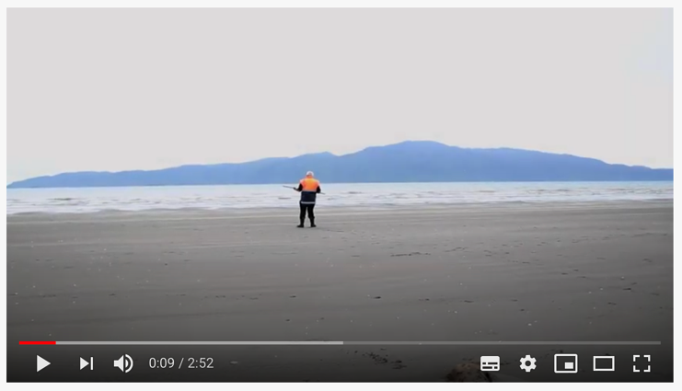
KO ĀU TE MOANA, KO MOANA TE ĀU
MAHI / ACTIVITY
Create a poem, waiata / song, piece of music or picture that conveys what the sea or a coastal place near you means to you
(See Activity 3 Ocean Citizenship Teacher Outline)
MĀTAKI TĒNEI / WATCH THIS
Ko au te Taha Moana. Ko te Taha Moana ko au [2:52]
Notes:
TEACHER NOTES
https://www.youtube.com/watch?v=EFT_SnfASNA&feature=emb_logo

Slide 13
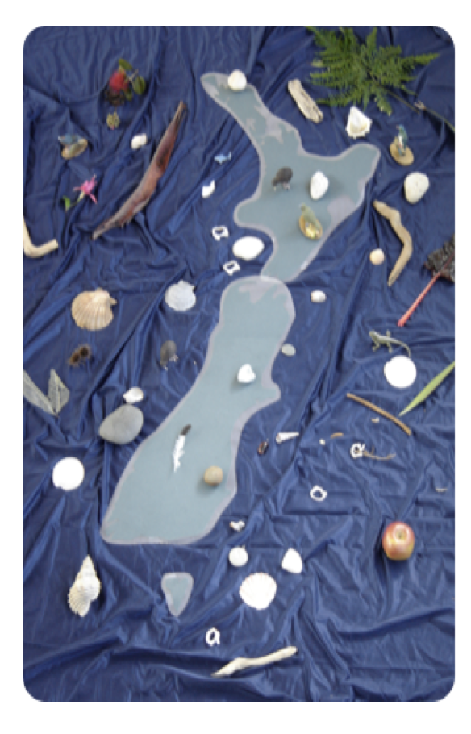
KO ĀU TE MOANA, KO MOANA TE ĀU
MAHI / ACTIVITY
Complete one or more of the following (see Teacher Outline Activities 4, 5, 6)
Identify a taonga o Tangaroa and share significance of this taonga for you
Share how your whānau [family] and tūpuna [ancestors] have used the sea
Make a short film or Powtoon that shares different viewpoints and connections with the sea
[Image and activity from Ministry of Education – Education for Sustainability]
Notes:
TEACHER NOTES
See teacher outline for fully developed activities and resources to support.

Slide 14
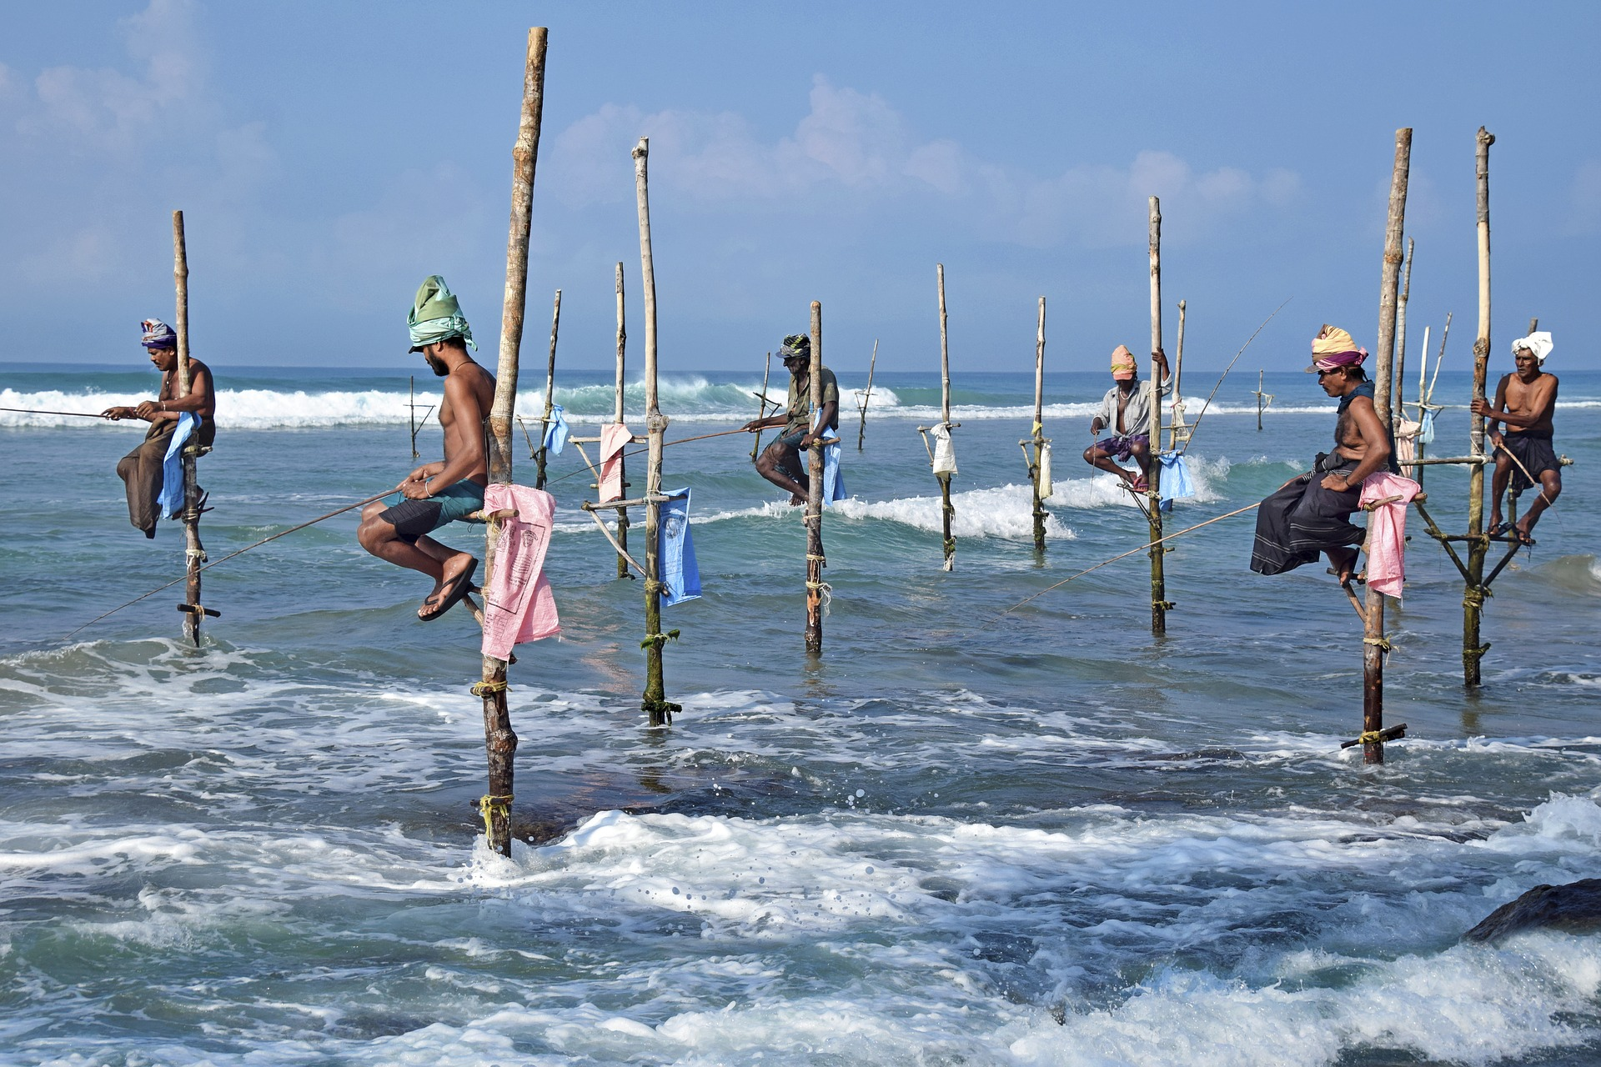
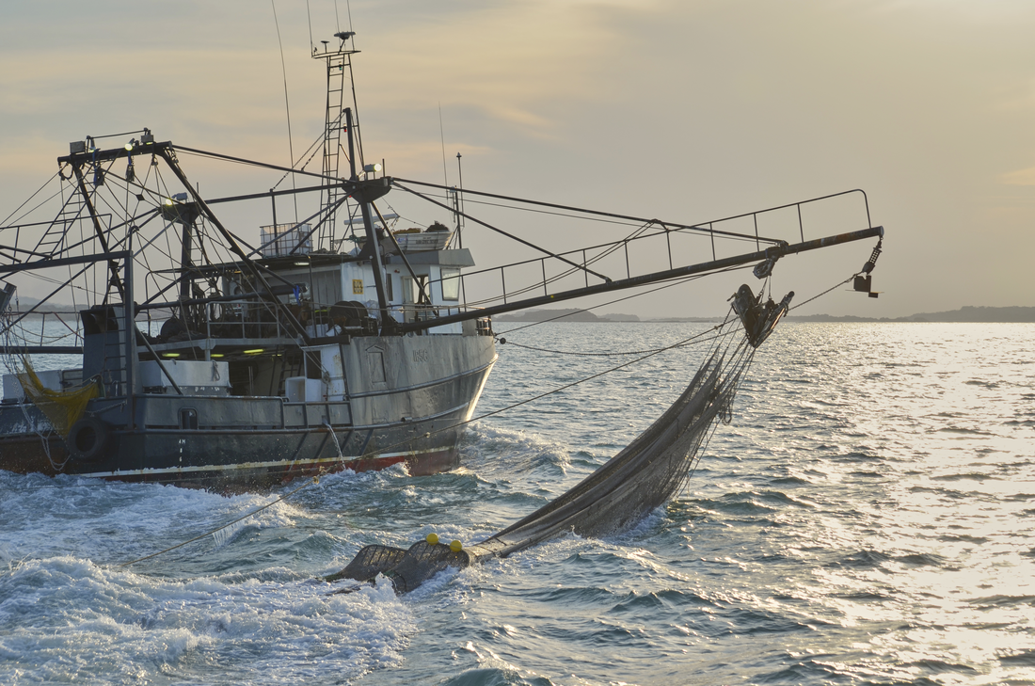
KO ĀU TE MOANA, KO MOANA TE ĀU
MAHI / ACTIVITY
Complete one or more of the following (see Teacher Outline Activities 7, 8, 9, 10)
Visit and connect with a local coastal site
Create a 360°view of a local coastal site
Collect and identify shells from your beach
Investigate other cultural and country viewpoints about the sea?
Conduct a group inquiry
Notes:
TEACHER NOTES
See teacher outline for fully developed activities and resources to support.

Slide 15
KAITIAKITANGA & SUSTAINABILITY Focus Question: What is my role in our kaitiakitanga of the ocean??
KŌRERORERO/ DISCUSSION
Kaitiakitanga is often understood as guardianship
Kaitiakitanga is about reciprocity
The ocean will sustain us only if it is looked after
MAHI / ACTIVITY
Complete the Kaitiakitanga worksheet
He tai moana, he tai ika,
He tai timu, he ika nunumi
A sea that is healthy, is a sea that flourishes with life
A sea in decline, becomes void of sea life
HE PĀTAI / CONSIDER THIS
What does this whakataukī or proverb suggest about looking after our ocean & kai moana [seafood]?
Notes:
TEACHER NOTES

Slide 16
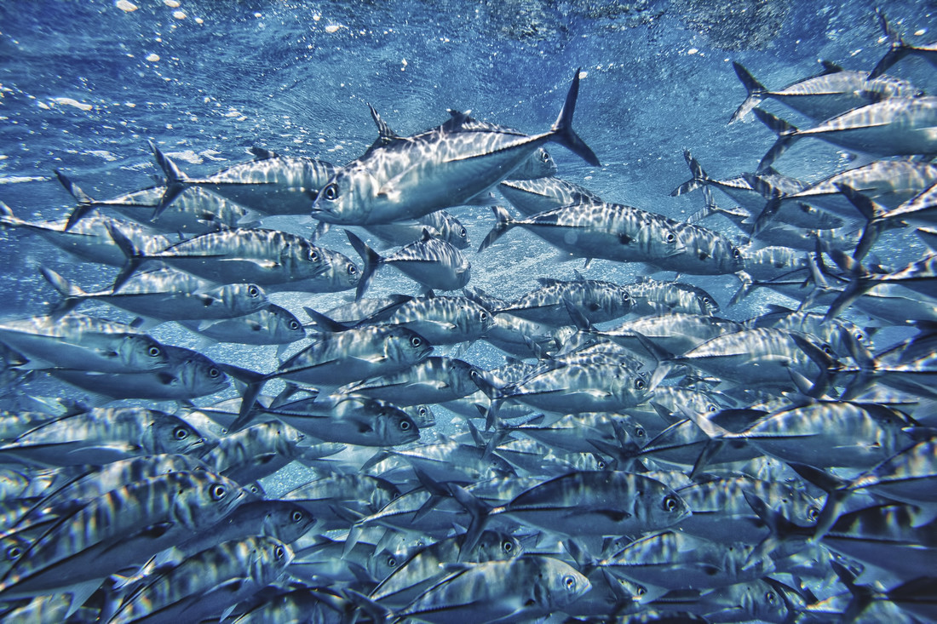
KAITIAKITANGA & SUSTAINABILITY
KŌRERORERO / DISCUSSION
The sea and its bounty is a Taonga Tuku iho [treasure passed down from previous generations]
If we are good kaitiaki [guardians] the sea will provide for generations to come
HE PĀTAI / CONSIDER THIS
Do you agree with this statement? If we are good kaitiaki [guardians] the sea will provide for generations to come - Why / Why not?
Notes:
TEACHER NOTES

Slide 17
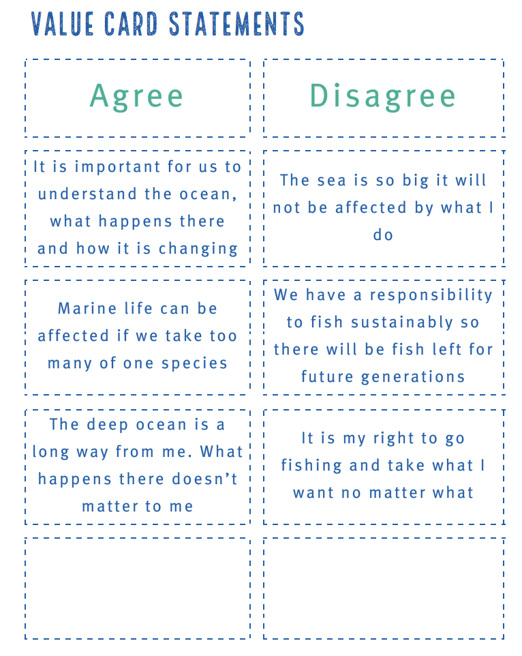
KAITIAKITANGA & SUSTAINABILITY
MAHI / ACTIVITY
Sort value statement cards according to what you agree and disagree with
(see Teacher Outline for cards)
Notes:
TEACHER NOTES
See teacher outline for fully developed activities and resources to support.

Slide 18
KAITIAKITANGA & SUSTAINABILITY
HE PĀTAI / CONSIDER THIS
People all over the world are thinking about looking after our environment
‘Sustainability’ is a term used when talking about the future of our planet!
Think about what you do every day (what you eat, where you live, what you buy…. What does the word ‘sustainability’ mean to you?
Sustainability is:
“development that meets the needs of the present without compromising the ability of future generations to meet their own needs”
Notes:
TEACHER NOTES
USEFUL RESOURCES / RĀRANGI PUKAPUKA
This definition of sustainable development comes from the Brundtland Report: Our Common Future. See: https://sustainabledevelopment.un.org/content/documents/5987our-common-future.pdf (see paragraph 27)

Slide 19
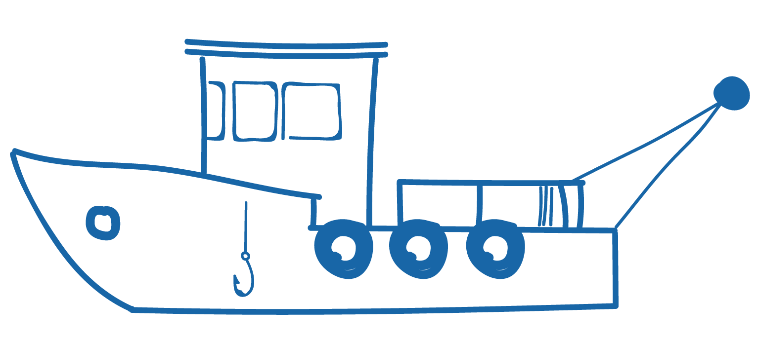
KAITIAKITANGA & SUSTAINABILITY
MAHI / ACTIVITY
Place yourself along a continuum (line) with strongly agree at one end & strongly disagree at the other based on your belief around the following statement:
“Human needs and requirements are more important than the protection of the environment. Resources (including seafood) should be fully exploited for human development.”
Strongly agree
Strongly disagree
Notes:
TEACHER NOTES
USEFUL RESOURCES / RĀRANGI PUKAPUKA
This definition of sustainable development comes from the Brundtland Report: Our Common Future. See: https://sustainabledevelopment.un.org/content/documents/5987our-common-future.pdf (see paragraph 27)

Slide 20
KAITIAKITANGA & SUSTAINABILITY
MAHI / ACTIVITY
Place yourself along a continuum (line) with strongly agree at one end & strongly disagree at the other based on your belief around the following statement:
“The ocean is a food basket. Marine life and other ocean resources primarily provide us with food and other uses.”
Strongly agree
Strongly disagree
Notes:
TEACHER NOTES
USEFUL RESOURCES / RĀRANGI PUKAPUKA
This definition of sustainable development comes from the Brundtland Report: Our Common Future. See: https://sustainabledevelopment.un.org/content/documents/5987our-common-future.pdf (see paragraph 27)

Slide 21
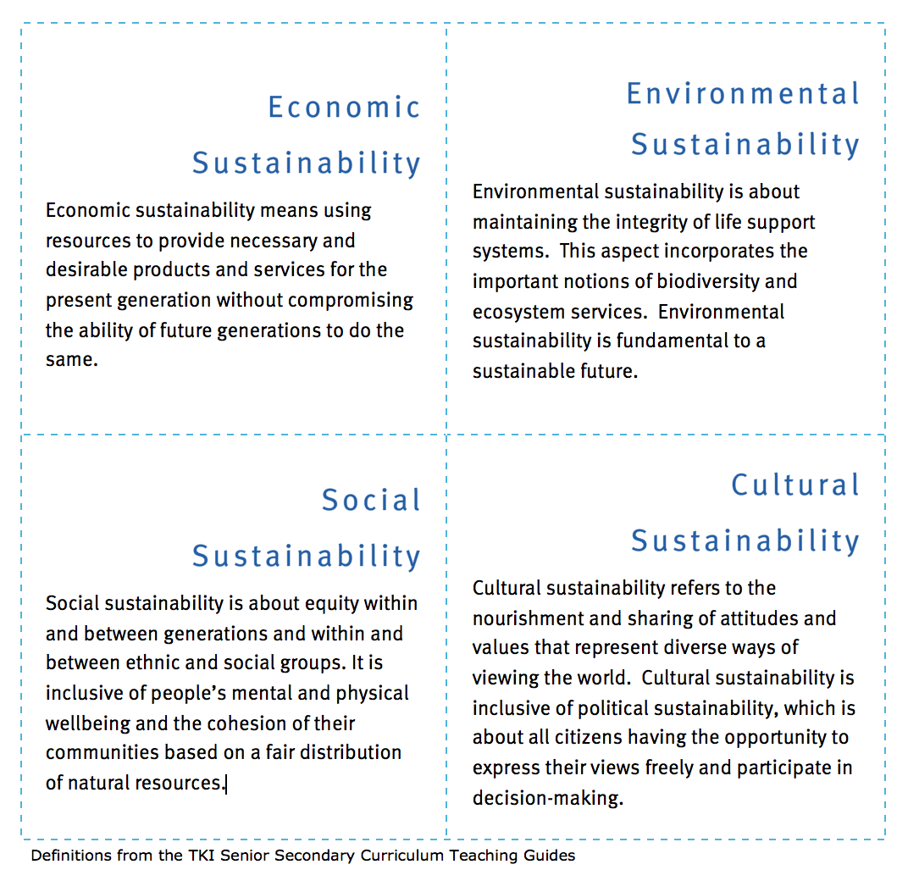
KAITIAKITANGA & SUSTAINABILITY
FOR THE EXPERTS!
HE PĀTAI / CONSIDER THIS
Consider different aspects of sustainability
Think about overfishing. Which aspect would each of the following relate to?
Notes:
TEACHER NOTES
Hoki story can be found at http://new-zealand-hoki.msc.org/

Slide 22
KAITIAKITANGA & SUSTAINABILITY
FOR THE EXPERTS!
KŌRERO PUKAPUKA / READ
Read the New Zealand Hoki story
MAHI / ACTIVITY
Consider different aspects of sustainability as they apply to the story of New Zealand hoki
(See Aspects of sustainability activity in Teacher Outline)
Notes:
TEACHER NOTES
Hoki story can be found at http://new-zealand-hoki.msc.org/

Slide 23
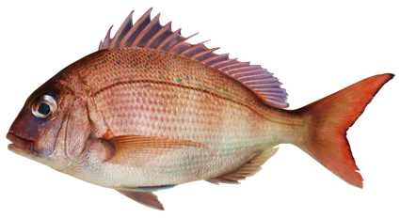
TAKING ACTION: FISHING Focus Question: What actions can I take to help the health of kai moana [seafood] resources?
KŌRERORERO / DISCUSSION
In Aotearoa, we have limits and rules for commercial, customary and recreational fishers. If you break the rules you can be fined up to $250,000 and have your fishing gear (and boat) taken away. Rules include:
daily bag limits (how many fish you can keep)
legal size limits (the size of fish you can keep)
species restrictions (the type of fish you can keep)
closed and restricted areas (where you can’t fish)
MAHI / ACTIVITY
Measure the fork length of a snapper [see Teacher Outline]
Notes:
TEACHER NOTES
Adapted from an activity by Blake Org

Slide 24
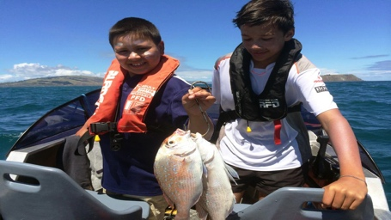
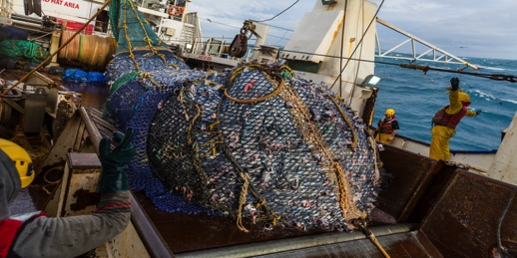
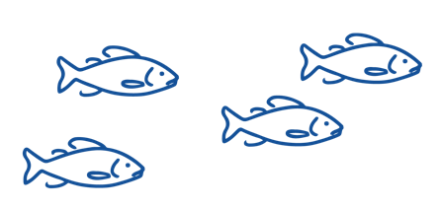
TAKING ACTION: FISHING
50% of fish are allocated to RECREATIONAL fishers and for CUSTOMARY MĀORI fishing
Recreational and customary fishers are not allowed to SELL their catch
There are size and catch limits for fish they can take
KŌRERORERO / DISCUSSION
50% of fish are allocated to COMMERCIAL fishers
They must BUY quota for each species of fish they want to catch
A commercial fisher must have quota in order to fish commercially
Photo: Ministry for the Environment
Notes:
TEACHER NOTES

Slide 25
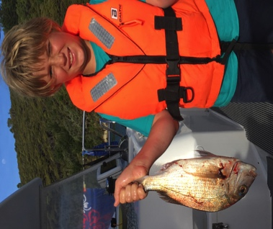
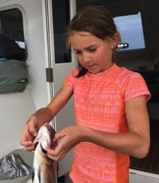
TAKING ACTION: SUSTAINABILITY & FISHING
HE PĀTAI / CONSIDER THIS
Why can’t these kids sell their fish? Is this fair?
Imagine a commercial fisher sees a recreational fisher at the wharf selling fish, what might they feel / say?
Have you ever caught a fish? Or thrown an undersized fish back in to the sea?
MAHI / ACTIVITY
Complete Customary
and Recreational Fisheries Worksheet
Source: Ministry for
the Environment
Notes:
TEACHER NOTES

Slide 26
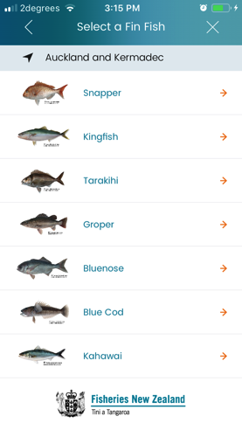
TAKING ACTION: FISHING
MAHI / ACTIVITY
Imagine you are going out for a day’s fishing with four members of your whānau {family]
Download the free NZ Fishing Rules app to see:
a) how much snapper you can legally catch?
b) what is the smallest snapper you are allowed to catch?
c) what should you do if you catch a snapper smaller than this?
NZ Fishing Rules
Notes:
TEACHER NOTES
Adapted from an activity by Blake Org

Slide 27
TAKING ACTION: CONSUMER CHOICE Focus Question: What actions can I take to help the health of kai moana [seafood] resources?
MAHI / ACTIVITY
(Viewpoint Continuum: see Teacher Outline)
There are many different viewpoints!
Place yourself along a continuum (line), based on your belief around the following statement:
“Consumers have a powerful role to play in influencing the production of goods”
Strongly agree
Strongly disagree
Notes:
TEACHER NOTES
Adapted from an activity by MBI on consumer protection.
See https://www.consumerprotection.govt.nz/resources-2/school-resources/year-9-10-school-resources/module-2-consumer-power/

Slide 28
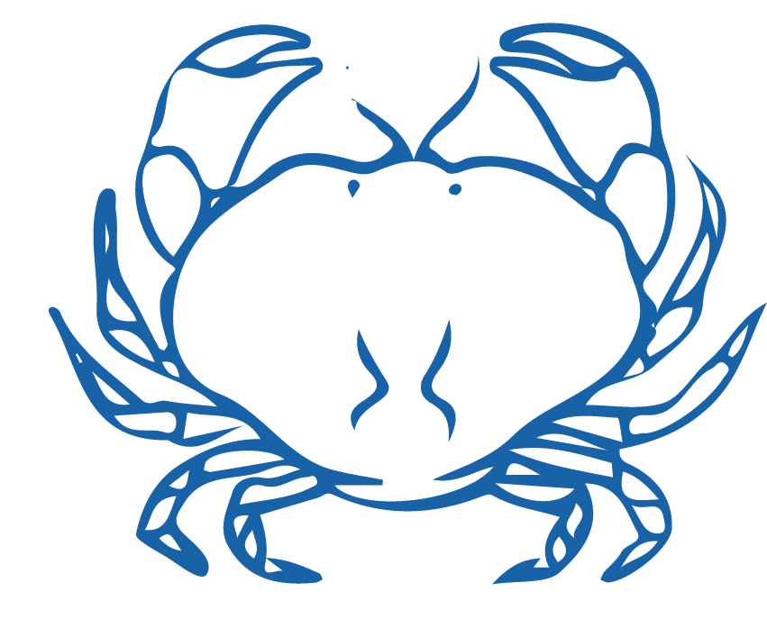
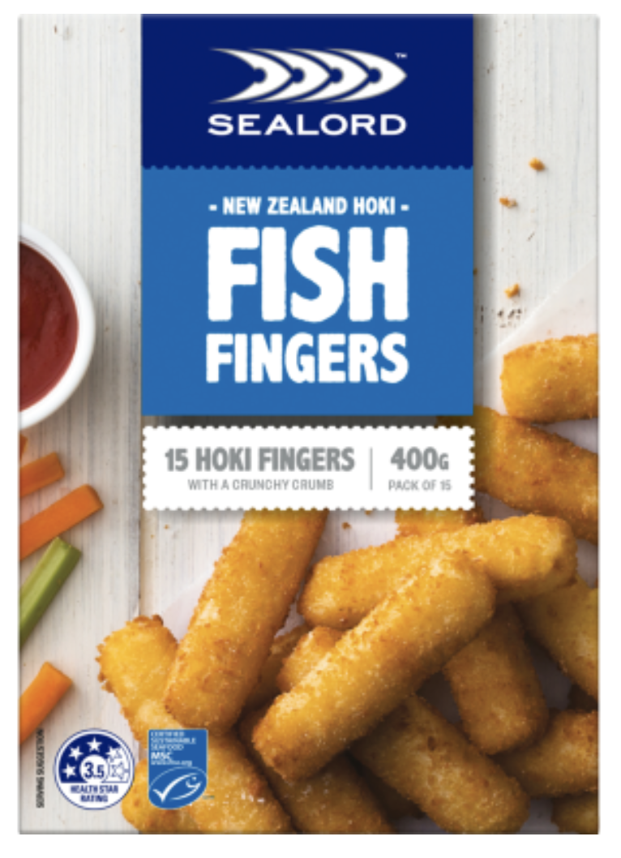
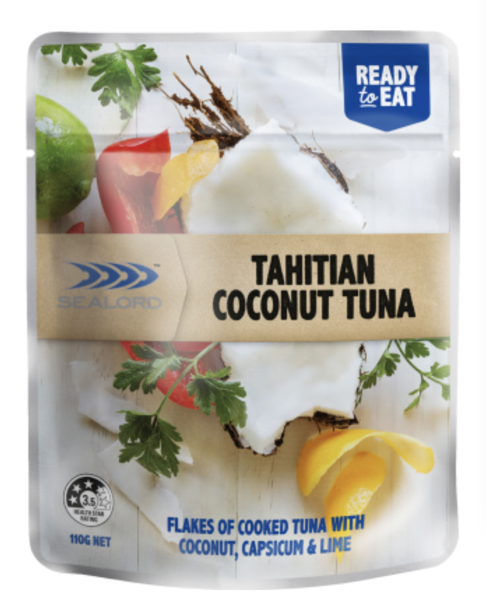
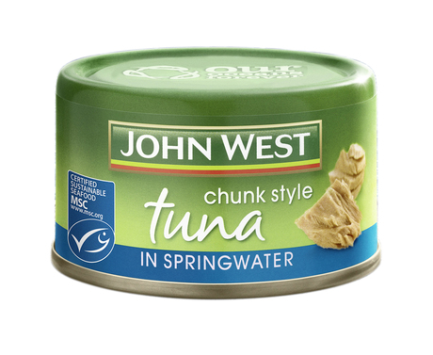
TAKING ACTION: CONSUMER CHOICE
KŌRERORERO/ DISCUSSION
A lot of thinking and research has gone in to trying to figure out what makes people buy one product over another
HE PĀTAI / CONSIDER THIS
What makes you buy one product over another? Is it the product, the packaging or….?
Notes:
TEACHER NOTES

Slide 29
TAKING ACTION: CONSUMER CHOICE
MAHI / ACTIVITY
Rank your preferred products 1-4. Give reasons for your choices.
$5.49 per box
$1.37 per 100g
$2.00 per can
$2.10 per 100g
$5.99 per box
$2.22 per 100g
$2.79 per sachet
$2.54 per 100g
Notes:
TEACHER NOTES
Reasons might include:
MSC label / environmentally driven decisions
Price – economically driven decisions
Taste / flavour
Look
Packaging
Brand
Other

Slide 30
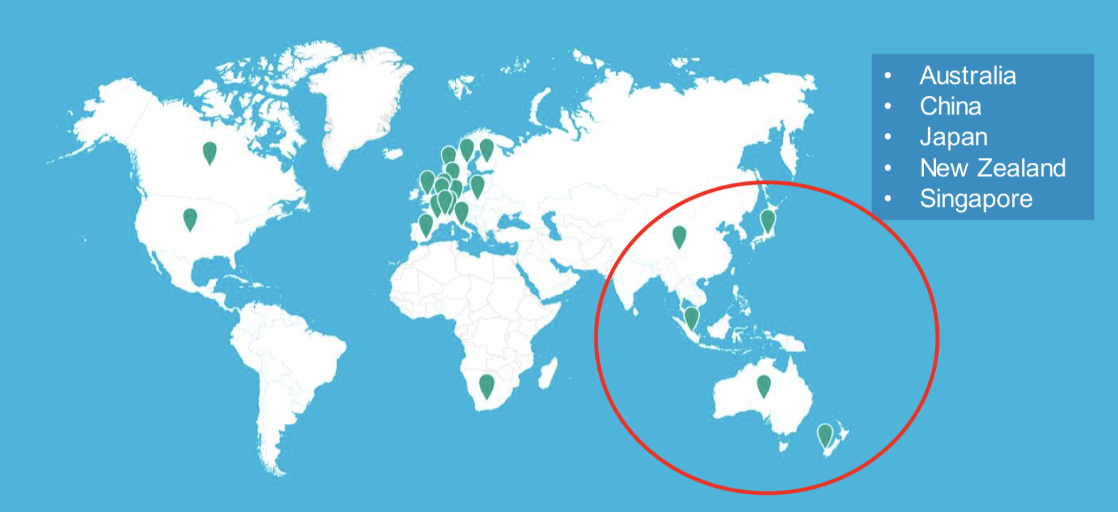
TAKING ACTION: CONSUMER CHOICE
KŌRERORERO/ DISCUSSION
Every couple of years Marine Stewardship Council conduct an independent survey to find out what seafood consumers are thinking!
Results from 2020 Asia Pacific survey of more than 5,700 consumers found 4,578 were seafood consumers
Notes:
TEACHER NOTES
USEFUL RESOURCES / RĀRANGI PUKAPUKA
For the full MSC slide show and more data see:
https://www.msc.org/docs/default-source/default-document-library/for-business/msc-globescan-understanding-consumers-webinar-deck---asia-pacific.pdf?sfvrsn=1abf2180_4

Slide 31
TAKING ACTION: CONSUMER CHOICE
HE PĀTAI /
CONSIDER THIS
The 2020 survey found 30% of seafood consumers felt strongly that their favourite sea food would not be available in 20 years time!
What do you think?
Notes:
TEACHER NOTES
USEFUL RESOURCES / RĀRANGI PUKAPUKA
For the full MSC slide show and more data see:
https://www.msc.org/docs/default-source/default-document-library/for-business/rise-of-the-conscious-food-consumer---asia-pacific-webinar-slides.pdf?sfvrsn=b5a32860_4

Slide 32
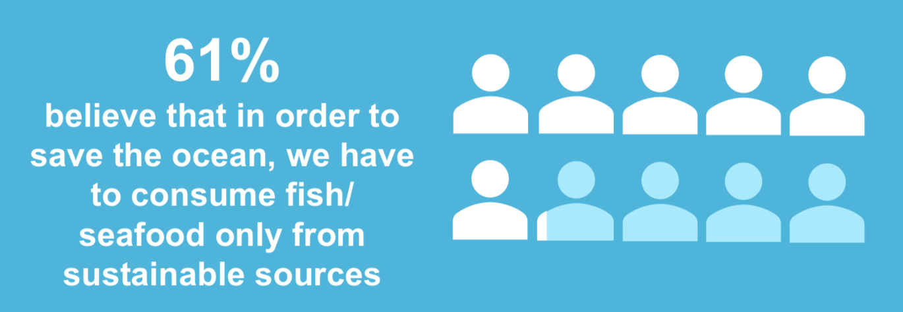
TAKING ACTION: CONSUMER CHOICE
Notes:
TEACHER NOTES
USEFUL RESOURCES / RĀRANGI PUKAPUKA
For the full MSC slide show and more data see:
https://www.msc.org/docs/default-source/default-document-library/for-business/msc-globescan-understanding-consumers-webinar-deck---asia-pacific.pdf?sfvrsn=1abf2180_4

Slide 33
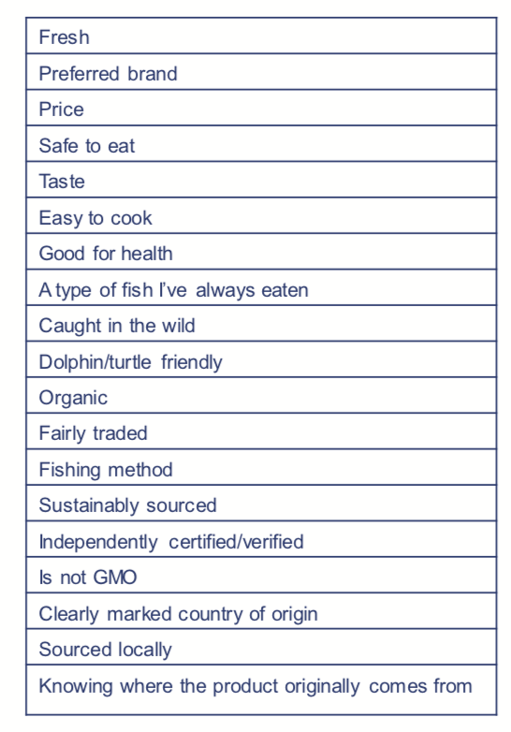
TAKING ACTION: CONSUMER CHOICE
HE PĀTAI / CONSIDER THIS
What factors motivates you when purchasing kai moana?
MAHI / ACTIVITY
Rank your top three motivations when buying seafood. Record all individual results and then graph to show results for your entire group / rōpu
Notes:
TEACHER NOTES
USEFUL RESOURCES / RĀRANGI PUKAPUKA
For the full MSC slide show and more data see:
https://www.msc.org/docs/default-source/default-document-library/for-business/msc-globescan-understanding-consumers-webinar-deck---asia-pacific.pdf?sfvrsn=1abf2180_4

Slide 34
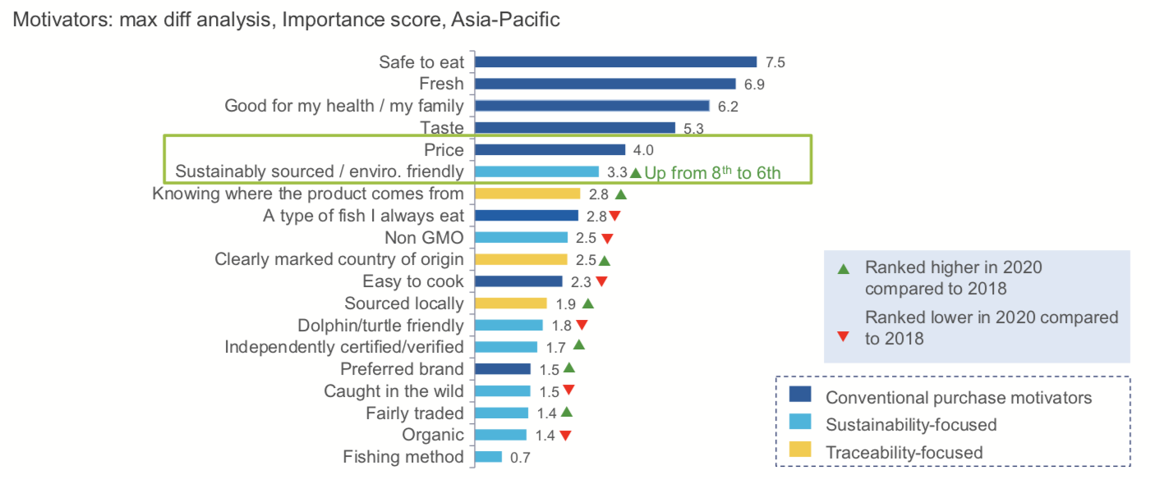
TAKING ACTION: CONSUMER CHOICE
HE PĀTAI /
CONSIDER THIS
In 2020 MSC found conventional factors such as freshness were the main factors influencing choice
How does this compare with your group / rōpu results?
Notes:
TEACHER NOTES
USEFUL RESOURCES / RĀRANGI PUKAPUKA
For the full MSC slide show and more data see:
https://www.msc.org/docs/default-source/default-document-library/for-business/msc-globescan-understanding-consumers-webinar-deck---asia-pacific.pdf?sfvrsn=1abf2180_4

Slide 35
TAKING ACTION: CONSUMER CHOICE
MAHI / ACTIVITY (see Teacher Outline)
Conduct a survey (using Google Survey or similar) of whānau. Include questions such as:
Do you consider sustainable & ethical issues before purchasing?
Would you buy a fish of lesser quality if it were more sustainable?
Would you spend more on an equivalent fish if it was certified as sustainable?
Would you stop buying seafood if it was not caught sustainably?
Notes:
TEACHER NOTES
Analyse the data from this survey by presenting it in a series of graphs.
Have the students analyse the results by reading and interpreting the graphs.
Can they suggest explanations for the results?
Find results from a global study on consumer trends and compare these with the class survey results.

Slide 36
TAKING ACTION: CONSUMER CHOICE
MAHI / ACTIVITY
Revisit the continuum – have your views changed? Why / Why not?
“Consumers have a powerful role to play in influencing the production of goods”
MAHI / ACTIVITY
Have another go ranking products on slide ??
Have your rankings changed?
Why / Why not?
Strongly agree
Strongly disagree
Notes:
TEACHER NOTES
USEFUL RESOURCES / RĀRANGI PUKAPUKA
https://www.msc.org/docs/default-source/default-document-library/about-the-msc/msc-consumer-survey-2016-infographic-seafood-consumers-put-sustainability-before-price-and-brand.pdf

Slide 37
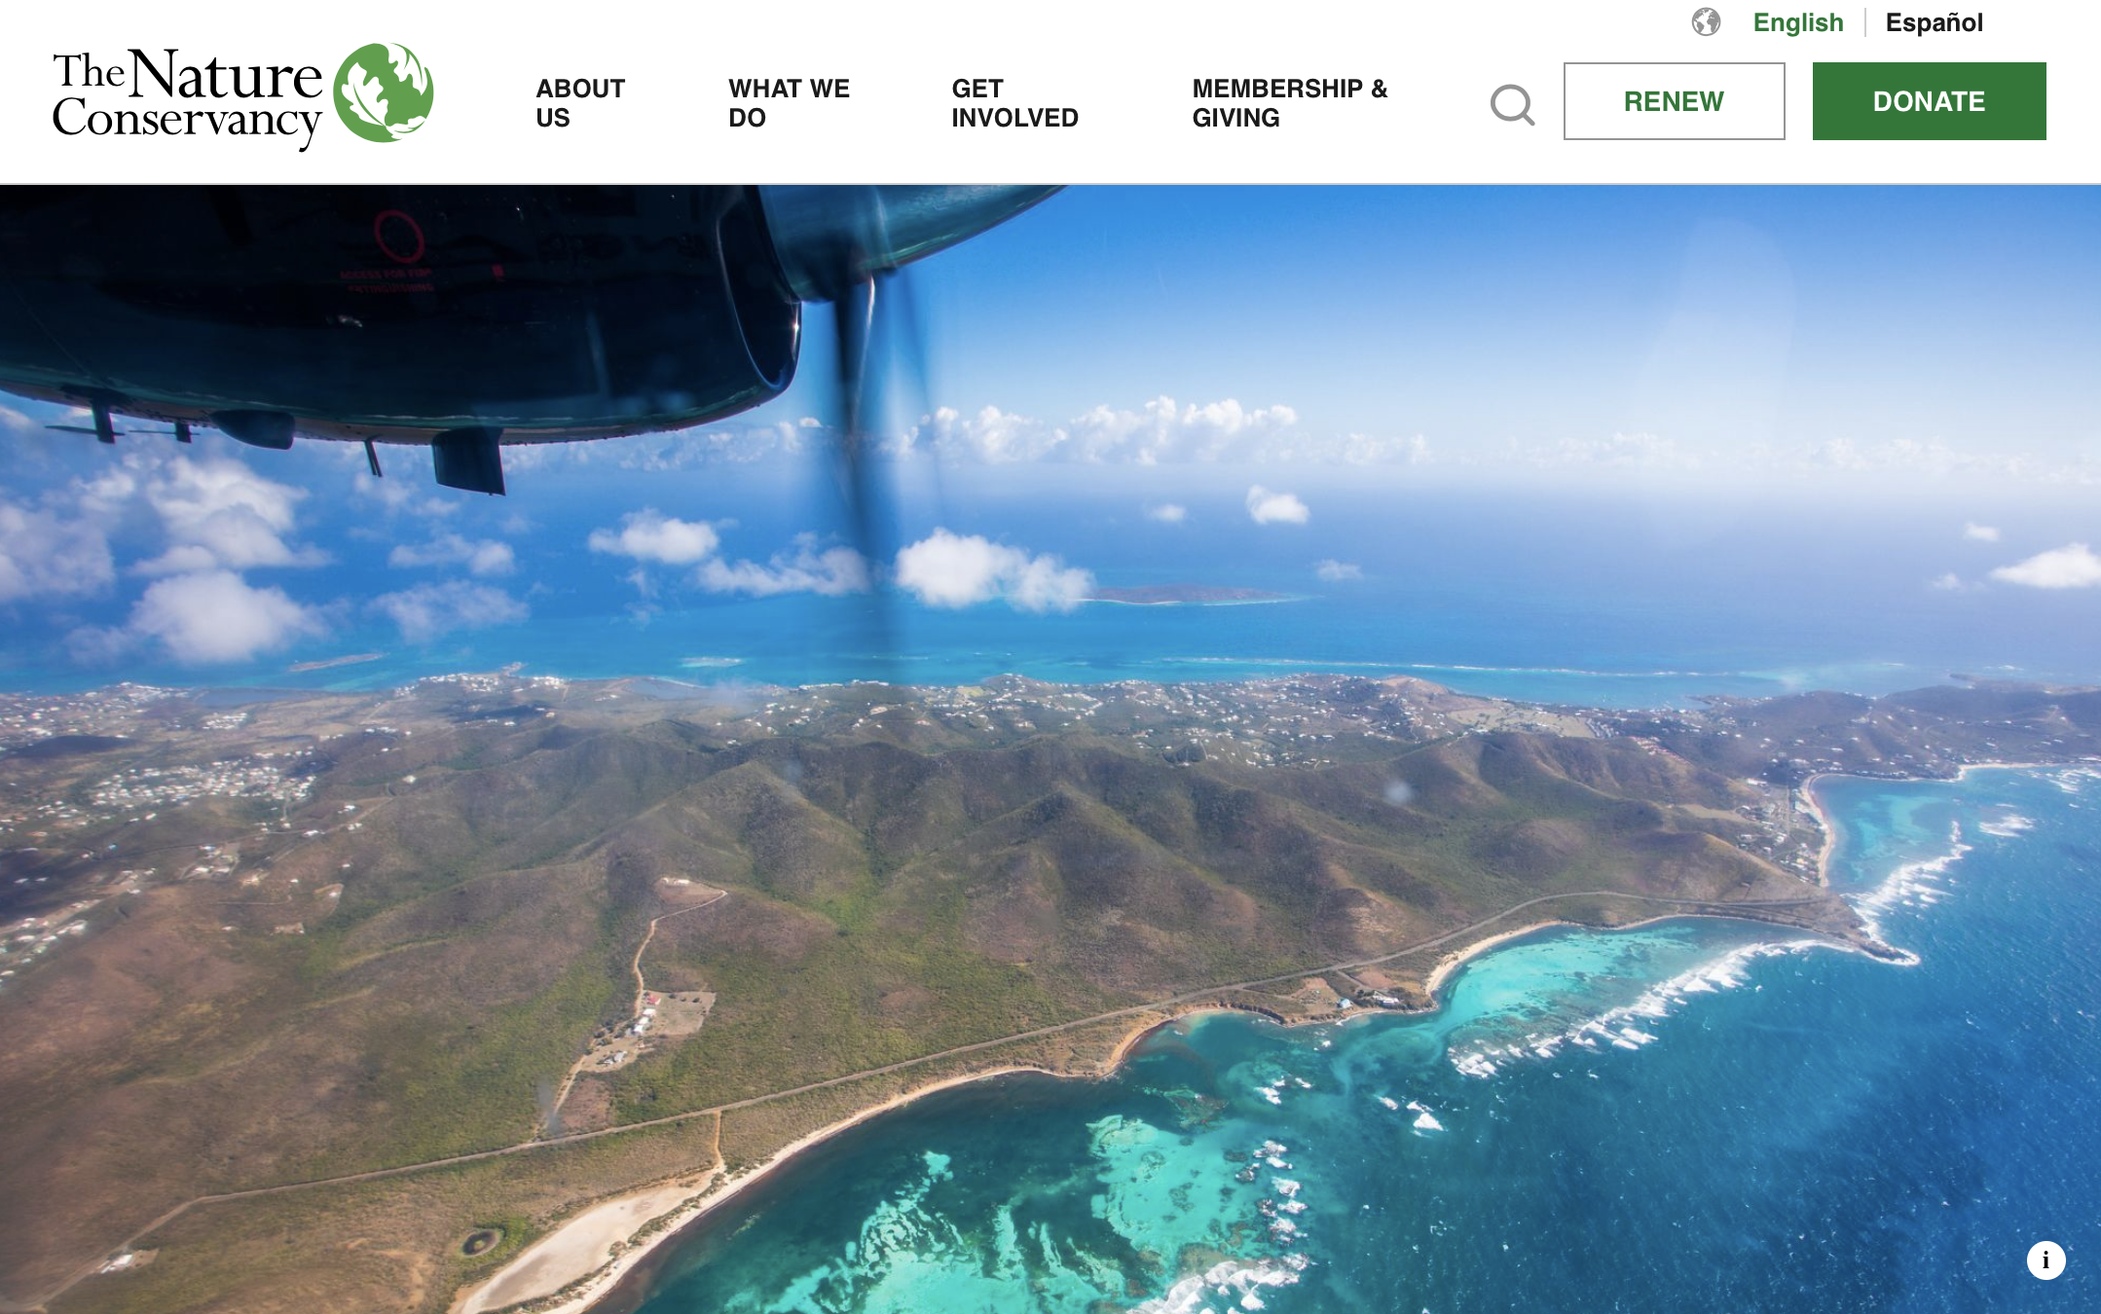
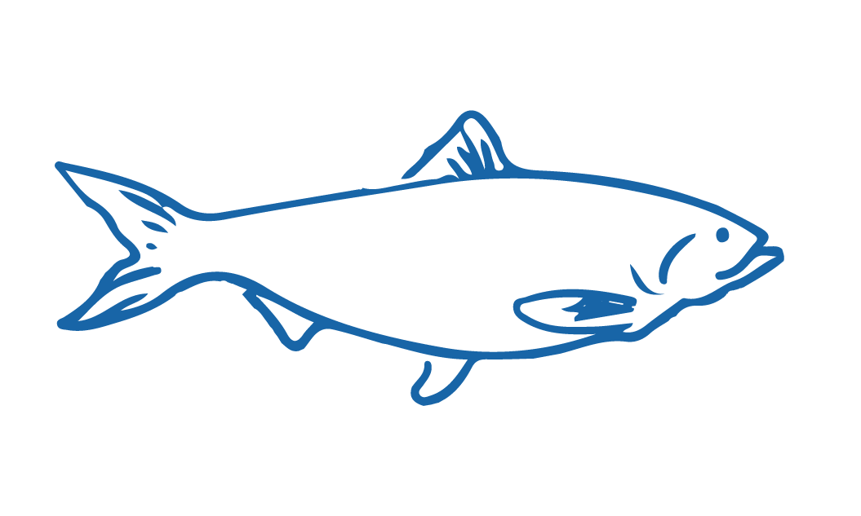
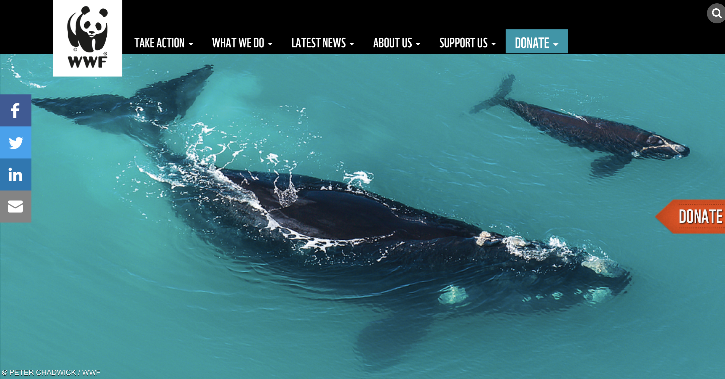
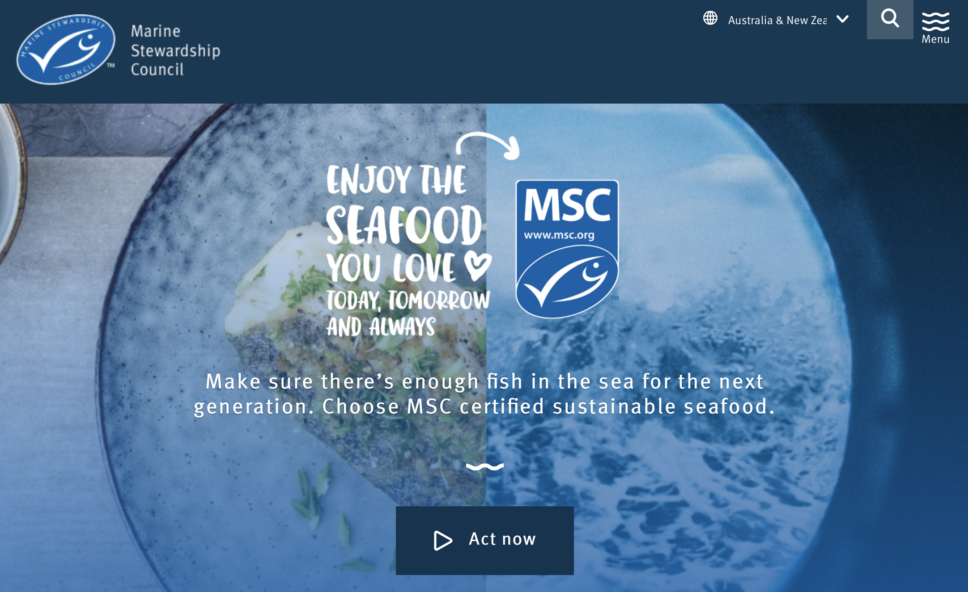
WHAKAPUĀWAI: COLLABORATIVE ACTION Focus Question: How can we collaboratively work to plan & carry out an action to help address an marine environmental issue?
MAHI / ACTIVITY
In groups, research and list ten different organisations that are working to conserve and protect our oceans. What do they do?
Select the one group and present back to the rest of your class / rōpū
Notes:
TEACHER NOTES

Slide 38
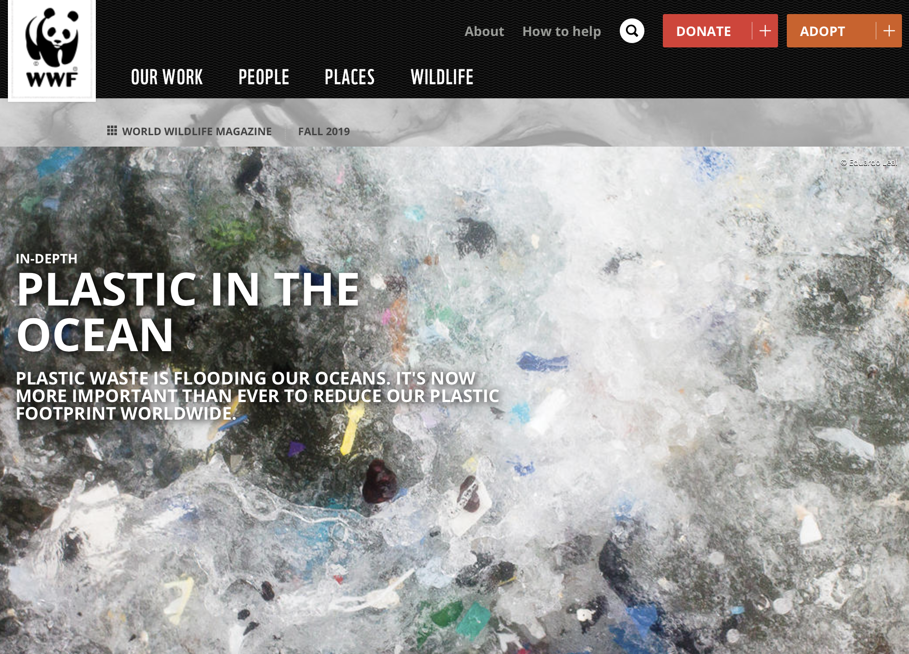
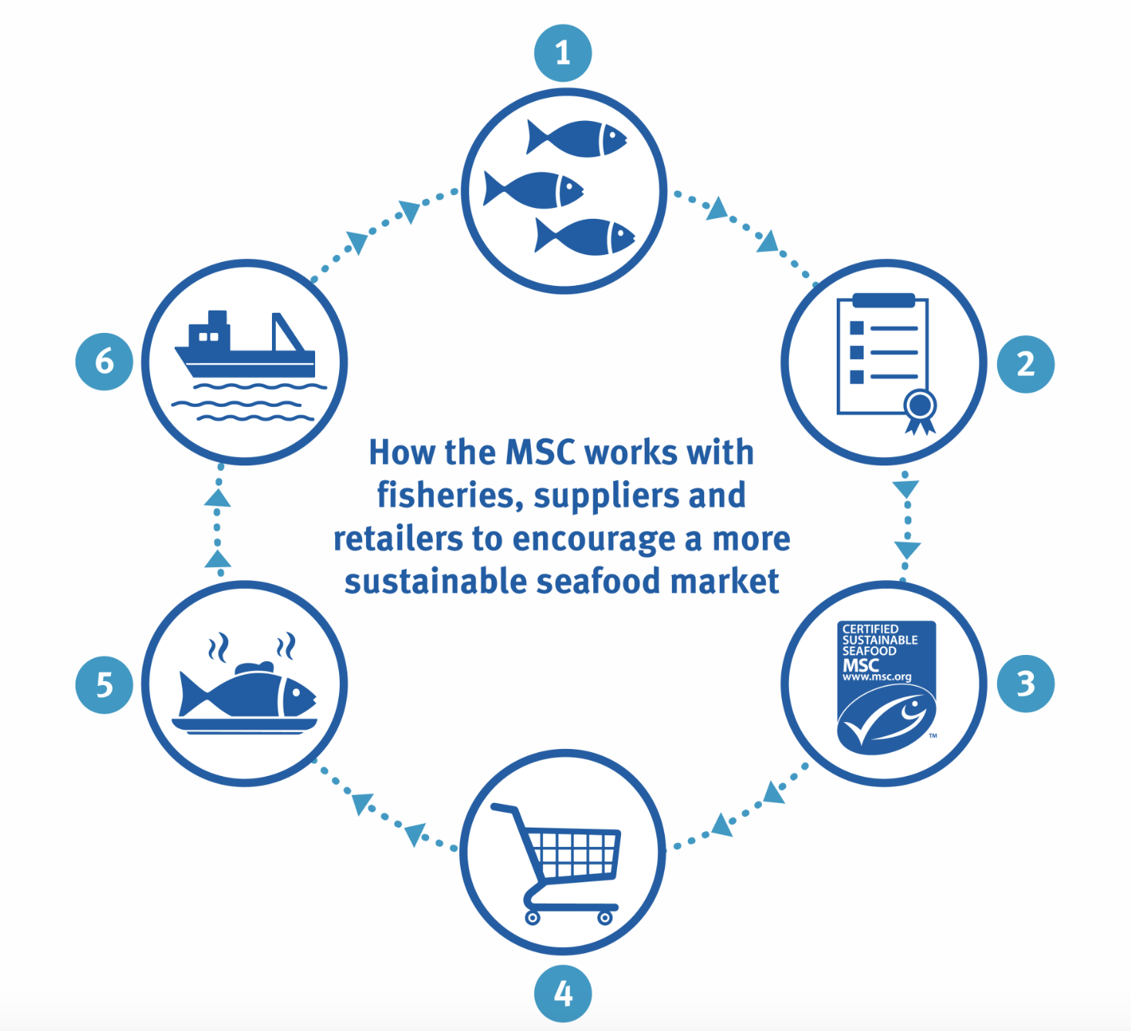
WHAKAPUĀWAI: COLLABORATIVE ACTION
MAHI / ACTIVITY
Make a LIST of issues currently affecting our oceans
SELECT three that you would personally like to work on
SHARE and discuss with a friend
Notes:
TEACHER NOTES

Slide 39
WHAKAPUĀWAI: COLLABORATIVE ACTION
MAHI / ACTIVITY
CONSIDER ways you could help make a difference for our oceans? Make a LIST! Be specific: Think… Where, Why, Who, When, What & How
Demand plastic free alternatives
Reduce your
carbon footprint
Avoid ocean harming products
Eat
sustainable
seafood
VOTE
on ocean issues
Get outside!
Explore the sea!
Clean up a beach
Notes:
TEACHER NOTES

Slide 40
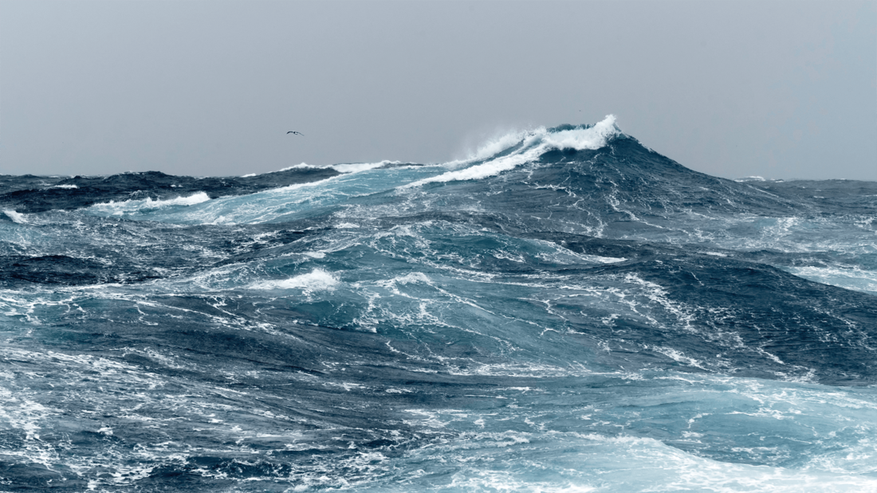
WHAKAPUĀWAI: COLLABORATIVE ACTION
Whakapuāwai Collaborative Inquiry
MAHI / ACTIVITY
IDENTIFY AND DECIDE ON AN ISSUE related to marine conservation
[See Teacher Outline]
Notes:
TEACHER NOTES

Slide 41
WHAKAPUĀWAI: COLLABORATIVE ACTION
Whakapuāwai Collaborative Inquiry
MAHI / ACTIVITY
CLARIFY the vision what is it that we will achieve?
[See Teacher Outline]
Notes:
TEACHER NOTES

Slide 42
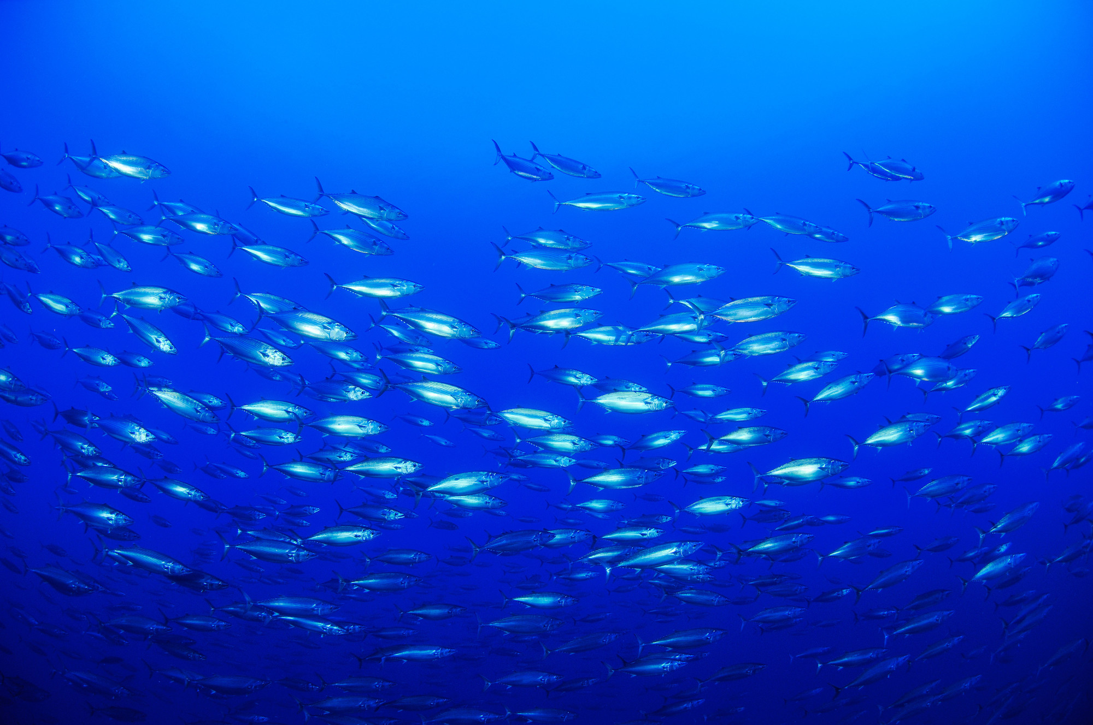
WHAKAPUĀWAI: COLLABORATIVE ACTION
Whakapuāwai Collaborative Inquiry
MAHI / ACTIVITY
Plan the ACTION
What exactly needs to be done to achieve the vision?
Check that your action addresses the issue!
[See Teacher Outline]
Notes:
TEACHER NOTES

Slide 43
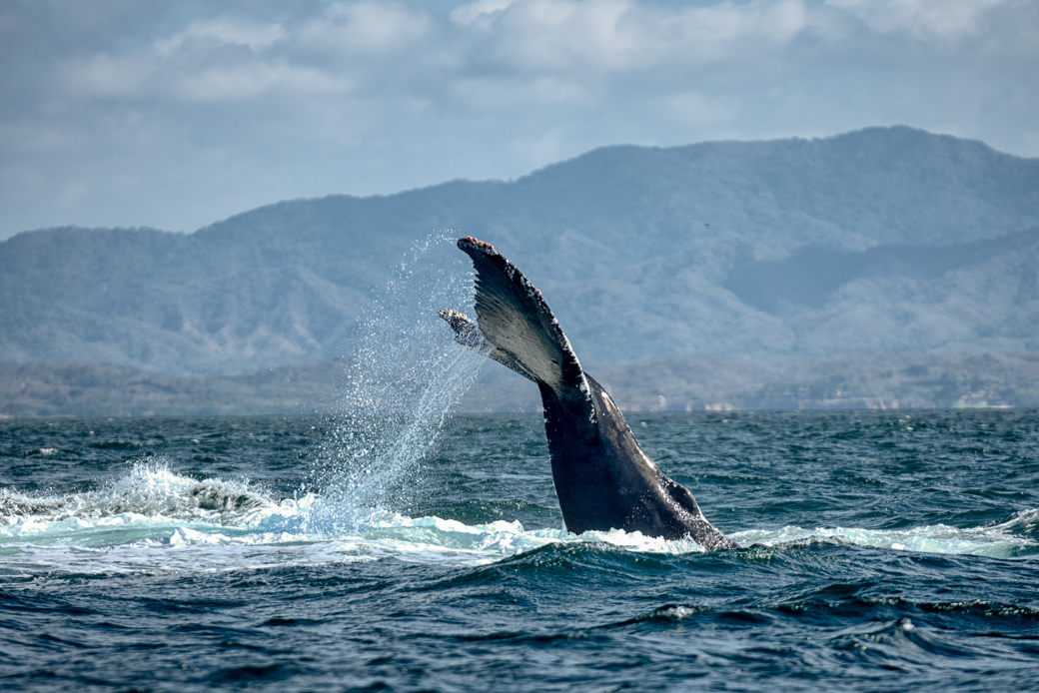
WHAKAPUĀWAI: COLLABORATIVE ACTION
Whakapuāwai Collaborative Inquiry
MAHI / ACTIVITY
Consider SKILLS needed
What skills will be needed to achieve the vision?
[See Teacher Outline]
Ehara taku toa i te toa takitahi, engari he toa takitini
Success does not come from the work of one, but the work of many
Notes:
TEACHER NOTES

Slide 44
WHAKAPUĀWAI: COLLABORATIVE ACTION
Whakapuāwai Collaborative Inquiry
MAHI / ACTIVITY
How will people think and feel about the planned action?
How will you find this out?
[See Teacher Outline]
Notes:
TEACHER NOTES

Slide 45
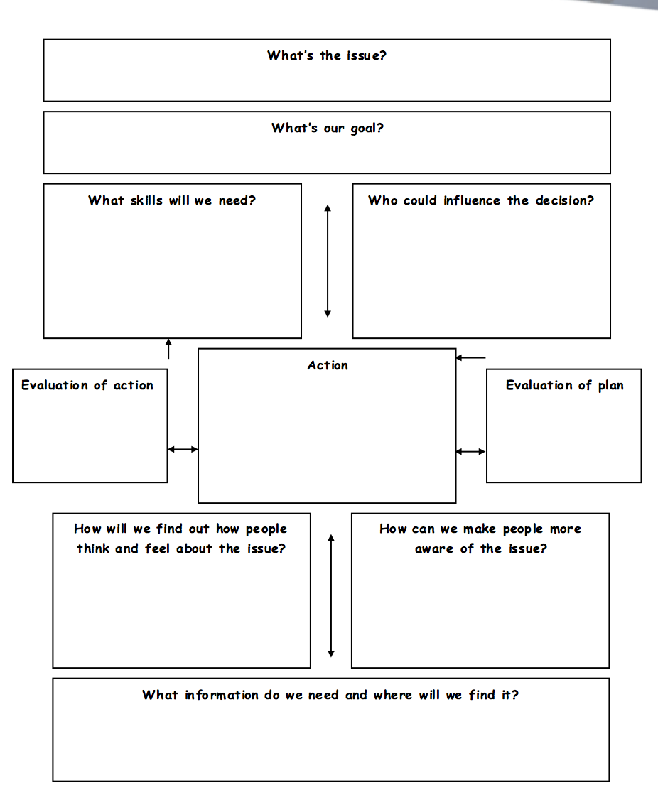
WHAKAPUĀWAI: COLLABORATIVE ACTION
Whakapuāwai Collaborative Inquiry
MAHI / ACTIVITY
DECIDE and ACT
Make some decisions
Create an action plan
Carry out the action!
Notes:
TEACHER NOTES

Slide 46
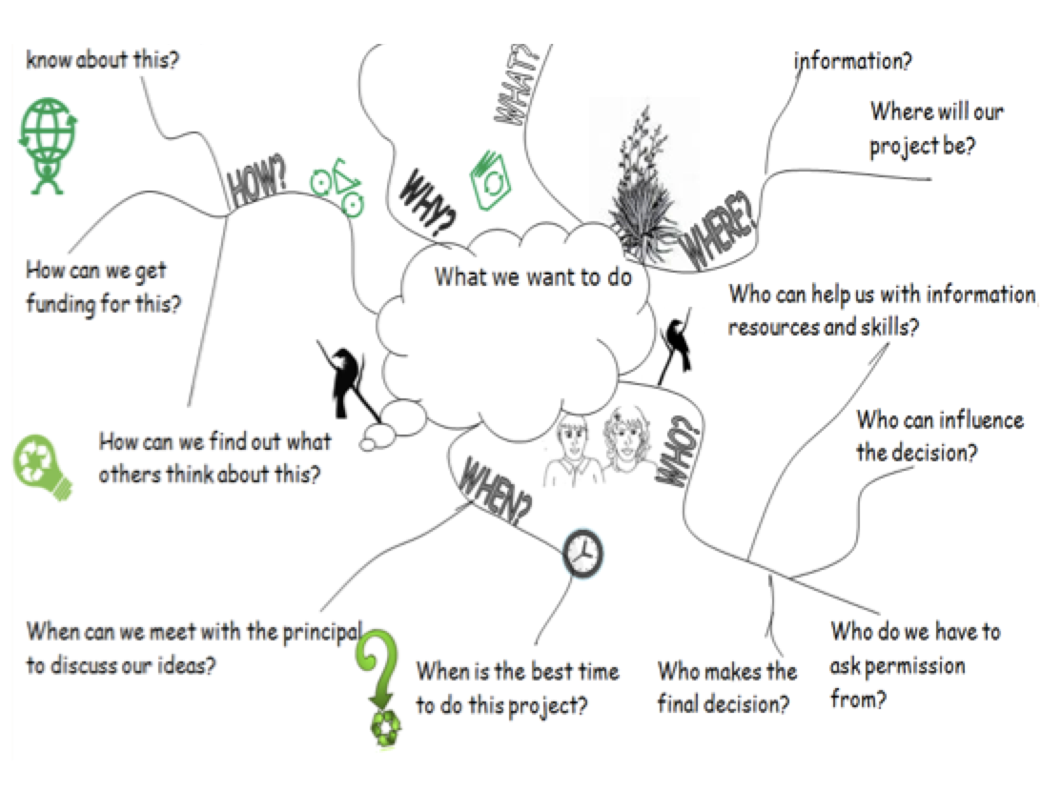
WHAKAPUĀWAI: COLLABORATIVE ACTION
Whakapuāwai Collaborative Inquiry
MAHI / ACTIVITY
DECIDE and ACT
Make some decisions
Create an action plan
Carry out the action!
Notes:
TEACHER NOTES

Slide 47
He tai moana, he tai ika,
He tai timu, he ika nunumi
A sea that is healthy, is a sea that flourishes with life
A sea in decline, becomes void of sea life
Whaktauki or proverb – it outlines a two way context; the need for caring for the ocean or the repercussions of mismanagement of resources
Notes:
TEACHER NOTES

