Slide 1
SEAFOOD SUPPLY CHAIN Focus Question: What are key steps in the chain that delivers seafood from the ocean to our plates
The seafood supply chain is the chain of steps that happens to supply seafood from the ocean to your plate
MAHI / ACTIVITY
What do you already know about the chain of steps in the supply of seafood?
Complete the ‘What we know about fish?’ columns 1 & 2
What do we know about THE SEAFOOD SUPPLY CHAIN? PRIOR KNOWLEDGE CHART
What we know | What we would like to know | What we have learned
Notes:
TEACHER NOTES

Slide 2
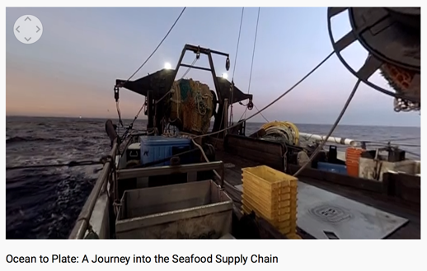
SEAFOOD SUPPLY CHAIN
MAHI / ACTIVITY
While watching this film write down steps in the journey of a fish from the ocean to a plate?
Fisheries shown here are not MSC certified you identify areas of improvement?
KŌRERORERO / DISCUSSION
Think about what you saw in this film
What improvements would you make to the ocean to plate seafood supply chain?
MĀTAKI TĒNEI / WATCH THIS
WWF short film [7:02] about seafood supply chain
Notes:
TEACHER NOTES
Ocean to Plate – Seafood Supply Chain film link: https://www.youtube.com/watch?v=pkfgILiGbVk

Slide 3
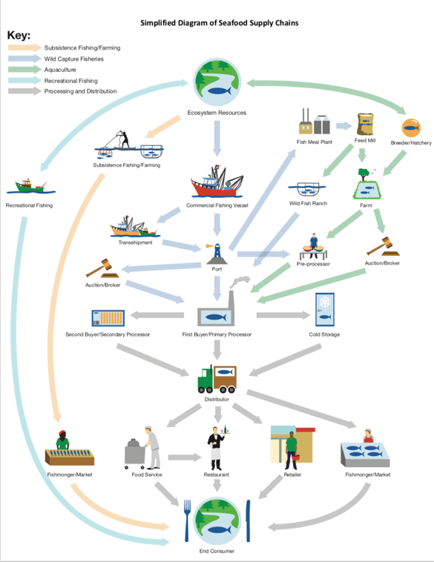
SEAFOOD SUPPLY CHAIN
KŌRERO PUKAPUKA / READ
Read & discuss: Ocean to plate in 36 hours: the Lee Fish Story
MAHI / ACTIVITY
In groups: use your notes from last slide. Draw a flow diagram showing steps a fish journeys through from the ocean to your plate (See Teacher Outline)
Click again for example!
Source: FishWise.org
Notes:
TEACHER NOTES
An example of a supply chain diagram is provided – found at http://fishwise.org/wp-content/uploads/2017/12/Seafood_Supply_Chains.pdf
https://www.nzstory.govt.nz/news/ocean-to-plate-in-36-hours-the-lee-fish-story/

Slide 4
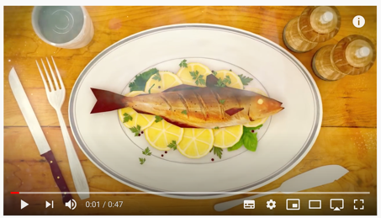
A VERIFIED SEAFOOD SUPPLY CHAIN Focus Question: How does verification in the supply chain contribute to sustainable seafood?
KŌRERORERO / DISCUSSION
Seafood fraud is common!
Seafood fraud is the selling of seafood with a misleading label, description or promise
HE PĀTAI / CONSIDER THIS
If someone labelled and sold fish as sustainable but it wasn’t – that would be an example of seafood fraud!
What other examples of seafood fraud can you think of?
MĀTAKI TĒNEI / WATCH THIS
Short film [0:47] about Sustainable seafood from ocean to plate: Choose MSC certified sustainable fish
Notes:
TEACHER NOTES
Film clip can be found at
https://www.youtube.com/watch?time_continue=40&v=Kac1cqkjX1U&feature=emb_logo

Slide 5
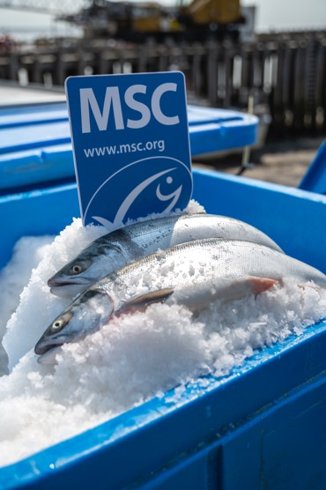
A VERIFIED SEAFOOD SUPPLY CHAIN
KŌRERORERO / DISCUSSION
Verification:
Is the ability to trace a fish directly back to its point of origin
Prevents illegal products from entering the supply chain
Protects consumers and the efforts of everyone working hard to keep our oceans healthy
Notes:
TEACHER NOTES
Film clip can be found at
https://www.youtube.com/watch?time_continue=40&v=Kac1cqkjX1U&feature=emb_logo

Slide 6
A VERIFIED SEAFOOD SUPPLY CHAIN
KŌRERORERO / DISCUSSION
The Marine Stewardship Council:
Work to ensure seafood sold with a sustainable label is in fact sustainable
Are working on creating verified seafood supply chains
Notes:
TEACHER NOTES
https://www.msc.org/en-us/what-we-are-doing/driving-change/traceable-seafood

Slide 7
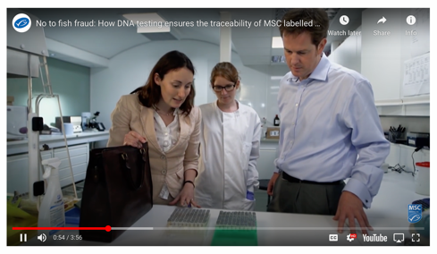
A VERIFIED SEAFOOD SUPPLY CHAIN
HE PĀTAI / CONSIDER THIS
Is being able to verify that your fish is sourced legally a good idea?
Why / Why not?
What ideas do you have about how this could be done?
MĀTAKI TĒNEI / WATCH THIS
WWF short film [3:56] about verification in the supply chain
Notes:
TEACHER NOTES
https://www.msc.org/en-us/what-we-are-doing/driving-change/traceable-seafood

Slide 8
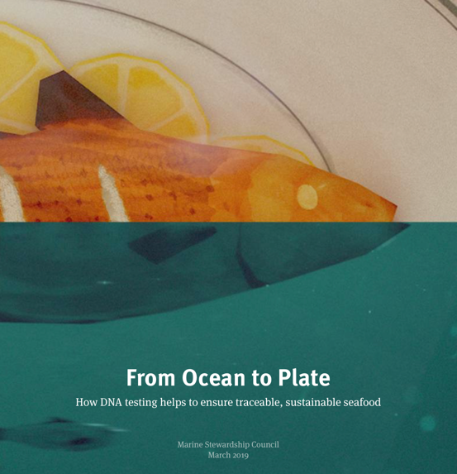
A VERIFIED SEAFOOD SUPPLY CHAIN
Experts ONLY!
KŌRERO PUKAPUKA / READ
Read From Ocean to Plate
MAHI / ACTIVITY
Complete Ocean to Plate worksheet
&
Explore the relationship between supply chain and illegal fishing using the interactive FishWise tuna supply chain
Notes:
TEACHER NOTES
http://ocean-to-plate-stories.msc.org/?
https://fishwise.org/salt/tuna-supply-chain/
_ga=2.3247414.782480448.1599085705-1303352827.1595455374
USEFUL RESOURCES / RĀRANGI PUKAPUKA
For an Aotearoa New Zealand take on the verified seafood supply see:https://www.nzstory.govt.nz/news/ocean-to-plate-in-36-hours-the-lee-fish-story/

