Slide 1
REVIEWING KEY CONCEPTS
Focus Question: What have we learnt?
MAHI / ACTIVITY
In small groups, create your own definition of
Sustainable fishing
Maximum sustainable yield
Unsustainable fishing
Act it out! For one of your definitions create a 30 second skit showing the meaning of the term from the perspective of a fisher person!
MAHI / ACTIVITY
Complete the Science & Sustainable Catch summary quiz on the following slides or play using Kahoot!
Source: MSC.ORG
Notes:
TEACHER NOTES
HOW TO PLAY KAHOOT
See other teacher notes for instructions
Find the game on the MSC NZ Kahoot page: https://www.msc.org/en-au/for-teachers/ocean-literacy/new-zealand-education-curriculum/kahoot-quizzes
Answers to quiz are provided on the slides following the quiz questions :]

Slide 2
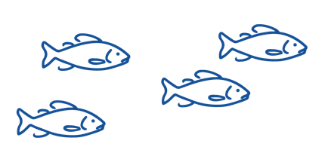
REVIEWING KEY CONCEPTS – QUIZ
True or False - A sustainable catch is one that can carry on forever?
2. Which of the following is NOT a principle applied by Marine Stewardship Council when certifying sustainable fishery
Principle 1: Sustainability of the fish stock
Principle 2: Environmental Impacts
Principle 1: Economic viability assessment
Principle 3: Effective Management

Slide 3
REVIEWING KEY CONCEPTS – QUIZ
3. Which of the following is LEAST useful to the MSC under Principle 1 to tell if a fish CATCH is sustainable?
Knowing the size of the fish stock / population
Scientists calculations on the health of the fish stocks
Knowing what fish stock a fish has come from
Knowing what other fish the boat caught
4. True or False - Sustainable fishing means making sure fish populations don’t drop below levels where they can reproduce themselves
5. True or False - Fisheries work with scientists to understand how the fish and shellfish population grows and shrinks over time

Slide 4
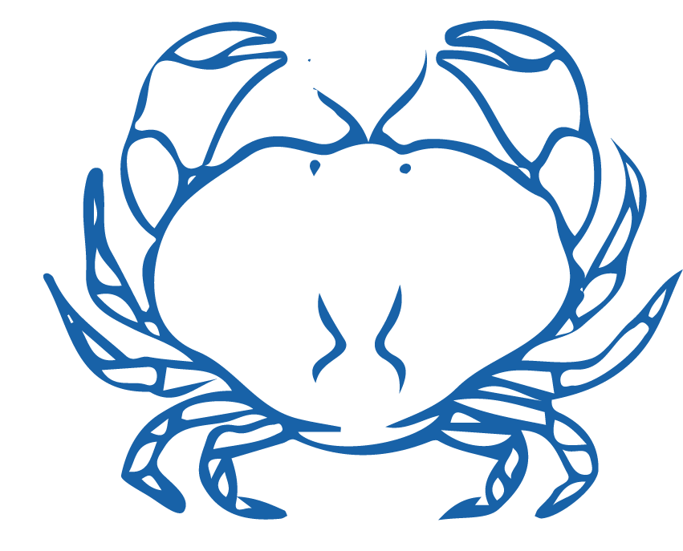
REVIEWING KEY CONCEPTS – QUIZ
6. True or False - How a fish population grows & shrinks over time is controlled by births, migrations in & out of the fishery, and deaths (including fish caught)
7. Which of the following is NOT true of sustainable yield for a fishery?
Sustainable yield is a scientific calculation
Sustainable yield shows how much fish can be caught without overfishing
Sustainable yields are set to enable high catches & declining fish stocks
Sustainable yields aim to prevent overfishing & decline of fish stocks
8.True or False - Population biomass is the total weight of fish in the population

Slide 5
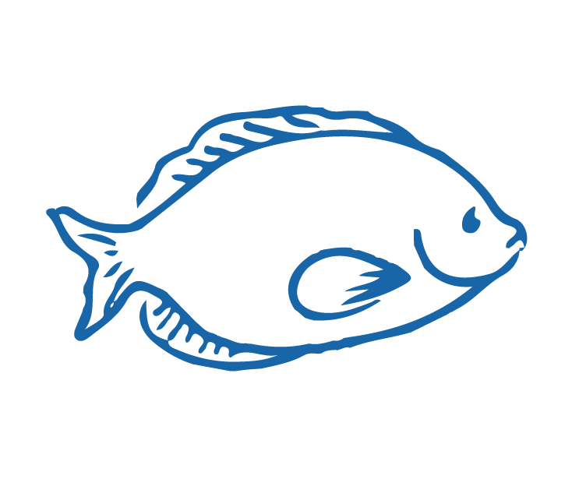
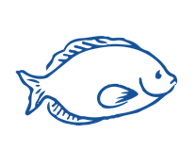
REVIEWING KEY CONCEPTS – QUIZ
9. In fishing, size does matter! Which of the following is NOT true?
Healthy fish stocks need large, mature fish (the ‘spawners’)
A fished population of fish is always healthy even with no big fish present
Without big fish reproduction slows and fish stocks decline
Not enough large mature fish means there will be less young healthy fish
10. Which of the following is not true of commercial fishing in Aotearoa NZ?
Commercial fisheries are managed under the QMS (Quota Management System)
There are no limits to the number of fish that can be caught
Scientists use info from commercial fishers to work out fishery size
Commercial fishers must report their catches

Slide 6
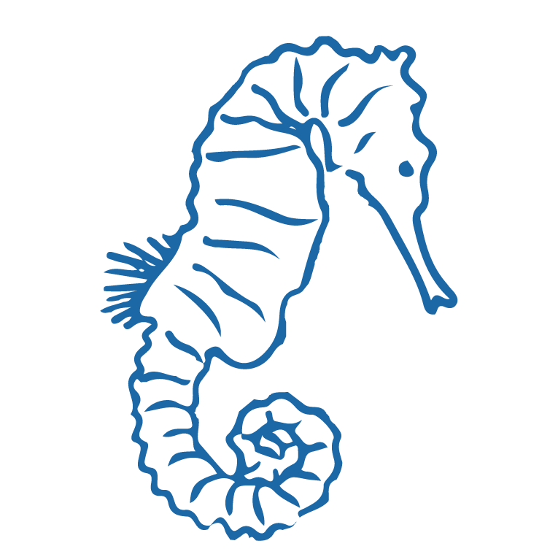
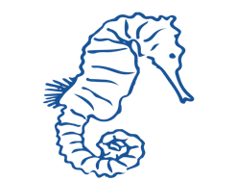
REVIEWING KEY CONCEPTS – QUIZ
11. True or False - The number of fish in a population is also known as 'abundance’
12. Which of the following can be a type of impact arising from the decline of a fish stock?
Environmental impacts
Social & cultural impacts
Economic impacts

Slide 7
REVIEWING KEY CONCEPTS – QUIZ ANSWERS
1. True or False - A sustainable catch is one that can carry on forever?
TRUE
2. Which of the following is NOT a principle applied by Marine Stewardship Council when certifying sustainable fishery
Principle 1: Sustainability of the fish stock
Principle 2: Environmental Impacts
Principle 1: Economic viability assessment
Principle 3: Effective Management

Slide 8
REVIEWING KEY CONCEPTS – QUIZ ANSWERS
3. Which of the following is LEAST useful to the MSC under Principle 1 to tell if a fish CATCH is sustainable?
Knowing the size of the fish stock / population
Scientists calculations on the health of the fish stocks
Knowing what fish stock a fish has come from
Knowing what other fish the boat caught
4. True or False - Sustainable fishing means making sure fish populations don’t drop below levels where they can reproduce themselves TRUE
5. True or False - Fisheries work with scientists to understand how the fish and shellfish population grows and shrinks over time TRUE

Slide 9
REVIEWING KEY CONCEPTS – QUIZ ANSWERS
6. True or False - How a fish population grows & shrinks over time is controlled by births, migrations in & out of the fishery, and deaths (including fish caught) TRUE
7. Which of the following is NOT true of sustainable yield for a fishery?
Sustainable yield is a scientific calculation
Sustainable yield shows how much fish can be caught without overfishing
Sustainable yields are set to enable high catches & declining fish stocks
Sustainable yields aim to prevent overfishing & decline of fish stocks
8.True or False - Population biomass is the total weight of fish in the population TRUE

Slide 10
REVIEWING KEY CONCEPTS – QUIZ ANSWERS
9. In fishing, size does matter! Which of the following is NOT true?
Healthy fish stocks need large, mature fish (the ‘spawners’)
A fished population of fish is always healthy even with no big fish present
Without big fish reproduction slows and fish stocks decline
Not enough large mature fish means there will be less young healthy fish
10. Which of the following is not true of commercial fishing in Aotearoa NZ?
Commercial fisheries are managed under the QMS (Quota Management System)
There are no limits to the number of fish that can be caught
Scientists use info from commercial fishers to work out fishery size
Commercial fishers must report their catches

Slide 11
REVIEWING KEY CONCEPTS – QUIZ ANSWERS
11. True or False - The number of fish in a population is also known as 'abundance’ TRUE
12. Which of the following can be a type of impact arising from the decline of a fish stock?
Environmental impacts
Social & cultural impacts
Economic impacts

