Slide 1
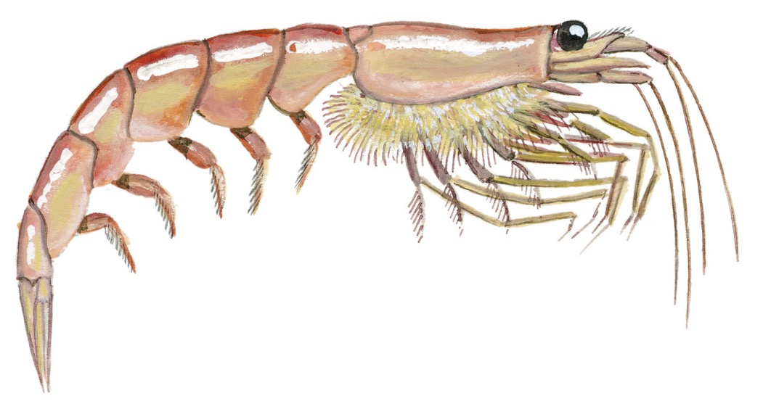
ANTARCTIC KRILL

Slide 2
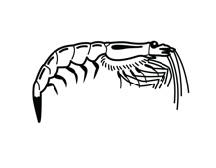
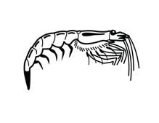
ANTARCTIC KRILL: FOCUS QUESTIONS
How are Antarctic krill connected through whakapapa?
What do we know about Antarctic krill?
How are Antarctic Krill connected with other Antarctic marine life?
What role do krill play in climate change?
How would overfishing krill affect other marine life?
How are krill protected from overfishing?

Slide 3
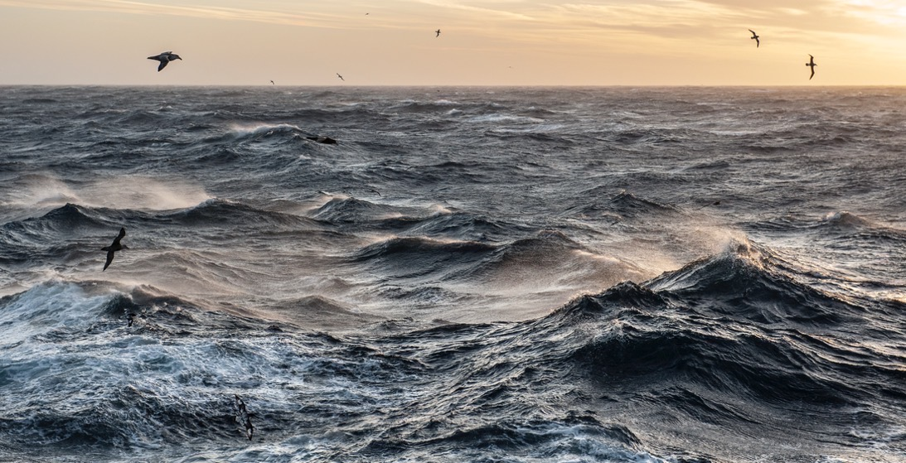
ANTARCTIC KRILL Focusing Question: What do we know about Antarctic Krill?
HE PĀTAI / CONSIDER THIS
WHAT DO YOU ALREADY KNOW ABOUT
KRILL AND OTHER MARINE LIFE IN ANTARCTICA?
Notes:
TEACHER NOTES
CHECK PRIOR KNOWLEDGE
POSSIBLE INQUIRY QUESTIONS:
What marine creatures live in Antarctica?
Do polar bears live there?
Do penguins live there?
What types of whales are there?
What do whales eat?
What do penguins eat?

Slide 4
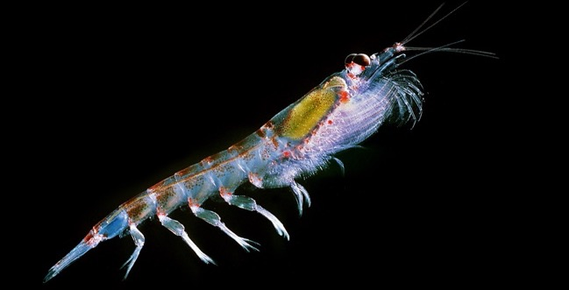
ANTARCTIC KRILL Focusing Question: What do we know about Antarctic Krill?
HE PĀTAI / CONSIDER THIS
What is the Māori name for krill?
Kōura rangi Or Uraura | OR | Ika rangi
Notes:
TEACHER NOTES
ANSWER ON NEXT SLIDE

Slide 5
ANTARCTIC KRILL Focusing Question: What do we know about Antarctic Krill?
HE PĀTAI / CONSIDER THIS
What is the Māori name for krill?
✓ Kōura rangi or Uraura
Whale-feed, shrimp, krill
Kōura rangi Or Uraura | OR | Ika rangi
Notes:
TEACHER NOTES
Kōura rangi or Uraura
In Norwegian, the word “krill” means “whale food”!

Slide 6
ANTARCTIC KRILL Focusing Question: How are Antarctic krill connected through whakapapa?
HE PĀTAI / CONSIDER THIS
Are krill more closely related to Tūtewehiwehi or Ikatere?
Tūtewehiwehi | OR | Ikatere
Notes:
TEACHER NOTES
ANSWER ON NEXT SLIDE

Slide 7
ANTARCTIC KRILL Focusing Question: How are Antarctic krill connected through whakapapa?
HE PĀTAI / CONSIDER THIS
Are krill more closely related to Tūtewehiwehi or Ikatere?
✓ Ikatere
Ikatere was the son of Punga.
Punga was the son of Tangaroa. Ikatere travelled to the sea.
Tūtewehiwehi | OR | Ikatere
Notes:
TEACHER NOTES
According to one Māori creation tradition the god of the sea and ancestor of fish is Tangaroa, the son of Ranginui (sky father) and Papatūānuku (earth mother). Tangaroa’s son Punga was the father of Ikatere and Tūtewehiwehi. Ikatere went to the sea. He and his children became fish. Tūtewehiwehi journeyed inland, He and his offspring became reptiles. All sea creatures are part of this whakapapa or family tree. And this whakapapa or family tree connects us, with the ocean and creatures that live there.
Question: Where did Tūtewehiwehi go and what creatures were his children?
Answer: Inland and the reptiles

Slide 8
ANTARCTIC KRILL Focusing Question: How are Antarctic krill connected with other marine life?
HE PĀTAI / CONSIDER THIS
Are krill more closely related to fish or crabs?
FISH | OR | CRABS
Notes:
TEACHER NOTES
ANSWER ON NEXT SLIDE

Slide 9
ANTARCTIC KRILL Focusing Question: How are Antarctic krill connected with other marine life?
HE PĀTAI / CONSIDER THIS
Are krill more closely related to fish or crabs?
✓ CRABS!
Like crabs, krill are crustacea
FISH | OR | CRABS
Notes:
TEACHER NOTES
Arthropods are invertebrates with an exoskeleton, a segmented body and jointed appendages. Crabs and Krill are marine crustaceans (a sub phylum of artrhopoda).

Slide 10
ANTARCTIC KRILL Focusing Question: What do we know about Antarctic Krill?
HE PĀTAI / CONSIDER THIS
Take a guess – How big are Antarctic Krill?
5 - 6 cm | OR | 2 – 3 cm
Notes:
TEACHER NOTES
ANSWER ON NEXT SLIDE

Slide 11
ANTARCTIC KRILL Focusing Question: What do we know about Antarctic Krill?
HE PĀTAI / CONSIDER THIS
Take a guess – how big are Antarctic Krill?
✓ 5 - 6 cm! Antarctic krill grow up to 6cm in length and can weigh 1 gram. When considering all animals that live in the ocean, this makes them average size (by weight).
5 - 6 cm | OR | 2 – 3 cm
Notes:
TEACHER NOTES
Antarctic krill grow up to 6cm in length and can weigh 1 gram. When considering all animals that live in the ocean, this actually makes them an average size (by weight).
Whilst krill are zooplankton they aren’t tiny. Antarctic krill have the scientific name Euphausia superba. This name suggests they are one of the biggest (most superb!) of krill species!
They are about the size of an adult human little finger. They are also bigger than many commonly sold shrimp species.
https://www.wwf.org.uk/learn/fascinating-facts/antarctic-krill

Slide 12
ANTARCTIC KRILL Focusing Question: What do we know about Antarctic Krill?
HE PĀTAI / CONSIDER THIS
Take a guess
– Can Antarctic Krill be seen from space?
YES | OR | NO
Notes:
TEACHER NOTES
ANSWER ON NEXT SLIDE

Slide 13
ANTARCTIC KRILL Focusing Question: What do we know about Antarctic Krill?
HE PĀTAI / CONSIDER THIS
Take a guess
– Can Antarctic Krill be seen from space?
✓ YES! Antarctic krill super swarms
(tens of kilometers wide) are seen from space!
YES | OR | NO
Notes:
TEACHER NOTES
Antarctic krill form super-swarms that can be tens of kilometres wide and over one hundred metres deep. This amazing spectacle can be seen from space. https://www.wwf.org.uk/learn/fascinating-facts/antarctic-krill

Slide 14
ANTARCTIC KRILL Focusing Question: What do we know about Antarctic Krill?
HE PĀTAI / CONSIDER THIS
Take a guess
– Can Antarctic Krill glow in the dark?
YES | OR | NO
Notes:
TEACHER NOTES
ANSWER ON NEXT SLIDE

Slide 15
ANTARCTIC KRILL Focusing Question: What do we know about Antarctic Krill?
HE PĀTAI / CONSIDER THIS
Take a guess
– Can Antarctic Krill glow in the dark?
✓ YES! They are bioluminescent!
Which means they produce light
YES | OR | NO
Notes:
TEACHER NOTES
Antarctic krill (and other krill species) are bioluminescent, meaning they produce light. Possible reasons for this production of light from specially adapted organs include communication and camouflage. https://www.wwf.org.uk/learn/fascinating-facts/antarctic-krill

Slide 16
ANTARCTIC KRILL Focusing Question: What do we know about Antarctic Krill?
HE PĀTAI / CONSIDER THIS
Take a guess
– Can Antarctic Krill dive deep?
YES | OR | NO
Notes:
TEACHER NOTES
ANSWER ON NEXT SLIDE

Slide 17
ANTARCTIC KRILL Focusing Question: What do we know about Antarctic Krill?
HE PĀTAI / CONSIDER THIS
Take a guess
- Can Antarctic Krill dive deep?
✓ YES! Recent research says yes,
they dive to abyssal depths – over 2,000 metres deep.
YES | OR | NO
Notes:
TEACHER NOTES
Until recently, scientific study of Antarctic krill largely focused on the top 250 metres of the ocean. Most krill are found here. They are in found in the shallower waters as they feed on phytoplankton – which need light. BUT research is increasingly showing that krill do swim down to visit the seafloor at depths of over 2,000 metres in what is known as the ‘abyssal zone’ of the ocean. https://www.wwf.org.uk/learn/fascinating-facts/antarctic-krill

Slide 18
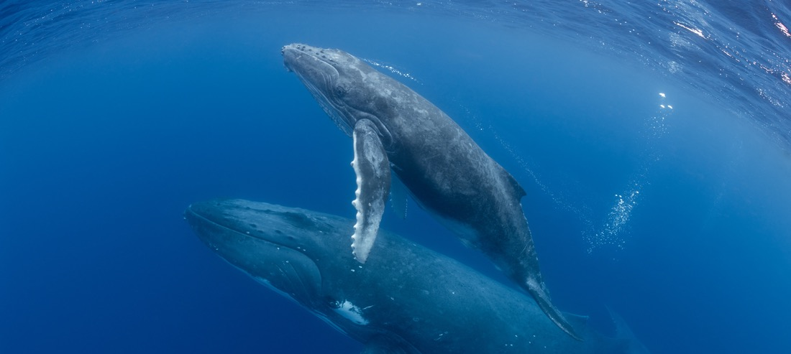
ANTARCTIC KRILL Focusing Question: How are krill connected with other marine life?
HE PĀTAI / CONSIDER THIS
Take a guess
– Which of the following animals eat krill?
SEALS |  | BALEEN WHALES |  | SQUID
SEABIRDS |  | FISH |  | PENGUINS
Notes:
TEACHER NOTES
ANSWER ON NEXT SLIDE

Slide 19
ANTARCTIC KRILL Focusing Question: How are krill connected with other marine life?
HE PĀTAI / CONSIDER THIS
Take a guess
– Which of the following animals eat krill?
✓ ALL OF THE ABOVE: Krill are eaten by
penguins, seals, whales, seabirds, fish, and squid
SEALS |  | BALEEN WHALES |  | SQUID
SEABIRDS |  | FISH |  | PENGUINS
Notes:
TEACHER NOTES
See https://www.worldwildlife.org/magazine/issues/fall-2019/articles/the-whales-of-antarctica

Slide 20
ANTARCTIC KRILL Focusing Question: How are krill connected with other marine life?
HE PĀTAI / CONSIDER THIS
Take a guess
– What do krill eat?
PHYTOPLANKTON | OR | CRABS | OR | ZOOPLANKTON
Notes:
TEACHER NOTES
ANSWER ON NEXT SLIDE

Slide 21
ANTARCTIC KRILL Focusing Question: How are krill connected with other marine life?
HE PĀTAI / CONSIDER THIS
Take a guess
– What do krill eat?
✓ PHYTOPLANKTON & ZOOPLANKTON: Krill eat mainly phytoplankton & some zooplankton
PHYTOPLANKTON | OR | CRABS | OR | ZOOPLANKTON
Notes:
TEACHER NOTES
Krill are important in the food chain because they feed on phytoplankton, and to a lesser extent zooplankton, making nutrients available to other animals for which krill make up the largest part of their diet. For this reason, krill are considered a keystone species in the Southern Ocean ecosystem. https://40years.ccamlr.org/ecosystem-based-management-of-krill-fishery/

Slide 22
ANTARCTIC KRILL Focusing Question: What do we know about krill?
Anatomy of Antarctic Krill:
Uwe Kils
Notes:
TEACHER NOTES
Krill are important in the food chain because they feed on phytoplankton, and to a lesser extent zooplankton, making nutrients available to other animals for which krill make up the largest part of their diet. For this reason, krill are considered a keystone species in the Southern Ocean ecosystem. https://40years.ccamlr.org/ecosystem-based-management-of-krill-fishery/

Slide 23
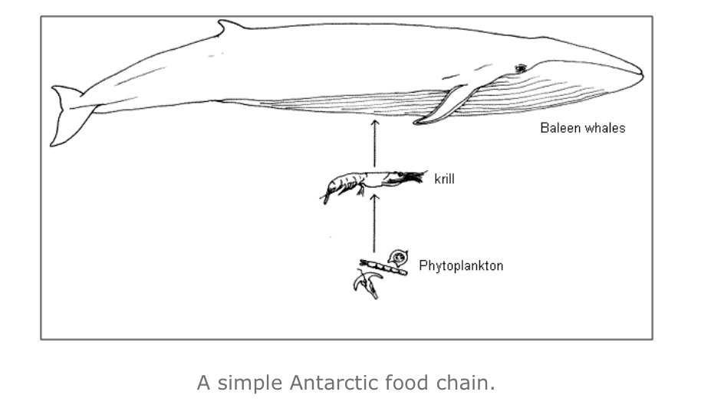
ANTARCTIC KRILL Focusing Question: How are Antarctic krill connected with other marine life?
HE PĀTAI / CONSIDER THIS
The ‘food chain’ connects marine creatures
Marine creatures depend on one another!
Source: LEARNZ.org.nz
Notes:
TEACHER NOTES
THE BIGGEST ANIMAL THAT HAS EVER LIVED – THE ANTARCTIC BLUE WHALE - DEPENDS ON KRILL
The majority of blue whales in the Southern Ocean feed mainly on Antarctic krill for six months of the year, before migrating thousands of kilometres north to breed, during which time they do not feed. It has been estimated that a single blue whale can consume 3.6 million krill in one day!
https://www.wwf.org.uk/learn/fascinating-facts/antarctic-krill

Slide 24
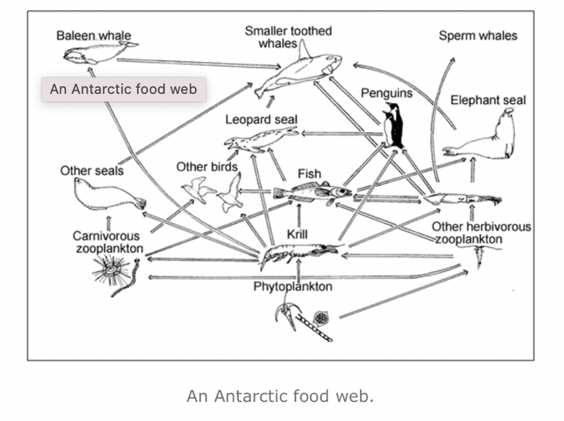
ANTARCTIC KRILL Focusing Question: How are Antarctic krill connected with other marine life?
HE PĀTAI / CONSIDER THIS
Use this food web to consider how:
Krill are connected to baleen whales
Krill are connected to small toothed whales
Phytoplankton are connected to baleen whales
Phytoplankton are connected to sperm whales
Source: LEARNZ.org.nz
Notes:
TEACHER NOTES
It is estimated that in one day, a single crabeater seal can consume 11,000 krill, and a single Adélie penguin can consume 1,200 krill!
https://www.wwf.org.uk/learn/fascinating-facts/antarctic-krill

Slide 25
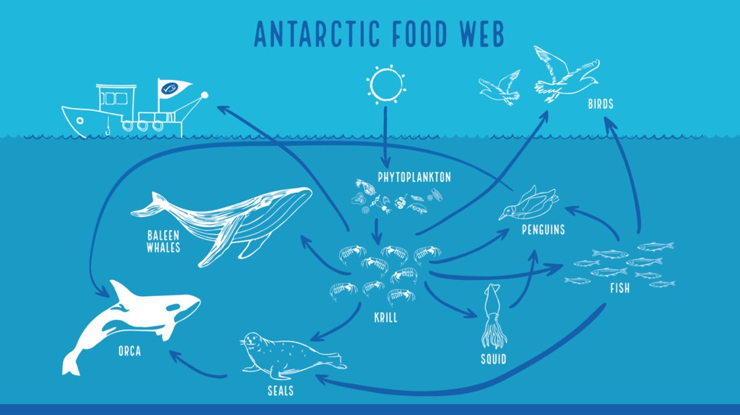
ANTARCTIC KRILL Focusing Question: How are Antarctic krill connected with other marine life?
HE PĀTAI / CONSIDER THIS
Use this food web to consider
How krill are connected to people?
What happens if we fish too much krill?
Notes:
TEACHER NOTES
It is estimated that in one day, a single crabeater seal can consume 11,000 krill, and a single Adélie penguin can consume 1,200 krill!
https://www.wwf.org.uk/learn/fascinating-facts/antarctic-krill

Slide 26
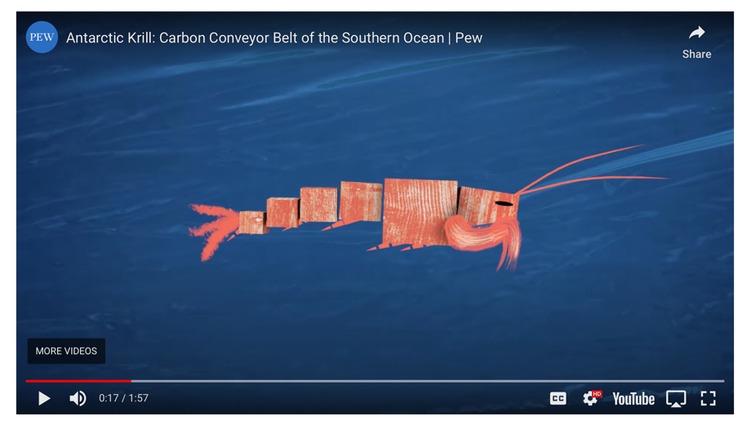
ANTARCTIC KRILL Focusing Question: What role do krill play in climate and climate change?
MĀTAKI TĒNEI / WATCH THIS
The role of krill in climate change [1.57]
Notes:
TEACHER NOTES
Film link: https://www.youtube.com/watch?v=hlGRFrWLZ_w&t=17s

Slide 27
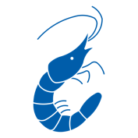
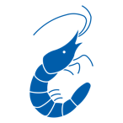
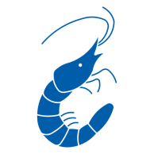
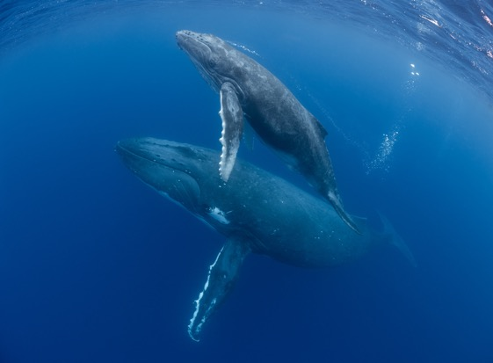
ANTARCTIC KRILL Focusing Question: What role do krill play in climate and climate change?
HE PĀTAI / CONSIDER THIS
Krill
WHAT’S THE CONNECTION
BETWEEN KRILL,
WHALE POOP & CLIMATE CHANGE?
Phytoplankton
Whales Poo
Notes:
TEACHER NOTES
Key points:
Phytoplankton removes CO from atmosphere through photosynthesis.
Uneaten phytoplankton eventually die and sink transferring the carbon to the deep sea.
Phytoplankton need iron to thrive.
The concentration of iron in whale faeces is more than 10 million times higher than seawater concentrations.
So whale poop acts as a fertiliser that increases phytoplankton growth, leading to a more productive ecosystem and enhanced atmospheric carbon dioxide removal.
See also:
https://www.youtube.com/watch?v=M18HxXve3CM&t=20s
Background reading:
https://www.theguardian.com/environment/georgemonbiot/2014/dec/12/how-whale-poo-is-connected-to-climate-and-our-lives
https://www.bbc.com/future/article/20210119-why-saving-whales-can-help-fight-climate-change

Slide 28
ANTARCTIC KRILL Focusing Question: How would overfishing Antarctic krill affect other marine life?
KŌRERORERO / DISCUSSION
Krill are critical to the entire Antarctic food web
Overfishing krill could:
Threaten all Antarctica life forms
Accelerate climate change

Slide 29
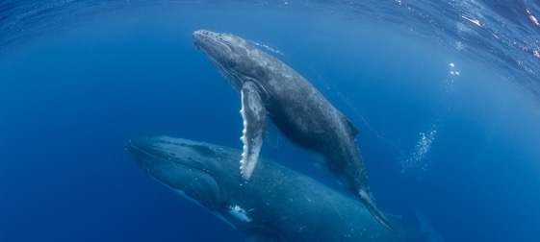
ANTARCTIC KRILL Focusing Question: Good News! How are krill protected from overfishing?
KŌRERORERO / DISCUSSION
The good news!
25 countries signed up to CCAMLR (Commission for the Conservation of Antarctic Marine Living Resources)
CCAMLR works to prevent over exploitation of krill and other Antarctic marine life

Slide 30
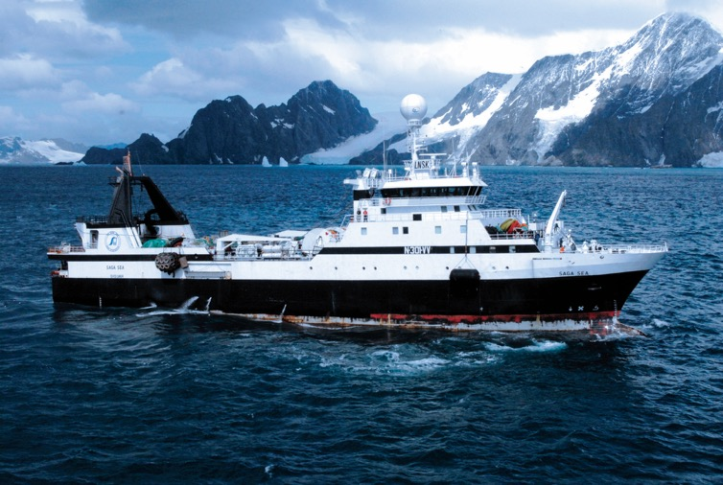
ANTARCTIC KRILL Focusing Question: Good News! How are krill protected from overfishing?
KŌRERORERO / DISCUSSION
CCAMLR rules require:
trawlers to stay largely confined to four areas off the Antarctic Peninsula
with a seasonal catch capped at 620,000 tonnes - less than 2% of total Antarctic Krill

Slide 31
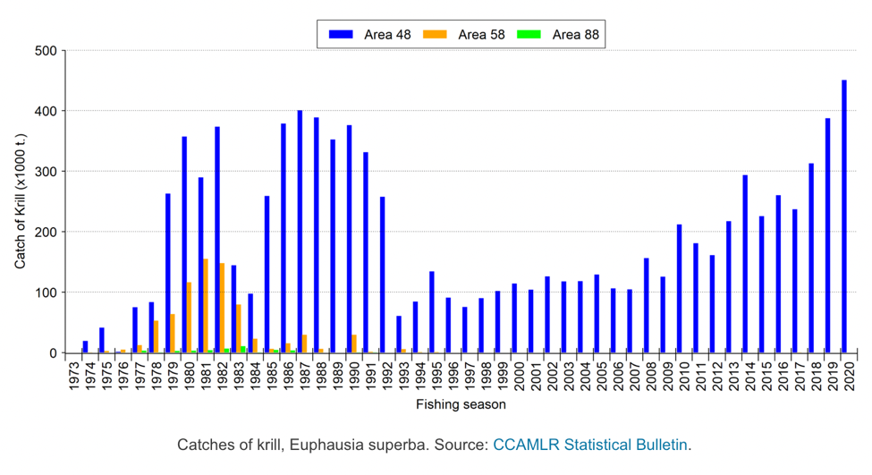
ANTARCTIC KRILL Focusing Question: Good News! How are krill protected from overfishing?
KŌRERORERO / DISCUSSION
Current regulated Antarctic krill fishing is under the seasonal catch limit of 620,000 tonnes
Graph: CCAMLR

Slide 32
ANTARCTIC KRILL Focusing Question: Good News! How are krill protected from overfishing?
KŌRERORERO / DISCUSSION
Major Antarctic krill fishing companies, including Aker BioMarine, have formed the Association of Responsible Krill Harvesting Companies (ARK)
ARK aims to foster the sustainable fishery of Antarctic krill
Notes:
https://www.ark-krill.org

Slide 33
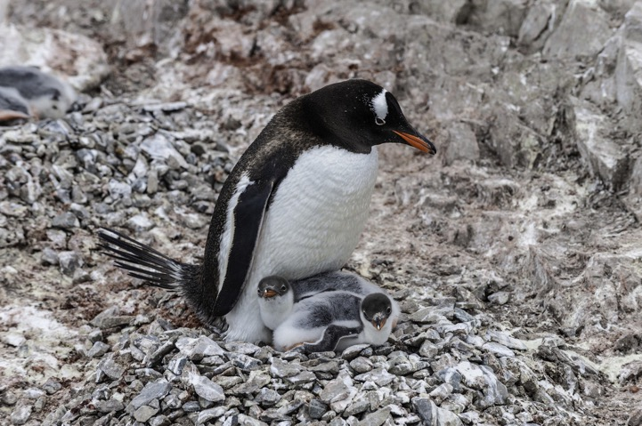
ANTARCTIC KRILL Focusing Question: Good News! How are krill protected from overfishing?
KŌRERORERO / DISCUSSION
Eight krill fishing companies in 2018 pledged to stay at least 30 km away from key penguin breeding colonies during incubation and chick-rearing season
Global Fishing Watch, a monitoring agency, found that since 2019 the trawlers in operation have upheld that promise

Slide 34
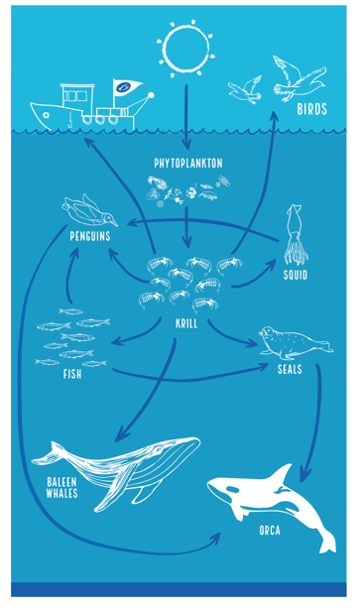
ANTARCTIC KRILL Focusing Question: Good News! How are krill protected from overfishing?
KŌRERORERO / DISCUSSION
Much of the regulated krill fishery in Antarctica has now been assessed against the Marine Stewardship Council sustainable fishery standard and certified sustainable by the Marine Stewardship Council

Slide 35
ANTARCTIC KRILL Focusing Question: What have we learnt?
MAHI / ACTIVITY
Test your knowledge using one or both of the following Kahoot!:
Antarctic Krill Kahoot
Antarctic Krill Fishing Kahoot!

