Slide 1
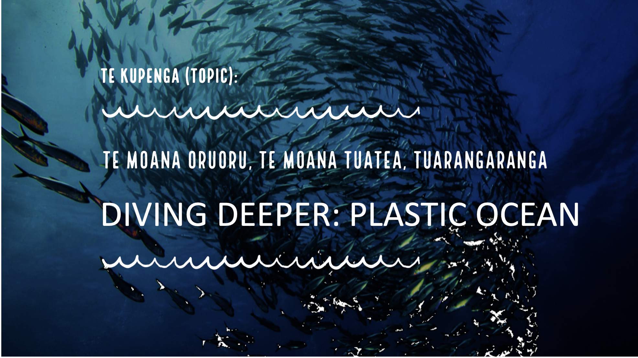
Insert heading page Topic 3
[Version 1.3 – 2024]

Slide 2






Slide 3

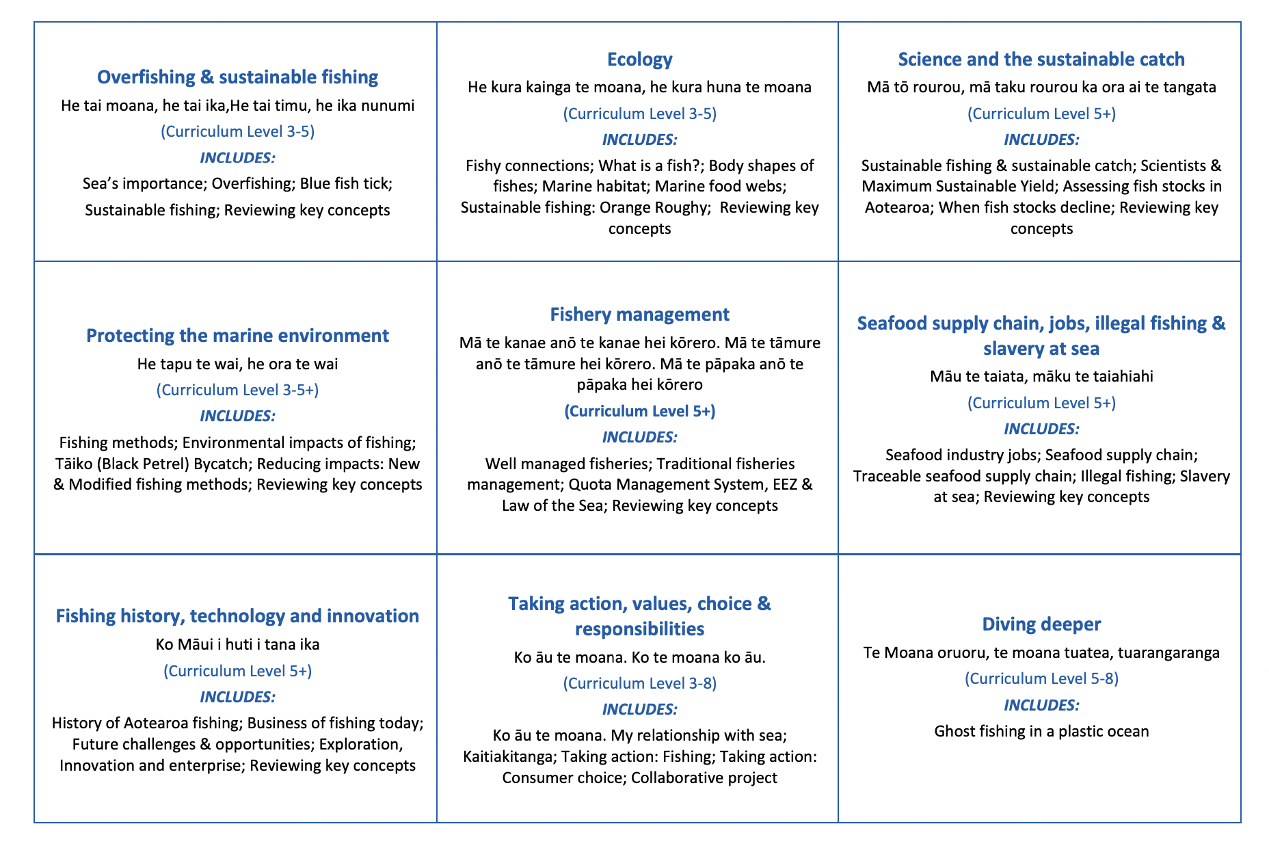





HELPFUL STUFF FOR TEACHERS
Welcome to OUR STORY!
In this topic we take a deep dive to look at the issue of plastic pollution (in the context of fishing!)
Notes:
TEACHER NOTES

Slide 4
HELPFUL STUFF FOR TEACHERS
Target age range:
13 – 18 years
Welcome to OUR STORY!
In this topic we take a deep dive to look at the issue of plastic pollution (in the context of fishing!)
Focus: Ghost Fishing & Plastic Oceans
Curriculum Level: Level 4-8
Curriculum: Geography; Science; Social Science; Tikanga-ā-iwi; Pūtaiao; Hauora
Key competencies: Thinking; Managing self; Relating to others; Participating & contributing
Planning: See also teacher notes below slides; created as a case study using inquiry based, student led learning
Expert: Slides with trickier content are labelled expert

Slide 5
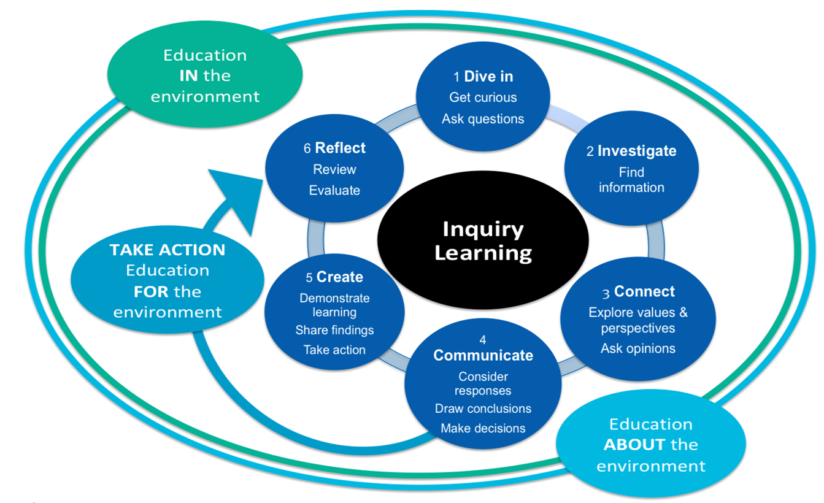
INQUIRY LEARNING

Slide 6


IN THIS TOPIC WE WILL LEARN ABOUT…
Investigate a contemporary issue related to sustainable fishing & healthy oceans
Explore different opinions and perspectives on contemporary issues related to sustainable fishing and healthy oceans
Demonstrate independent research capabilities
Determine and express a personal viewpoint on a contemporary issue related to sustainable fishing and healthy oceans
Explore possible solutions and determine actions that can be taken to help alleviate issues related to sustainable fishing and healthy oceans
Select, carry out and evaluate the effectiveness of an action to help alleviate sustainable fishing and healthy oceans
Present findings on a contemporary issue related to sustainable oceans
Use appropriate terminology related to sustainable fishing and healthy oceans

Slide 7

DIVING DEEPER
Focus Question: How do I research & present findings on a contemporary ocean sustainability issue?
Your task is to study one of the issues provided in this topic:
  Investigate the issue
  Explore different opinions and perspectives on the issue
  Complete research tasks to deepen understanding
  Consider and justify your own viewpoint
  Explore solutions and determine possible actions
  Select, carry out and evaluate the effectiveness of an action to help alleviate the issue
  Share findings

Slide 8

DIVING DEEPER
Over time we plan to add other issues to this topic that affect sustainable fishing and ocean health.
The issue we explore here is:
GHOST FISHING IN A PLASTIC OCEAN
– How lost and discarded fishing gear contributes to the problem of plastics in our oceans,
& what can be done!
Enjoy!

Slide 9


GHOST FISHING IN A PLASTIC OCEAN: THE ISSUE
Focus Questions: Why are ghost fishing & plastics such a problem in our oceans? How can we solve this problem?
HE PĀTAI / CONSIDER THIS
What do we already know about ghost fishing, plastics and how they affect the oceans?
MAHI / ACTIVITY
Complete the Prior Knowledge Chart columns 1 & 2
Ghost fishing & plastic at sea PRIOR KNOWLEDGE CHART
What we know | What we would like to know | What we have learned
Notes:
TEACHER NOTES

Slide 10
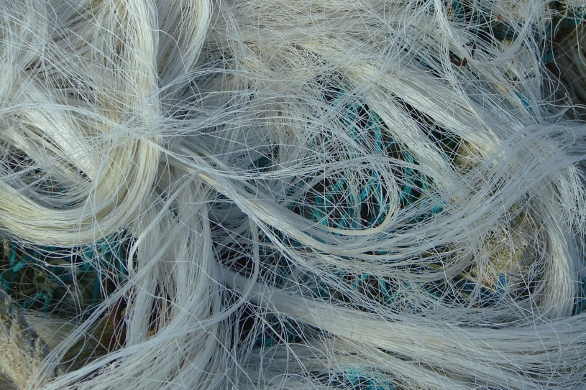
GHOST FISHING IN A PLASTIC OCEAN: THE ISSUE
HE PĀTAI / CONSIDER THIS
Fishing gear was once made of bone, flax, shell, wood and other biodegradable materials
Now fishing gear is more commonly made of plastic
Take a guess: once in the ocean, plastic monofilament fishing line can take up to _____ years to degrade!
Monofilament Fishing Line
Source: Daplaza
Notes:
TEACHER NOTES
READ MORE! Amazing article from National Geographic with great images! You can find it at: https://www.nationalgeographic.com/magazine/2019/05/microplastics-impact-on-fish-shown-in-pictures/
Answer is 600 years!

Slide 11
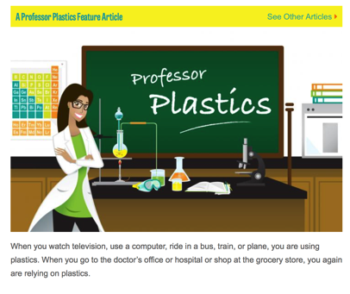
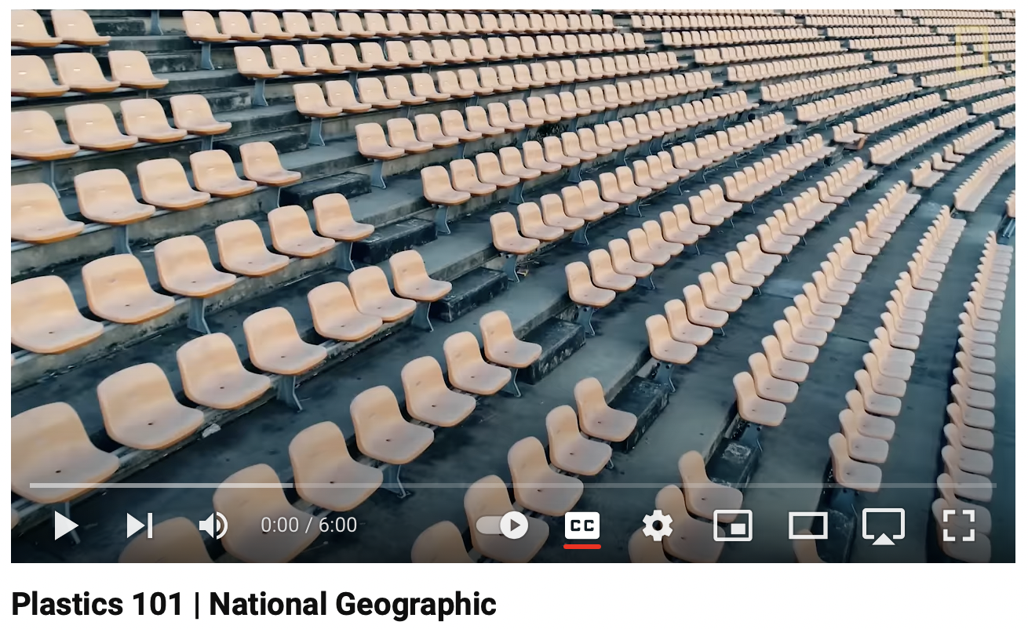
GHOST FISHING IN A PLASTIC OCEAN:
ABOUT PLASTICS & THE SEA
Once in the ocean, plastic monofilament fishing line can take up to 600 years to degrade!
KŌRERO PUKAPUKA / READ
Visit these links or conduct your own search & answer the following:
MAHI / ACTIVITY
What is plastic made from?
What qualities make plastic so useful?
What qualities can make plastic a problem?
Why do you think plastic is used to make fishing gear?
What are plastics?
Plastics 101!
Notes:
TEACHER NOTES
What are plastics
https://www.plasticsmakeitpossible.com/about-plastics/types-of-plastics/what-are-plastics/
All about plastic
https://www.youtube.com/watch?v=ggh0Ptk3VGE

Slide 12


GHOST FISHING IN A PLASTIC OCEAN:
ABOUT PLASTICS & THE SEA
KŌRERO PUKAPUKA / READ
Visit Plastics NZ and complete the activity below
MAHI / ACTIVITY
In pairs find three facts that interest and surprise you about plastics in Aotearoa New Zealand
Use these facts to write three quiz questions and answers and hand to your teacher for a class quiz
Test your plastic knowledge in a class quiz
Notes:
TEACHER NOTES
https://www.plastics.org.nz/environment/faqs#how-is-plastic-recycled

Slide 13
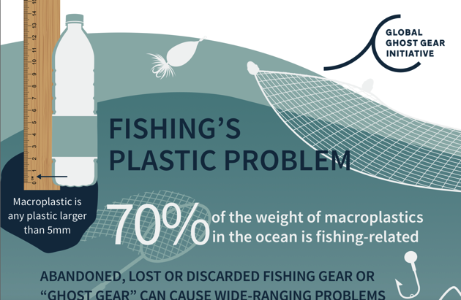
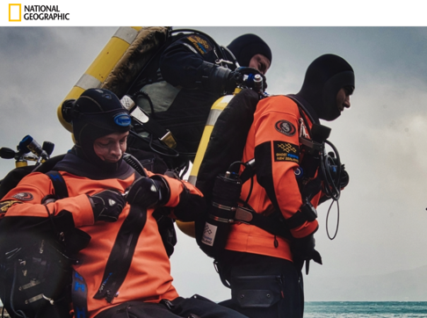
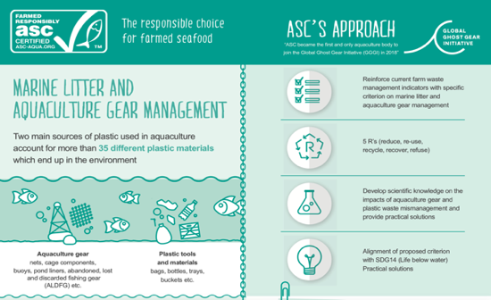
GHOST FISHING IN A PLASTIC OCEAN: THE ISSUE
Fishing’s Plastic Problem | National Geographic
 | Marine Litter & Aquaculture Gear Management
KŌRERO PUKAPUKA / READ
Explore: Two or all of links shown here
Think: How & why is lost fishing gear & plastic a problem at sea?
List then share your answers!
Notes:
TEACHER NOTES
National Geographic on ghost fishing: https://www.nationalgeographic.com/environment/slideshow/paid-content-new-zealand-ghost-gear-hunters
Fishing’s Plastic Problem: https://static1.squarespace.com/static/5b987b8689c172e29293593f/t/5bd6e96e0852291fdf62cee6/1540811123395/GGGI_Macroplastics_WEB.pdf
Marine Litter & Aquaculture Gear Management https://static1.squarespace.com/static/5b987b8689c172e29293593f/t/5d1298a66a2d79000146f60d/1561499820225/ASC_Gear+management_FINAL+WHITE+POWER+POINT.pdf

Slide 14
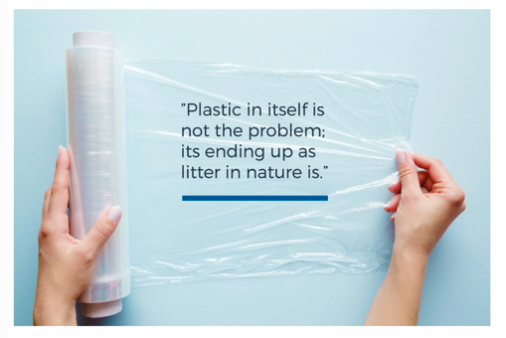

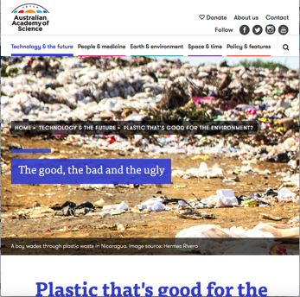
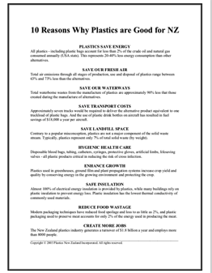
GHOST FISHING IN A PLASTIC OCEAN:
OTHER VIEWPOINTS
Plastic has many Environmental benefits too | Top 5 benefits of plastic packaging
Plastic that’s good for the environment | Ten reasons why plastics are good for NZ
HE PĀTAI / CONSIDER THIS
KŌRERO PUKAPUKA / READ
Explore: One or more link
Think: What is good & bad about plastic?
Share: Two different viewpoints about plastic
Notes:
TEACHER NOTES
Plastic has many environmental benefits too https://www.raniplast.com/plastic-on-the-agenda/
Top 5 benefits of plastic packaging https://www.custom-pak.com/top-5-benefits-of-plastic-packaging/
Plastic Pollution Solution https://www.youtube.com/watch?v=0MWOXR_6qZc
Plastic that’s good for the environment https://www.science.org.au/curious/technology-future/plastic-thats-good-environment
Ten reasons why plastics are good for NZ https://ecoicf.co.nz/wp-content/uploads/2016/10/10-Reasons-Why-Plastics-are-Good-for-NZ.pdf
AND THIS ONE IS A GOOD READ FOR TEACHERS
Plastic can be good for the environment https://www.scientificamerican.com/article/wait-plastic-can-be-good-for-the-environment/

Slide 15

GHOST FISHING & PLASTIC OCEAN:
VIEWPOINTS
Agree or disagree?
The problem is marine litter, not plastics!
Many in the packaging industry and sustainability space believe that demonising plastics in packaging and other applications [like fishing gear] is an emotional reaction to plastic pollution, and that the problem really should be framed as marine litter, not plastics overall.
(Davis, 2018)
MAHI / ACTIVITY
#1. There are different perspectives on plastics in our ocean?
Read the statement
Do you agree / disagree?
Why / Why not?
Place yourself along a continuum between totally agree and totally disagree
Be ready to justify your position!
# 2. List arguments for and against the
use of plastics (see next slide)
Notes:
TEACHER NOTES
Read more about this perspective at:
A sea of voices: Trends and perspectives in marine plastic pollution. Tristanne Davis | Nov 26, 2018. Packaging Digest
https://www.packagingdigest.com/sustainability/sea-voices-trends-and-perspectives-marine-plastic-pollution

Slide 16


GHOST FISHING IN A PLASTIC OCEAN:
VIEWPOINTS
Arguments in favour of plastics!
Plastics are good because…
Arguments against plastics!
Plastics are NOT good because…
Notes:
TEACHER NOTES
https://www.custom-pak.com/top-5-benefits-of-plastic-packaging/

Slide 17
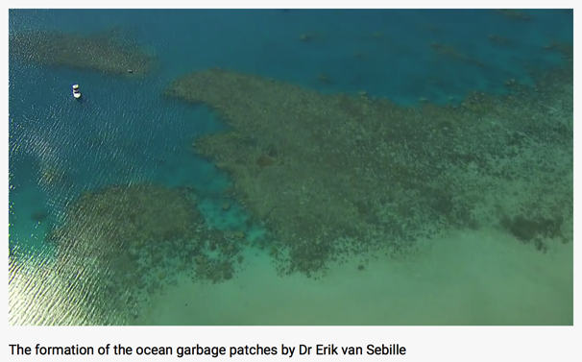
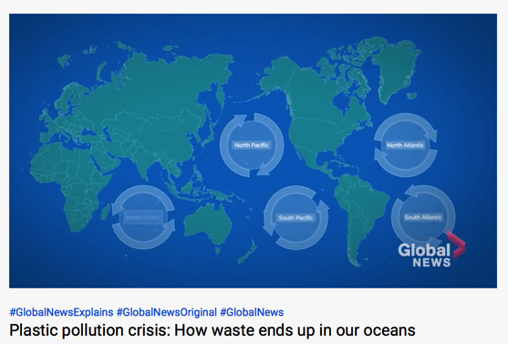
GHOST FISHING IN A PLASTIC OCEAN:
WHERE IT GOES
Formation of the ocean Garbage patch [3:21] | How waste ends up in our oceans [4:26]
MĀTAKI TĒNEI / WATCH THIS
HE PĀTAI / CONSIDER THIS
Watch: One or both film clip
Think: 1. What is a gyre? 2. What is an ocean garbage patch?
3. How can I do to act and help solve the problem?
Share: Your thinking
Notes:
TEACHER NOTES
Formation of the garbage patch at https://www.youtube.com/watch?v=_gm2EjYbUXk&feature=emb_logo
How waste ends up in our oceans https://www.youtube.com/watch?v=MNFUwVcpZAI
Deep dive on plastic pollution - https://www.youtube.com/watch?v=LiH3f6AKFbc

Slide 18
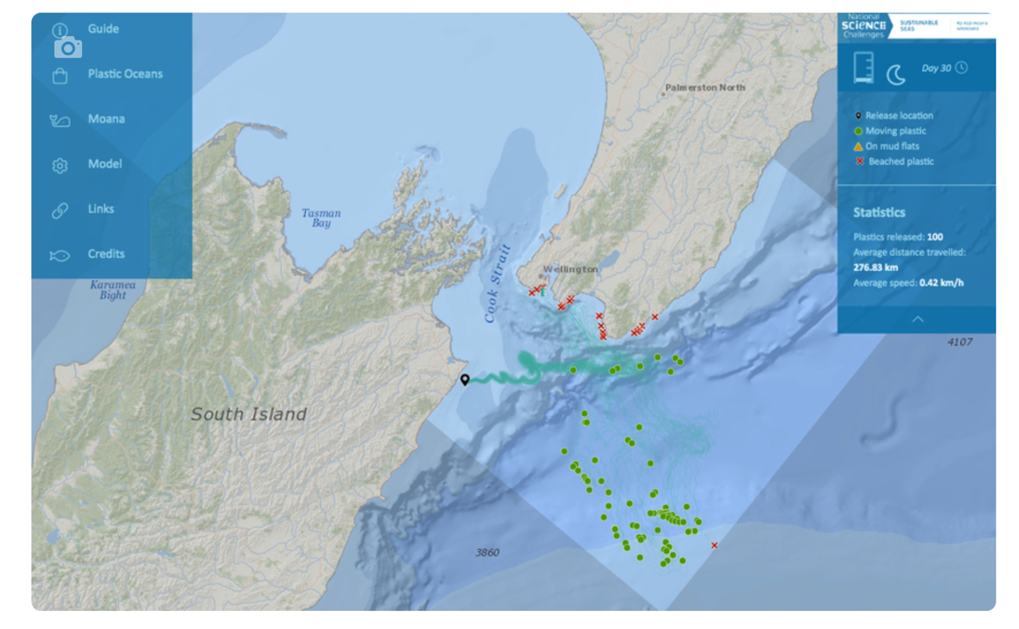
GHOST FISHING IN A PLASTIC OCEAN:
JOURNEY IN THE SEA
MAHI / ACTIVITY
Where does the plastic go? Let’s find out!
Track plastics in our Aotearoa New Zealand ocean using the ocean plastic simulator
Notes:
TEACHER NOTES
Ocean plastic simulator can be found at http://www.oceanplasticsimulator.nz/wheres-our-plastic-going/
Find out more at https://www.sciencelearn.org.nz/resources/2807-tracking-plastics-in-our-oceans
Check out also Sailing Seas of Plastic map at https://app.dumpark.com/seas-of-plastic-2/

Slide 19
GHOST FISHING IN A PLASTIC OCEAN:
JOURNEY IN THE SEA
HE PĀTAI /
CONSIDER THIS
1 What surprised you about how plastics move?
2 What more would you like to learn about the movement of plastics at sea?
Notes:
TEACHER NOTES
Ocean plastic simulator can be found at http://www.oceanplasticsimulator.nz/wheres-our-plastic-going/
Find out more at https://www.sciencelearn.org.nz/resources/2807-tracking-plastics-in-our-oceans
Check out also Sailing Seas of Plastic map at https://app.dumpark.com/seas-of-plastic-2/

Slide 20
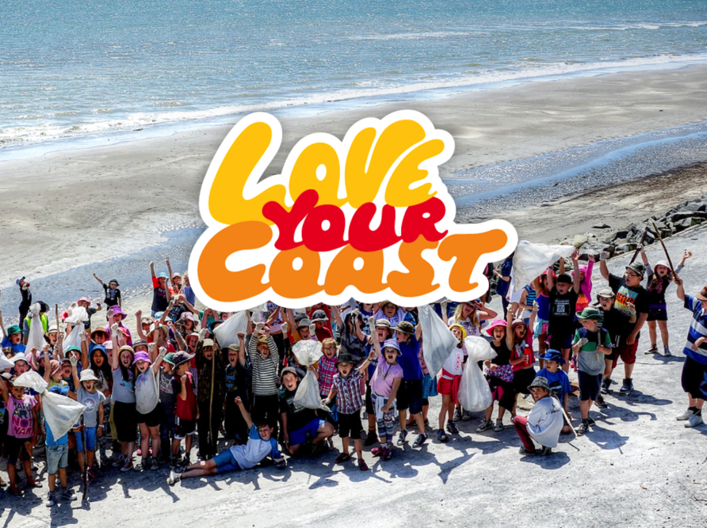
GHOST FISHING IN A PLASTIC OCEAN:
JOURNEY IN THE SEA: FIELD WORK
MAHI / ACTIVITY
Adopt a beach to clean up and record what you find! What percentage of the rubbish found is fishing related?
Find a proven methodology for your clean up and add your data to an existing database.
You could join the litter intelligence community via sustainablecoastlines.org
sustainablecoastlines.org
Notes:
TEACHER NOTES
https://litterintelligence.org/about/
https://sustainablecoastlines.org/about/our-programmes/love-your-coast/
https://sustainablecoastlines.org

Slide 21
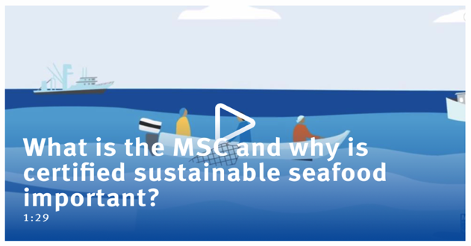
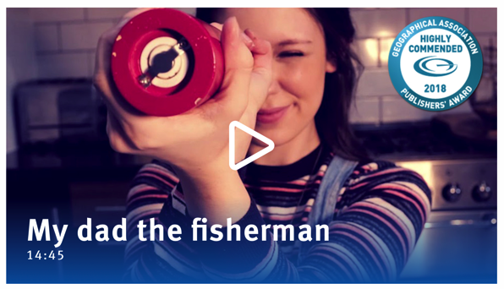
GHOST FISHING IN A PLASTIC OCEAN:
MARINE STEWARDSHIP COUNCIL
What is the MSC [1:29]
My Dad the Fisherman [14:45]
Watch & Read
Think: Who are the MSC? What do they do?
How do they work to reduce plastic at sea?
Share: Your thinking
MĀTAKI TĒNEI / WATCH THIS
HE PĀTAI / CONSIDER THIS
Notes:
TEACHER NOTES
My dad the fisherman can be found at:
https://www.msc.org/en-au/for-teachers
What is the MSC https://www.youtube.com/watch?v=3rVeSBdpO6Q
Sustainable Seafood https://www.youtube.com/watch?v=Kac1cqkjX1U
HOMEWORK IDEAS
The ‘My Dad the Fisherman’ video clip includes most of the concepts that are key to understanding the idea of sustainable fishing.
To reinforce learning or as a good homework activity - re-watch the video ‘My Dad the Fisherman’ and play the Kahoot.
HOW TO PLAY KAHOOT
Connect a device to a projector or screen in front of the classroom.
Navigate to the game called Marine Stewardship Council NZ My Dad the Fisherman on the MSC NZ Kahoot page at https://www.msc.org/en-au/for-teachers/ocean-literacy/new-zealand-education-curriculum/kahoot-quizzes
Select settings
At Kahoot.it, learners enter game-pin and nickname on their own devices (phone, tablet, or computer).
Press “Start now”. The fun begins!
Learners answer questions on their own devices by selecting one of the four answer buttons.
See additional instructions, options, and how to make your own Kahoot at: https://kahoot.com

Slide 22
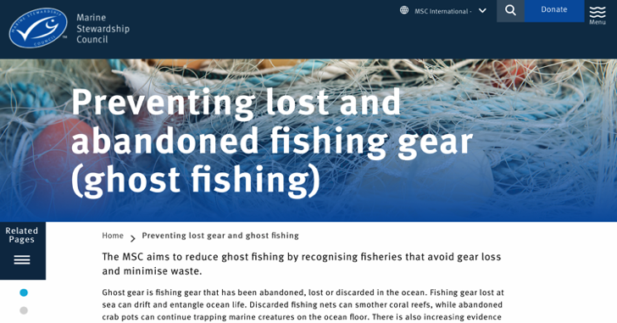

GHOST FISHING IN A PLASTIC OCEAN:
MARINE STEWARDSHIP COUNCIL
HE PĀTAI / CONSIDER THIS
Why is the Marine Stewardship Council concerned about plastic pollution?
Unsustainable fishing can result in lost and abandoned fishing gear contributing to accumulated plastic!
There is emerging evidence that fish size and health can be affected by plastic in the ocean
KŌRERO PUKAPUKA / READ
Watch & Read
Think: How do MSC work to reduce plastic at sea?
Share: Your thinking
Notes:
TEACHER NOTES
Read how MSC is working to reduce and eliminate lost and abandoned fishing gear: https://www.msc.org/what-we-are-doing/preventing-lost-gear-and-ghost-fishing

Slide 23
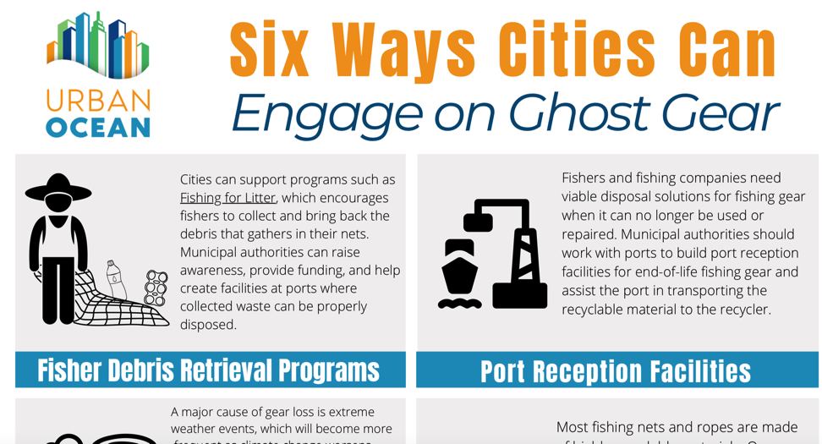




GHOST FISHING IN A PLASTIC OCEAN:
SOLUTIONS
HE PĀTAI / CONSIDER THIS
If you go fishing what can you do to help prevent ghost fishing?
KŌRERO PUKAPUKA / READ
Living in a city or a small town it’s sometimes hard to imagine how to help the issue of ghost fishing. Check out six ways cities can help prevent ghost fishing
Notes:
https://oceanconservancy.org/wp-content/uploads/2020/10/UO-GGGI-One-Pager-102220-1.pdf

Slide 24
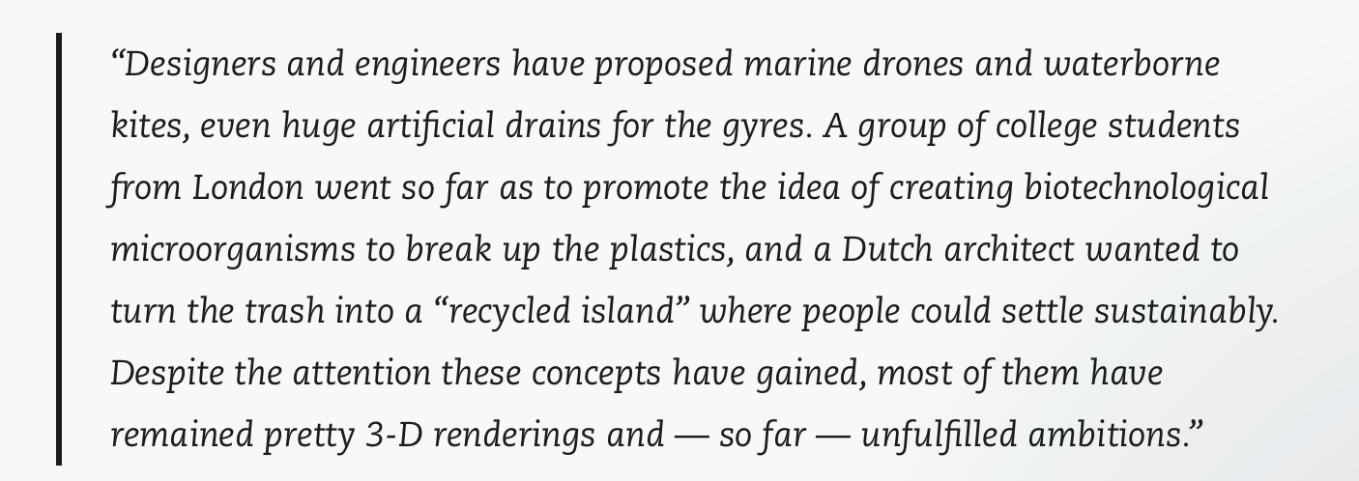
GHOST FISHING IN A PLASTIC OCEAN: SOLUTIONS
HE PĀTAI /
CONSIDER THIS
What is being done to alleviate the problem?
What ideas do you have on how we / you / I can solve the problem?
From the article:

Slide 25
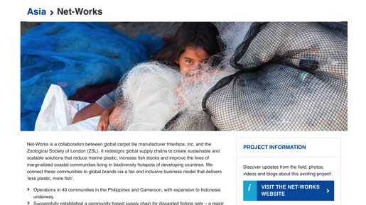
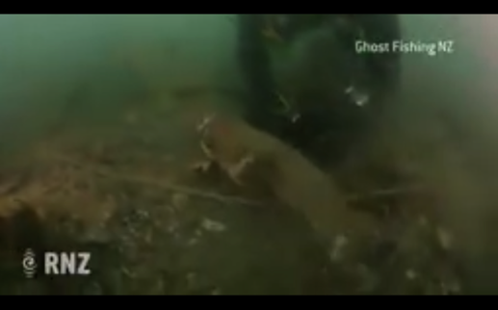
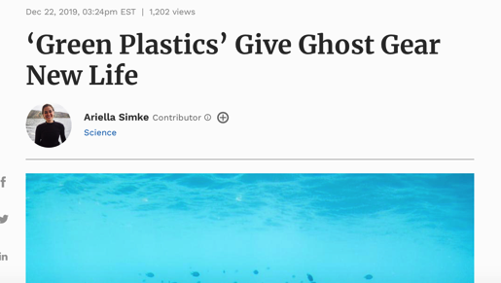
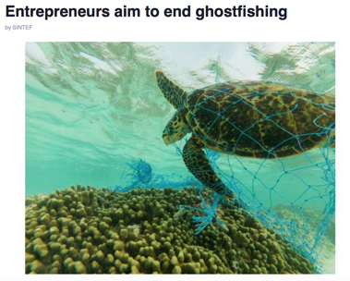
GHOST FISHING IN A PLASTIC OCEAN:
SOLUTIONS & ACTIONS
Net Works are turning discarded nets in to carpets! [2:00] | WATCH: Ghost fishing [5:21] READ: Prada recycling ocean plastics
Green plastics give ghost gear new life | E Entrepreurs Aim to end Ghostfishing
MĀTAKI TĒNEI / WATCH THIS
WHAKAHOOHO / INSPIRE
Watch / Read: One or more of these Think: What are the pros & cons of the solution? What can you do to help? Share: Your thinking
Notes:
TEACHER NOTES
Net Works at https://www.zsl.org/conservation/regions/asia/net-works
Green plastics: https://www.forbes.com/sites/ariellasimke/2019/12/22/green-plastics-give-ghost-gear-new-life/?sh=631e29eb4ece
Kiwi divers tackling ghost fishing: https://www.newsroom.co.nz/2017/05/21/29139/kiwi-divers-tackle-ghost-fishing-phenomenon
Ghost fishing https://www.youtube.com/watch?v=pM4sxQrQs1I
Entrepreneurs aim to end ghost fishing:
https://phys.org/news/2018-10-entrepreneurs-aim-ghostfishing.html
Prada recycling ocean plastics
https://www.nationalgeographic.com/science/article/paid-content-prada-renylon-ljubljana-slovenia

Slide 26
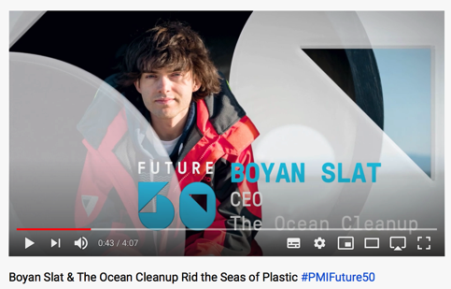
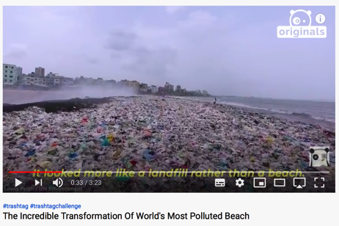
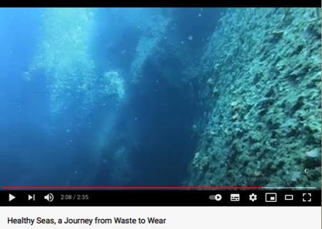
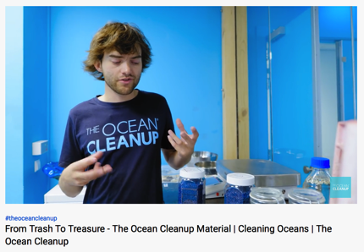
GHOST FISHING IN A PLASTIC OCEAN:
SOLUTIONS & ACTIONS
A teenagers vision – Boyan Slat I Ocean Cleanup [4:07] | Transformation of World’s Most Polluted Beach [3:23]
From Trash to Treasure Ocean Cleanup [5:48] | Healthy Seas From Waste to Wear [2:34]]
MĀTAKI TĒNEI / WATCH THIS
WHAKAHOOHO / INSPIRE
Watch / Read: One or more of these Think: What are the pros & cons of the solution? What can you do to help? Share: Your thinking
Notes:
TEACHER NOTES
One teenagers vision making a massive difference: Boyan Slat & the Ocean Cleanup
https://www.youtube.com/watch?v=mhEffEsC9iw
Incredible Transformation of the World’s Most Polluted Beach https://www.youtube.com/watch?v=jXcoPO76UyA
From Trash to Treasure https://www.youtube.com/watch?v=mhEffEsC9iw
Healthy Seas: From Waste to Wear: https://www.youtube.com/watch?v=9JvQgSTEpzk&feature=emb_logo

Slide 27
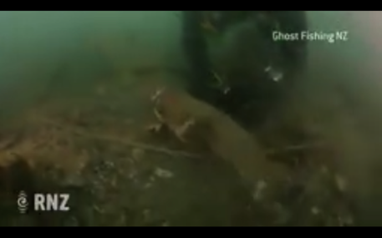


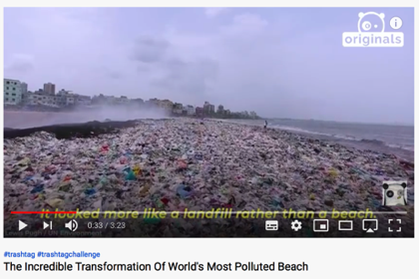

GHOST FISHING IN A PLASTIC OCEAN:
SOLUTIONS & ACTIONS
MAHI / ACTIVITY Select one of these possible solutions. Watch / read again. In small groups brainstorm advantages & disadvantages of this solution (next slide)
Notes:
TEACHER NOTES
One teenagers vision making a massive difference: Boyan Slat & the Ocean Cleanup
https://www.youtube.com/watch?v=mhEffEsC9iw
Incredible Transformation of the World’s Most Polluted Beach https://www.youtube.com/watch?v=jXcoPO76UyA
From Trash to Treasure https://www.youtube.com/watch?v=mhEffEsC9iw
Plastic Pollution Solution https://www.youtube.com/watch?v=0MWOXR_6qZc

Slide 28
GHOST FISHING IN A PLASTIC OCEAN:
SOLUTIONS
Solution: ___________
Disadvantages of this
solution are …
Solution: ___________
Advantages of this
solution are …
Notes:
TEACHER NOTES
Learners record the nature of the solution they looked at and note advantages and disadvantages of this solution… this activity scaffolds in to the group project (next slide)

Slide 29

GHOST FISHING IN A PLASTIC OCEAN:
SOLUTIONS & ACTIONS
Not sure which solution to chose – try one of the following:
Recycling ghost nets
Electronic trackers on fishing gear
Ocean & beach clean ups
Fishing gear made from biodegradable plastics
MAHI / ACTIVITY
In groups research one or more potential solution to the problem of ghost fishing polluting our oceans and use Powtoon, Slides or similar to create a 2-3 minute Explainer about your chosen solution.
Follow the steps in the Plastic Oceans: Group Project Outlinet to guide your project
Notes:
TEACHER NOTES
Adapted from and inspired by the work of teacher Andrew Corney (Tauranga Boys College) and 8 Exceptional Inquiry Based Learning Activities Students will love! Found at: https://wabisabilearning.com/blogs/inquiry/inquiry-based-learning-activities
Plastic pollution in the ocean can be found at: https://www.youtube.com/watch?v=aFUHLtaTazQ&feature=emb_logo

Slide 30
GHOST FISHING IN A PLASTIC OCEAN:
TOUGH QUESTIONS
Experts ONLY!
HE PĀTAI / CONSIDER THIS
You will be given one of the following questions. Your group will have 30 minutes to come up with a good answer. Be ready to present back to the class!
As plastics production evolves, could fishing gear constructed from bioplastics be the answer?
What are some of the hidden costs of us not addressing the problem of ghost fishing and plastic pollution in our oceans?
How does ghost fishing and plastic pollution affect sea life and the fishing industry both short and long term?
Do you believe plastics pollution is a threat we can conquer in the next decade? Why or why not?
What do you feel it will take to get plastics out of our oceans from a personal/community/global standpoint?
Notes:
TEACHER NOTES
Questions from 8 Exceptional Inquiry Based Learning Activities Students will love! Found at: https://wabisabilearning.com/blogs/inquiry/inquiry-based-learning-activities

Slide 31



GHOST FISHING IN A PLASTIC OCEAN:
SHARE FINDINGS
Where does plastic come from?
Why do we use plastic?
How does ghost fishing gear get into oceans?
Why is ghost gear a problem in the ocean?
What’s one thing you can do about about ghost gear and plastics in the sea?
How can we share the message about ghost gear and the ocean?
MAHI / ACTIVITY
Create a skit, poem, story, report, infographic, poster, movie…. to share your thoughts & feelings about ghost fishing & plastics in the sea including…
Notes:
TEACHER NOTES
From Plastic Ocean Org https://plasticoceans.org/plastic-pollution-info-resources/
What can we do personally?
Q. What can we do?
We need to stop using single-use plastic wherever that is possible.
Here are some more potential solutions:
• Go to our website for inspiration and please donate if you can to help us:
https://www.plasticoceans.org
• Bring your own bag to the shops
• Drink tap water and carry it in your own bottle
• Don’t buy body scrubs - in many countries those tiny beads are usually made of plastic
• Choose fruit and vegetables that are not wrapped in plastic
• Use matches instead of ‘disposable’ lighters or use a re-fillable one
• Don’t use ‘single-use’ plates, knives, forks etc and wash up after you eat
• Wherever you can, choose liquid products that can be re-filled rather than bought new
• Refuse plastic straws in your drinks
• If you can’t find an alternative to single-use plastic, make sure you recycle it
• Don’t celebrate with balloon releases, because the chances are that the balloons will land in the ocean, choking seabirds, turtles and marine mammals
• Use crystal deodorants – they last far longer, are more effective and some even come with no plastic packaging at all
• Use good old-fashioned soap – it works as well as liquid soap and lasts longer
• Buy butter wrapped in paper instead of in a plastic tub

Slide 32

GHOST FISHING IN A PLASTIC OCEAN:
TAKE ACTION & SHARE FINDINGS
Write and publish a report
Make a movie to promote awareness about this problem – check out Seat Up guide to making movies
Create and publish a poster
Create an action to help alleviate the problem
Clean up a beach! (& promote through media)
MAHI / ACTIVITY
Some ideas on how you could share your findings:
Notes:
TEACHER NOTES
https://seatup.com/blog/kids-guide-to-making-movies/

Slide 33
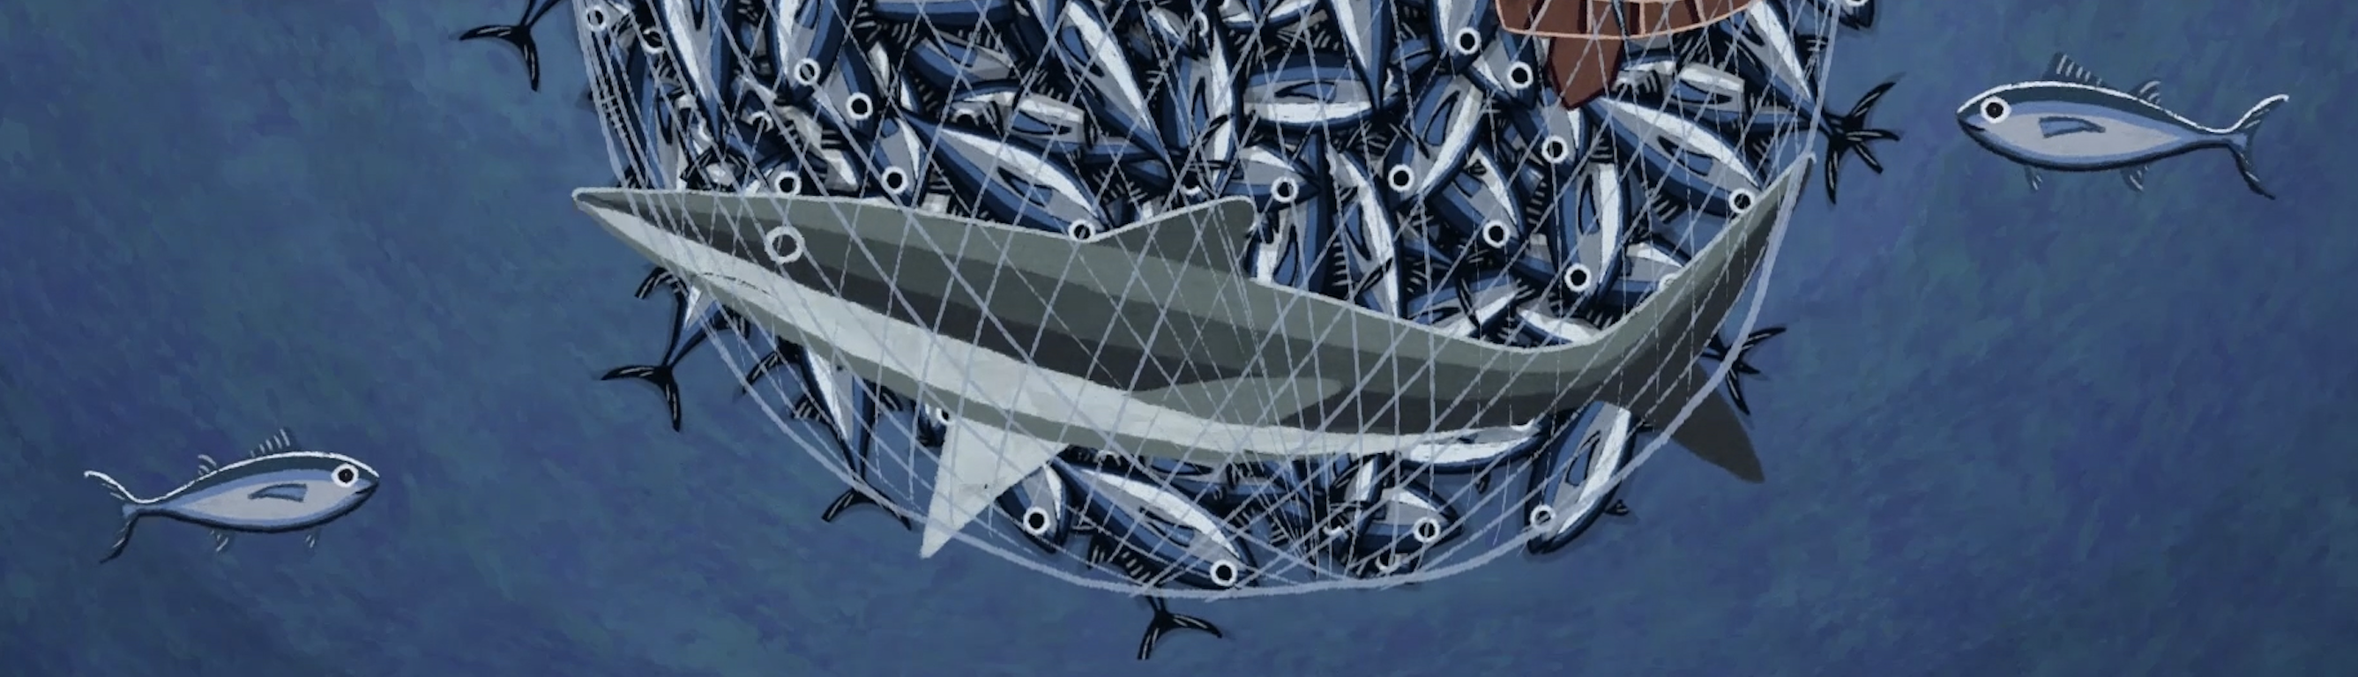


GHOST FISHING IN A PLASTIC OCEAN:
RESOURCE PAGE
KŌRERO PUKAPUKA / READ
Ecotricity: Facts on plastic (NZ & Global)
Global Ghost Gear Initiative
Marine Stewardship Council: Ghost Fishing
Plastics Make it Possible
Plastic Oceans International
Refill NZ & The Problem with Plastic
Notes:
TEACHER NOTES
Ecotricity: Facts on plastic (NZ & Global)
https://ecotricity.co.nz/facts-on-plastic-waste/
Plastic Oceans International: Plastic Ocean Resources
https://plasticoceans.org/plastic-pollution-info-resources/
Refill NZ: The Problem with Plastic
https://refillnz.org.nz/about/the-problem-with-plastic/
Global Ghost Gear Initiative
https://www.ghostgear.org
MSC Ghost Fishing
https://www.msc.org/what-we-are-doing/preventing-lost-gear-and-ghost-fishing
Plastics Make it Possible
https://www.plasticsmakeitpossible.com/about-plastics/types-of-plastics/what-are-plastics/

