Slide 1
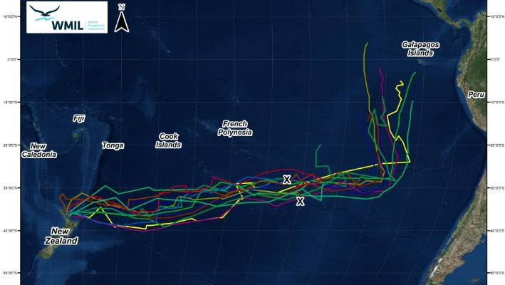
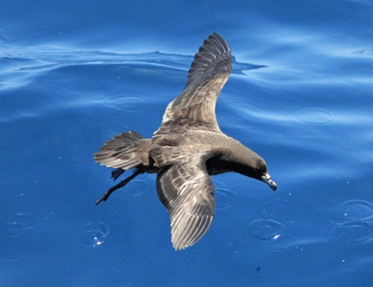
4.3. TĀIKO (BLACK PETREL) BYCATCH Focus Question: How are Tāiko (Black Petrel) impacted by fishing?
KŌRERORERO / DISCUSSION
Tāiko or Black Petrel are:
A nationally vulnerable seabird
Endemic [unique] to Aotearoa NZ
Sometimes caught as bycatch by longliners and trawlers
Long distance flyers – the lines on this map shows where they fly to in Winter (South America!)
Photo: Charlie Westerinen
Trust & Map: Wildlife Management International
Notes:
TEACHER NOTES
Film URL: https://www.youtube.com/watch?v=bV6ZIGIAgNw
MAHI / ACTIVITY
Activity 4.1 gets learners to write a script using images from this short film clip to make a booklet about Marine Stewardship Council’s Principle 2.

Slide 2
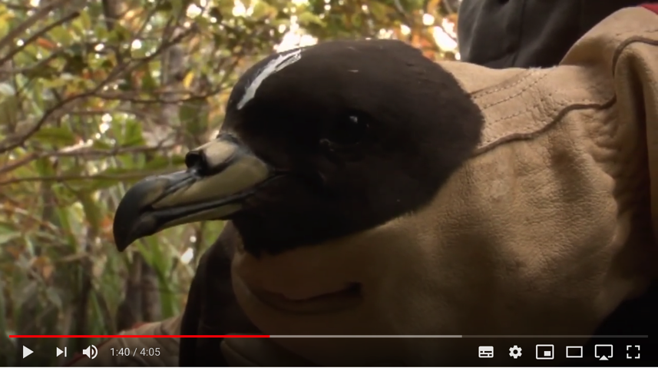
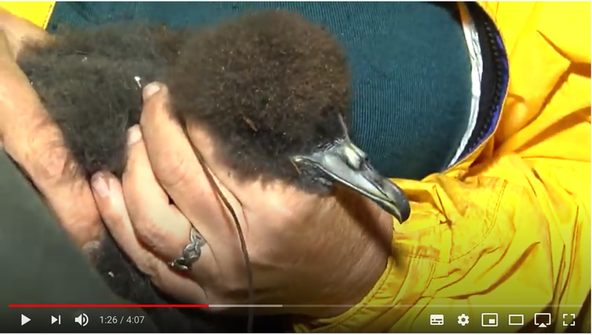
TĀIKO (BLACK PETREL) BYCATCH
MĀTAKI TĒNEI / WATCH THIS
Short video [4:07] from Moana New Zealand about Commercial fishers work in helping look after Tāiko or Black Petrel
MĀTAKI TĒNEI / WATCH THIS
Short video [4:05] on Tāiko
or Black Petrel
Notes:
TEACHER NOTES
Film URL #1: https://www.youtube.com/watch?v=bV6ZIGIAgNw
Film URL #2: https://www.youtube.com/watch?v=qU0QfYw-4EU

Slide 3
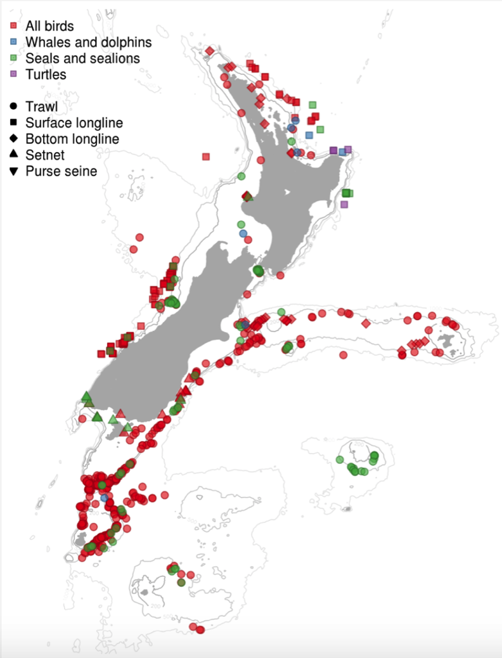
TĀIKO (BLACK PETREL) BYCATCH
KŌRERORERO / DISCUSSION
In Aotearoa New Zealand government observers on commercial fishing vessels record any protected species bycatch incidents that occur
This map shows all observed captures for the fishing year 2017–18
The colour of symbols shows the type of animal caught
The shape of the symbol shows fishing method
Notes:
TEACHER NOTES
This figure shows the position of all captures reported by fisheries observers. The colour of the symbol indicates the type of animal that was caught, and the shape of the symbol indicates the fishing method.

Slide 4
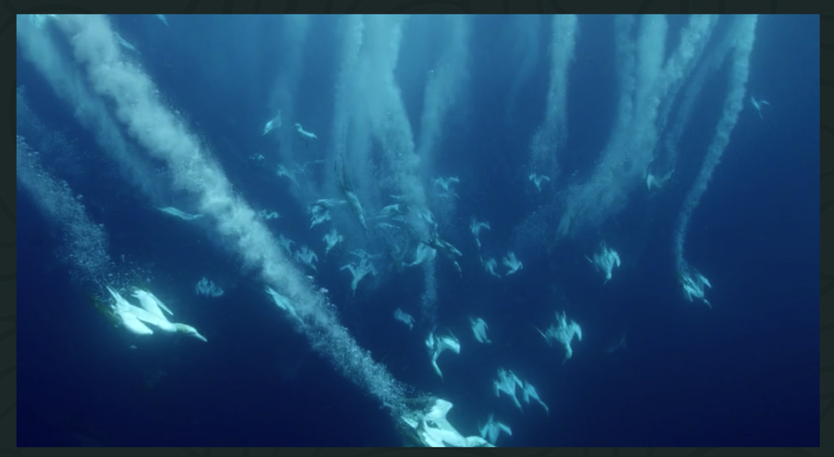
TĀIKO (BLACK PETREL) BYCATCH
MAHI / ACTIVITY
Check out the how many observed captures of the Tāiko or Black Petrel there have been in recent years by completing Activity 4.1 ‘Bycatch Data’
MĀTAKI TĒNEI / WATCH THIS
And if you have time watch this awesome film [4:05] where Riley and her dad come across Black Petrel and False Killer Whales
Notes:
TEACHER NOTES
Film URL: https://www.youngoceanexplorers.com/yoe/video/405949642273#cplayer
All data for Aotearoa New Zealand protected species can be explored at: https://psc.dragonfly.co.nz/2019v1/released/2017-18/

